Slide 1
Revelation 17
The Seven Last Judgments

Slide 2
Revelation 17
Mystery Babylon the Great
Introduction
In the previous chapter, John is shown the seven angels having the seven last plagues—the seven bowl judgments. He sees the seven bowls poured forth, including the last bowl wherein a voice from the Temple declares “It is done!” The effects of the previous chapter, at the pouring forth of all the bowls, include all aspects of God’s wrath being poured out on the earth.
Beginning with Revelation 17 John is shown additional detail concerning aspects of the bowl judgments and their recipients. Also included is additional information concerning the destruction of Babylon.

Slide 3
Revelation 17
Mystery Babylon the Great
Introduction (Cond’t)
There have been two earlier and somewhat cryptic references in Revelation to the city of Babylon.
There is good reason to take these references literally even though the large majority of commentaries on Revelation take the position that this great city, Babylon, is not a real city at all.
What is the explanation for this reluctance to believe that John meant Babylon when he wrote “Babylon”?
Even at the time John was writing, Babylon was still a viable city.
At the very least, it would be confusing to John’s first century readers for him to write so much about Babylon when he really meant something else.

Slide 4
Revelation 17
Mystery Babylon the Great
Introduction (Cond’t)
It must be stressed again that Revelation means “unveiling,” not “veiling.” In the absence of any statement in the context to the contrary, we must assume that the term Babylon applies to the real city of Babylon.
As we progress in the study of Revelation 17 and 18, it will become increasingly more obvious that the great world capital of the beast will indeed be centered either directly on, or in the immediate vicinity of, the strategic site of ancient Babylon.
Babylon is mentioned by name six times in Revelation (Revelation 14:8; 16:19; 18:2; 18:10; 18:21).
Only in Revelation 17:5 is she called “Mystery, Babylon the great,” a term that clearly conveys something different from the others.
Notes:
Revelation 14:8-And there followed another angel, saying, Babylon is fallen, is fallen, that great city, because she made all nations drink of the wine of the wrath of her fornication.
Revelation 16:19-And the great city was divided into three parts, and the cities of the nations fell: and great Babylon came in remembrance before God, to give unto her the cup of the wine of the fierceness of his wrath.Revelation 18:2-
Revelation 18:10-Standing afar off for the fear of her torment, saying, Alas, alas, that great city Babylon, that mighty city! for in one hour is thy judgment come.
Revelation 18:21-And a mighty angel took up a stone like a great millstone, and cast it into the sea, saying, Thus with violence shall that great city Babylon be thrown down, and shall be found no more at all.
Revelation 17:5-And upon her forehead was a name written, MYSTERY, BABYLON THE GREAT, THE MOTHER OF HARLOTS AND ABOMINATIONS OF THE EARTH.

Slide 5
Revelation 17
Mystery Babylon the Great
Outline
Mother of Harlots
The Seven Heads
The Ten Horns

Slide 6
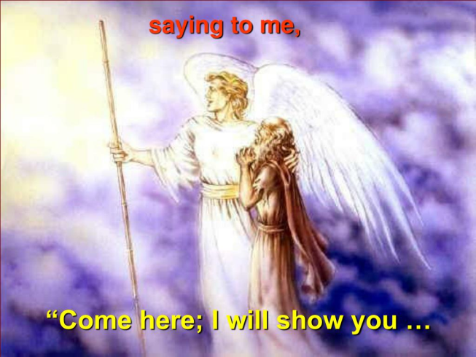
Revelation 17
Mystery Babylon the Great
Mother of Harlots
Revelation 17:1. And there came one of the seven angels which had the seven vials, and talked with me, saying unto me, Come hither; I will show unto thee the judgment of the great whore that sitteth upon many waters.
As the unprecedented global earthquake which comprised the last plague was leveling the cities of the world, it had been called to John’s attention that one of those cities - great Babylon - was about to undergo some exquisite special judgment appropriate to her unparalleled wickedness (Revelation 16:19, Revelation 14:8).
Only he calls it “the judgment of the great whore that sitteth upon many waters.”
Notes:
Revelation 16:19-And the great city was divided into three parts, and the cities of the nations fell: and great Babylon came in remembrance before God, to give unto her the cup of the wine of the fierceness of his wrath.
Revelation 14:8-And there followed another angel, saying, Babylon is fallen, is fallen, that great city, because she made all nations drink of the wine of the wrath of her fornication.

Slide 7
Revelation 17
Mystery Babylon the Great
Mother of Harlots
Revelation 17:1. And there came one of the seven angels which had the seven vials, and talked with me, saying unto me, Come hither; I will show unto thee the judgment of the great whore that sitteth upon many waters. (Cont’d)
Babylon indeed had been the enemy of God’s people for centuries, and her idolatries had infected many nations (Jeremiah 51:7; Isaiah 47:5).
The prophecies in Isaiah and Jeremiah concerning Babylon were directed primarily against the Babylon of their own day.
Now, however, John learns that these prophecies have both a near and a distant fulfillment, which is usually the case with Old Testament prophecies.
Notes:
Jeremiah 51:7-Babylon hath been a golden cup in the LORD'S hand, that made all the earth drunken: the nations have drunken of her wine; therefore the nations are mad.
Isaiah 47:5-Sit thou silent, and get thee into darkness, O daughter of the Chaldeans: for thou shalt no more be called, The lady of kingdoms.

Slide 8
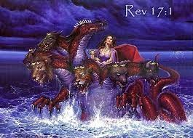
Revelation 17
Mystery Babylon the Great
Mother of Harlots
Revelation 17:1. And there came one of the seven angels which had the seven vials, and talked with me, saying unto me, Come hither; I will show unto thee the judgment of the great whore that sitteth upon many waters. (Cont’d)
The word “whore” (Gr. porne) is the same as “harlot” (verse 5) and is related to porneia (“fornication”).
It does not refer only to women who sell their bodies but simply to any who commit fornication.
Babylon as a nation could not have literally committed fornication with other nations, but she did indeed lead many nations away from God.

Slide 9
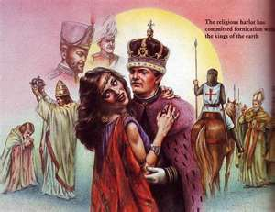
Revelation 17
Mystery Babylon the Great
Mother of Harlots
Revelation 17:2. With whom the kings of the earth have committed fornication, and the inhabitants of the earth have been made drunk with the wine of her fornication.
How could it really be that Babylon had made all nations and inhabitants drunk with the wrath of her fornication?
To understand this situation, it should be remembered that Nebuchadnezzar’s Babylon was not the original Babylon.
In view of the many uncertainties of the monuments and secular records, it is sad that the authorities pay so little attention to the true record of the origin of these ancient nations and cities. (Genesis 10:10-11)
Notes:
Genesis 10:10-11-And the beginning of his kingdom was Babel, and Erech, and Accad, and Calneh, in the land of Shinar.
11Out of that land went forth Asshur, and builded Nineveh, and the city Rehoboth, and Calah,

Slide 10
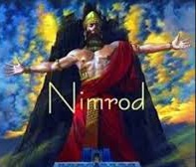
Revelation 17
Mystery Babylon the Great
Mother of Harlots
Revelation 17:2. With whom the kings of the earth have committed fornication, and the inhabitants of the earth have been made drunk with the wine of her fornication. (Cont’d)
We are well justified biblically, therefore (and the Bible is our authority), in inferring that the religious system established at the original Babylon (“Babel”) by its founder and first king, Nimrod, is the root source of the later Assyria/Babylonian complex of religion and philosophy.
Furthermore, with the confusion of tongues and resultant dispersion (Genesis 11:9), this religious system was carried by the scattering tribes into every region of the world.
Notes:
Genesis 11:9-Therefore is the name of it called Babel; because the LORD did there confound the language of all the earth: and from thence did the LORD scatter them abroad upon the face of all the earth.

Slide 11
Revelation 17
Mystery Babylon the Great
Mother of Harlots
Revelation 17:2. With whom the kings of the earth have committed fornication, and the inhabitants of the earth have been made drunk with the wine of her fornication. (Cont’d)
This is the reason why every nation and tribe of the past or present has a religious system which is fundamentally pantheistic, polytheistic, evolutionary, animalistic/spiritualistic, astrological, and idolatrous.
This monstrous system has permeated practically every culture in the world in one form or another.
All religions and philosophies , except those founded on special creation as revealed in Genesis, worship and serve the creation more than the Creator and thus are under God’s condemnation.

Slide 12
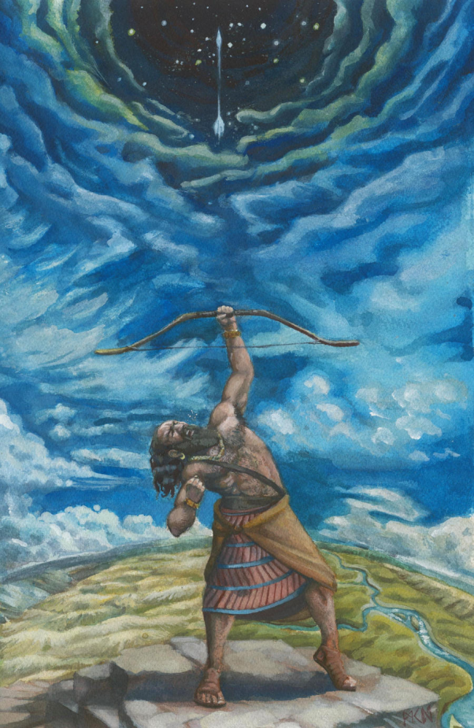
Revelation 17
Mystery Babylon the Great
Mother of Harlots
Revelation 17:2. With whom the kings of the earth have committed fornication, and the inhabitants of the earth have been made drunk with the wine of her fornication. (Cont’d)
Thus have all the inhabitants of earth been made drunk with the wine of Babel’s primeval fornication, as Nimrod chose Satan rather than God.
Who changed the truth of God into a lie, and worshipped and served the creature more than the Creator, who is blessed for ever. Amen. (Romans 1:25)

Slide 13
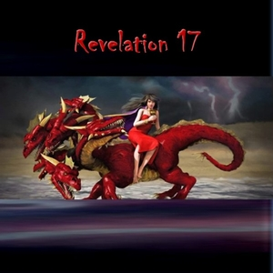
Revelation 17
Mystery Babylon the Great
Mother of Harlots
Revelation 17:3. So he carried me away in the spirit into the wilderness: and I saw a woman sit upon a scarlet coloured beast, full of names of blasphemy, having seven heads and ten horns.
Once again John is transformed “in the Spirit” to another time and place, evidently to observe the whole history of the Babylonian corruption.
The aspect of the land and sea becomes vastly different. It is nothing but “wilderness”.

Slide 14
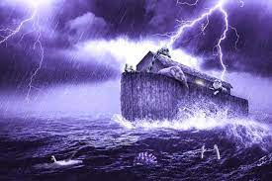
Revelation 17
Mystery Babylon the Great
Mother of Harlots
Revelation 17:3. So he carried me away in the spirit into the wilderness: and I saw a woman sit upon a scarlet coloured beast, full of names of blasphemy, having seven heads and ten horns. (Cond’t)
The most likely time for such a scene is immediately after the great Flood.
The world emerging from the watery disaster was indeed a vast wilderness.
Mankind had opportunity for a new beginning, with every incentive to obey God.
But Satan had not been bound, and he still had a host of demonic principalities and powers available to command.

Slide 15
Revelation 17
Mystery Babylon the Great
Mother of Harlots
Revelation 17:3. So he carried me away in the spirit into the wilderness: and I saw a woman sit upon a scarlet coloured beast, full of names of blasphemy, having seven heads and ten horns. (Cont’d)
John had previously seen the sign of the great red dragon in heaven (Revelation 12:3-4).
He had also seen the beast rising out of the sea (Revelation 13:1-2).
Now John sees the same symbol once again, emerging from the great wilderness.
This time, however, the symbolic beast seems to combine the characters of both the dragon and the beast of Revelation 13.
Notes:
Revelation 12:3-4-And there appeared another wonder in heaven; and behold a great red dragon, having seven heads and ten horns, and seven crowns upon his heads.
4And his tail drew the third part of the stars of heaven, and did cast them to the earth: and the dragon stood before the woman which was ready to be delivered, for to devour her child as soon as it was born.
Revelation 13:1-2-And I stood upon the sand of the sea, and saw a beast rise up out of the sea, having seven heads and ten horns, and upon his horns ten crowns, and upon his heads the name of blasphemy.
2And the beast which I saw was like unto a leopard, and his feet were as the feet of a bear, and his mouth as the mouth of a lion: and the dragon gave him his power, and his seat, and great authority.

Slide 16
Revelation 17
Mystery Babylon the Great
Mother of Harlots
Revelation 17:3. So he carried me away in the spirit into the wilderness: and I saw a woman sit upon a scarlet coloured beast, full of names of blasphemy, having seven heads and ten horns. (Cont’d)
It will be recalled that the beast of Revelation 13:1 is the same as the beast of Daniel 7:7, and there had been three similar beasts which preceded him (Daniel 7:4-6).
Similarly, this beast of Revelation 17 is said to be the eighth, with seven similar kings preceding him (Revelation 17:11).
Putting this data all together, it seems most likely that this beast, on which the woman rides, is symbolic of the historical succession of world governments, which are raised up and empowered by Satan.
Notes:
Revelation 13:1 -And I stood upon the sand of the sea, and saw a beast rise up out of the sea, having seven heads and ten horns, and upon his horns ten crowns, and upon his heads the name of blasphemy.
Daniel 7:7-After this I saw in the night visions, and behold a fourth beast, dreadful and terrible, and strong exceedingly; and it had great iron teeth: it devoured and brake in pieces, and stamped the residue with the feet of it: and it was diverse from all the beasts that were before it; and it had ten horns.
Daniel 7:4-6-The first was like a lion, and had eagle's wings: I beheld till the wings thereof were plucked, and it was lifted up from the earth, and made stand upon the feet as a man, and a man's heart was given to it.
5And behold another beast, a second, like to a bear, and it raised up itself on one side, and it had three ribs in the mouth of it between the teeth of it: and they said thus unto it, Arise, devour much flesh.
6After this I beheld, and lo another, like a leopard, which had upon the back of it four wings of a fowl; the beast had also four heads; and dominion was given to it.
Revelation 17:11-And the beast that was, and is not, even he is the eighth, and is of the seven, and goeth into perdition.

Slide 17
Revelation 17
Mystery Babylon the Great
Mother of Harlots
Revelation 17:3. So he carried me away in the spirit into the wilderness: and I saw a woman sit upon a scarlet coloured beast, full of names of blasphemy, having seven heads and ten horns. (Cont’d)
It seems this beast of Revelation 17 depicts the principle of dictatorial world government, as continually instigated and energized by the old dragon, Satan.
Who, then, is the unclean woman riding this beast?
As the beast is symbolic, so must be the woman, and she herself is identified as Babylon the great, except that she is Babylon in mystery form (verse 5).
The woman makes the beast appear outwardly beautiful, thus making it easier for him to attain the control he seeks over mankind.

Slide 18
Revelation 17
Mystery Babylon the Great
Mother of Harlots
Revelation 17:3. So he carried me away in the spirit into the wilderness: and I saw a woman sit upon a scarlet coloured beast, full of names of blasphemy, having seven heads and ten horns. (Cont’d)
The harlot Babylon is a contrasting type of the chaste Jerusalem and, in one sense, the whole course of history is essentially a tale of these two spiritual cities.
As the beast represents political Babylon, the great whore is religious Babylon.
The one is governmental rebellion and confusion, the other is spiritual rebellion and confusion.
As Jerusalem is the City of Peace, Babel is the City of Confusion.

Slide 19
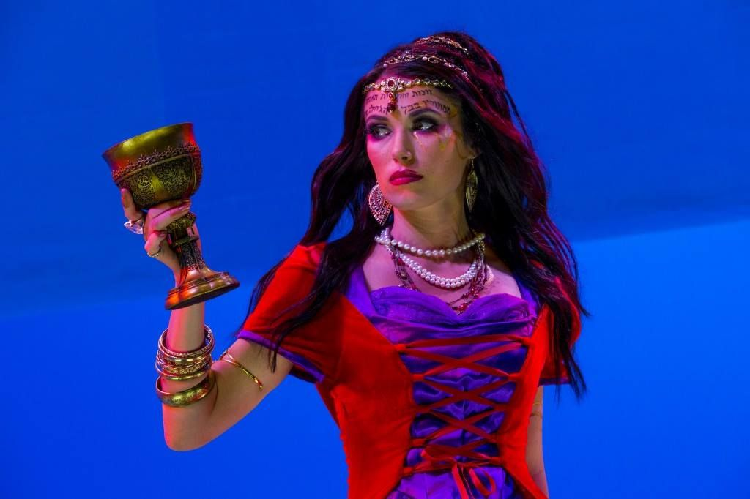
Revelation 17
Mystery Babylon the Great
Mother of Harlots
Revelation 17:4. And the woman was arrayed in purple and scarlet colour, and decked with gold and precious stones and pearls, having a golden cup in her hand full of abominations and filthiness of her fornication:
Arrayed like a beautiful queen, the harlot is irresistibly attractive to ungodly men, perpetually seduces and tempts them to depart from the true God.
Her invitation is tendered, age after age, nation after nation, and multitudes are deceived and lost thereby. (Proverbs 5:3-5)
Notes:
Proverbs 5:3-5-For the lips of a strange woman drop as an honeycomb, and her mouth is smoother than oil:
4But her end is bitter as wormwood, sharp as a twoedged sword.
5Her feet go down to death; her steps take hold on hell.

Slide 20
Revelation 17
Mystery Babylon the Great
Mother of Harlots
Revelation 17:4. And the woman was arrayed in purple and scarlet colour, and decked with gold and precious stones and pearls, having a golden cup in her hand full of abominations and filthiness of her fornication: (Cont’d)
This is the way of false religion. There is the absence of real spiritual life and only an outward display and sensual satisfactions. The state religion, supported by political power, impresses the followers with ornate temples and golden images, jeweled garments and marble statues along with hypnotic music, and incense.
Such religious worship, panders to man’s religious nature and appeals to his sensual feelings.
It is the religious system established by Nimrod, and probably revealed to him by Satan back at Babel long ago.

Slide 21
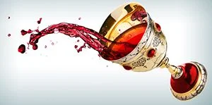
Revelation 17
Mystery Babylon the Great
Mother of Harlots
Revelation 17:4. And the woman was arrayed in purple and scarlet colour, and decked with gold and precious stones and pearls, having a golden cup in her hand full of abominations and filthiness of her fornication: (Cont’d)
Multitudes throughout the ages have enjoyed the harlot’s golden cup and been made drunken with the wine of her fornication.
Instead of life giving wine from heaven, the cup has contained a stupefying concoction of foolishness, and filthiness, abominable idolatry and unspeakable wickedness, even the blood of persecuted saints of God.
All have been blasphemously offered to men in the name of religion.

Slide 22
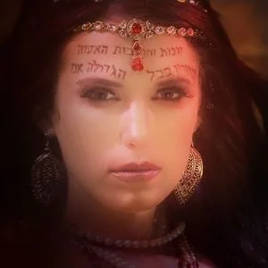
Revelation 17
Mystery Babylon the Great
Mother of Harlots
Revelation 17:5. And upon her forehead was a name written, MYSTERY, BABYLON THE GREAT, THE MOTHER OF HARLOTS AND ABOMINATIONS OF THE EARTH.
Did ever a woman have such a name as this?
She is the great city BABYLON, and is the fountainhead of all spiritual fornication and false worship.
The word “abominations” is specifically associated with idol worship.
When ye therefore shall see the abomination of desolation, spoken of by Daniel the prophet, stand in the holy place, whoso readeth, let him understand: (Matthew 24:15)

Slide 23
Revelation 17
Mystery Babylon the Great
Mother of Harlots
Revelation 17:5. And upon her forehead was a name written, MYSTERY, BABYLON THE GREAT, THE MOTHER OF HARLOTS AND ABOMINATIONS OF THE EARTH. (Cont’d)
Many intellectuals have ridiculed the worship of sticks and stones but they have, to all intents and purposes, worshiped mental ideas of their own imaginings.
It is significant also that the Bible identifies covetousness with idolatry (Ephesians 5:5; Colossians 3:5).
The underlying motive of the covetous person is that of rejection of God and His will, discontent with what God has supplied, and a desire for things instead of God (Luke 16:13-15).
Notes:
Ephesians 5:5-For this ye know, that no whoremonger, nor unclean person, nor covetous man, who is an idolater, hath any inheritance in the kingdom of Christ and of God.
Colossians 3:5-Mortify therefore your members which are upon the earth; fornication, uncleanness, inordinate affection, evil concupiscence, and covetousness, which is idolatry:
Luke 16:13-15-No servant can serve two masters: for either he will hate the one, and love the other; or else he will hold to the one, and despise the other. Ye cannot serve God and mammon.
14And the Pharisees also, who were covetous, heard all these things: and they derided him.
15And he said unto them, Ye are they which justify yourselves before men; but God knoweth your hearts: for that which is highly esteemed among men is abomination in the sight of God.

Slide 24
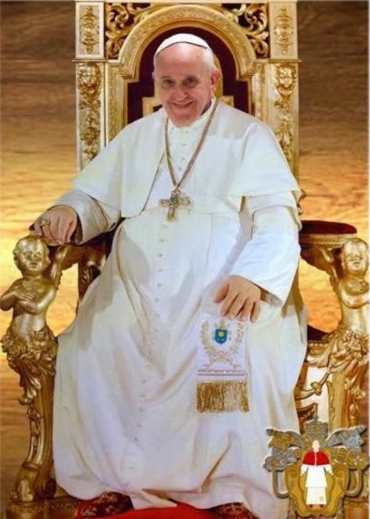
Revelation 17
Mystery Babylon the Great
Mother of Harlots
Revelation 17:5. And upon her forehead was a name written, MYSTERY, BABYLON THE GREAT, THE MOTHER OF HARLOTS AND ABOMINATIONS OF THE EARTH. (Cont’d)
Many Bible teachers have identified this harlot as the Roman Catholic Church.
There is no doubt that many of the doctrines and practices of the Roman Catholic Church are based on tradition rather than Scripture.
But to say that spiritual Babylon is either Rome or the Roman Catholic Church is to grossly underestimate the age long global impact of this great mystery, Babylon the Great.

Slide 25

Revelation 17
Mystery Babylon the Great
Mother of Harlots
Revelation 17:5. And upon her forehead was a name written, MYSTERY, BABYLON THE GREAT, THE MOTHER OF HARLOTS AND ABOMINATIONS OF THE EARTH. (Cont’d)
Of more concern in present day America is the direct descent of modern scientism and evolutionary humanism from this ancient mother of harlots.
Furthermore, even those that do acknowledge God as true Creator have largely rejected Him as Savior, relying on their own works for their salvation, and so also are humanistic.

Slide 26
Revelation 17
Mystery Babylon the Great
Mother of Harlots
Revelation 17:6. And I saw the woman drunken with the blood of the saints, and with the blood of the martyrs of Jesus: and when I saw her, I wondered with great admiration.
Not only is spiritual Babylon a false and corruptive religion, it is fiercely intolerant. When it cannot subvert by infiltration and false teaching, it will seek to destroy by persecution.
One of the most amazing aspects of religious history is the hatred of other religions against Christ and His followers.
Why this unreasoning animosity against a loving Creator?

Slide 27
Revelation 17
Mystery Babylon the Great
Mother of Harlots
Revelation 17:6. And I saw the woman drunken with the blood of the saints, and with the blood of the martyrs of Jesus: and when I saw her, I wondered with great admiration. (Cont’d)
The only answer is the old dragon and his enmity against the seed of the woman, the true God and Creator and Savior, Jesus Christ.
He has energized the political power (the beast) which controls the religious power (the whore), and they do all they can to resist and destroy the work of God.
The sight of this drunken harlot and her blood-strewn history filled John with great “admiration” - not in the twentieth-century meaning of the term, but in the older sense of “awe” or “amazement.”

Slide 28
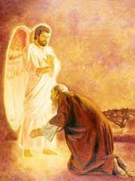
Revelation 17
Mystery Babylon the Great
The Seven Heads
Revelation 17:7. And the angel said unto me, Wherefore didst thou marvel? I will tell thee the mystery of the woman, and of the beast that carrieth her, which hath the seven heads and ten horns.
John’s amazement had been directed toward the woman and her influence, but the angel mildly rebukes him.
The “mystery” of great Babylon involves not only the woman but also the beast that carries her.

Slide 29
Revelation 17
Mystery Babylon the Great
The Seven Heads
Revelation 17:7. And the angel said unto me, Wherefore didst thou marvel? I will tell thee the mystery of the woman, and of the beast that carrieth her, which hath the seven heads and ten horns. (Cond’t)
It is sad but true that most Christians tend to be so involved with their own personal needs and activities that they are little aware of the great plan of God and their own place in that plan.
In any case, the mystery is about to be unveiled. Not only the characteristics of the woman and the beast, but their relation to the seven heads and ten horns needs also to be understood.

Slide 30
Revelation 17
Mystery Babylon the Great
The Seven Heads
Revelation 17:8. The beast that thou sawest was, and is not; and shall ascend out of the bottomless pit, and go into perdition: and they that dwell on the earth shall wonder, whose names were not written in the book of life from the foundation of the world, when they behold the beast that was, and is not, and yet is.
Various candidates for the Antichrist, in the minds of various expositors of the past, including Nimrod, Judas Iscariot, Nero, Hitler and others, are expected to return from their incarceration in Hades, rise from the dead, and assume leadership of the last world empire.
Such interpretations ignore the fact that after men die in their sins, they will not rise until the last judgment (Hebrews 9:27; Revelation 20:4-6,12).
Notes:
Hebrews 9:27-And as it is appointed unto men once to die, but after this the judgment:
Revelation 20:4-6-And I saw thrones, and they sat upon them, and judgment was given unto them: and I saw the souls of them that were beheaded for the witness of Jesus, and for the word of God, and which had not worshipped the beast, neither his image, neither had received his mark upon their foreheads, or in their hands; and they lived and reigned with Christ a thousand years.
5But the rest of the dead lived not again until the thousand years were finished. This is the first resurrection.
6Blessed and holy is he that hath part in the first resurrection: on such the second death hath no power, but they shall be priests of God and of Christ, and shall reign with him a thousand years.
Revelation 20:12-And I saw the dead, small and great, stand before God; and the books were opened: and another book was opened, which is the book of life: and the dead were judged out of those things which were written in the books, according to their works.

Slide 31
Revelation 17
Mystery Babylon the Great
The Seven Heads
Revelation 17:8. The beast that thou sawest was, and is not; and shall ascend out of the bottomless pit, and go into perdition: and they that dwell on the earth shall wonder, whose names were not written in the book of life from the foundation of the world, when they behold the beast that was, and is not, and yet is. (Cont’d)
As we have seen, however, the beast is not an individual but a world kingdom, raised up and energized by Satan.
This kingdom existed in the past, does not exist in the present, and will be revived in the future.
The Babylonian empire perfectly meets all the biblical specifications for this beast.

Slide 32
Revelation 17
Mystery Babylon the Great
The Seven Heads
Revelation 17:8. The beast that thou sawest was, and is not; and shall ascend out of the bottomless pit, and go into perdition: and they that dwell on the earth shall wonder, whose names were not written in the book of life from the foundation of the world, when they behold the beast that was, and is not, and yet is. (Cont’d)
Of course, kingdoms neither enter the abyss nor ascend from it.
This whole scene is symbolic, and these “beast kingdoms” have all, in a figure, come from the wicked one. (Isaiah 14:4-10).
The wicked king of Babylon (Belshazzar perhaps), descending into Hades, is treated as symbolic of the fallen kingdom of Babylon.
Notes:
Isaiah 14:4-10-That thou shalt take up this proverb against the king of Babylon, and say, How hath the oppressor ceased! the golden city ceased!
5The LORD hath broken the staff of the wicked, and the sceptre of the rulers.
6He who smote the people in wrath with a continual stroke, he that ruled the nations in anger, is persecuted, and none hindereth.
7The whole earth is at rest, and is quiet: they break forth into singing.
8Yea, the fir trees rejoice at thee, and the cedars of Lebanon, saying, Since thou art laid down, no feller is come up against us.
9Hell from beneath is moved for thee to meet thee at thy coming: it stirreth up the dead for thee, even all the chief ones of the earth; it hath raised up from their thrones all the kings of the nations.
10All they shall speak and say unto thee, Art thou also become weak as we? art thou become like unto us?

Slide 33
Revelation 17
Mystery Babylon the Great
The Seven Heads
Revelation 17:8. The beast that thou sawest was, and is not; and shall ascend out of the bottomless pit, and go into perdition: and they that dwell on the earth shall wonder, whose names were not written in the book of life from the foundation of the world, when they behold the beast that was, and is not, and yet is. (Cont’d)
However, the beast, specifically Satan, but symbolically the kingdom of Babylon that fell at the time its king was cast into Sheol, will someday ascend out of the abyss, and become a great world kingdom again (Daniel 5:22-30).
Notes:
Daniel 5:22-30-And thou his son, O Belshazzar, hast not humbled thine heart, though thou knewest all this;
23But hast lifted up thyself against the Lord of heaven; and they have brought the vessels of his house before thee, and thou, and thy lords, thy wives, and thy concubines, have drunk wine in them; and thou hast praised the gods of silver, and gold, of brass, iron, wood, and stone, which see not, nor hear, nor know: and the God in whose hand thy breath is, and whose are all thy ways, hast thou not glorified:
24Then was the part of the hand sent from him; and this writing was written.
25And this is the writing that was written, MENE, MENE, TEKEL, UPHARSIN.
26This is the interpretation of the thing: MENE; God hath numbered thy kingdom, and finished it.
27TEKEL; Thou art weighed in the balances, and art found wanting.
28PERES; Thy kingdom is divided, and given to the Medes and Persians.
29Then commanded Belshazzar, and they clothed Daniel with scarlet, and put a chain of gold about his neck, and made a proclamation concerning him, that he should be the third ruler in the kingdom.
30In that night was Belshazzar the king of the Chaldeans slain.

Slide 34

Revelation 17
Mystery Babylon the Great
The Seven Heads
Revelation 17:8. The beast that thou sawest was, and is not; and shall ascend out of the bottomless pit, and go into perdition: and they that dwell on the earth shall wonder, whose names were not written in the book of life from the foundation of the world, when they behold the beast that was, and is not, and yet is. (Cont’d)
This will be a most remarkable development in history, that a long-dead world kingdom and its great capital should suddenly be raised from the dead, as it were.
It will excite “wonder” among the worldly-minded men and women who will shortly accept the mark of the beast.

Slide 35
Revelation 17
Mystery Babylon the Great
The Seven Heads
Revelation 17:9. And here is the mind which hath wisdom. The seven heads are seven mountains, on which the woman sitteth.
Those whose names are in the book of life also have minds of wisdom, and so can discern the nature, not only of the beast, but also of the harlot woman riding the beast.
The mind that possesses biblical wisdom is given the needed clue concerning recognition of the beast’s kingdom and of the corrupt religious system which it fosters and uses, before the rest of the world can realize what is happening. Note that:
The Roman Catholic Church/Vatican does not sit on the seven hills of Rome.
A “hill” such as in Rome is not a “mountain”, and it is the latter word that is used here.
Notes:
Revelation 17:10-And there are seven kings: five are fallen, and one is, and the other is not yet come; and when he cometh, he must continue a short space.
five are fallen…This has no reference at all to the death of certain emperors or kings, whether by suicide or other means. What is meant is that Egypt, Assyria, Babylon, Persia, and Greece, the first five successive heads of the beast, have passed from history as persecuting powers, or world empires.
The one is ... This, of course, is Rome, the great worldwide power when John wrote.
The other is yet to come ... Alas, there is to be another; and it will come just like all the others came, that is, after its predecessor has fallen, in this case, after the fall of Rome. The significance of this is that the seventh head (the Great Harlot) will not fully appear until after Rome has fallen.

Slide 36
Revelation 17
Mystery Babylon the Great
The Seven Heads
Revelation 17:10. And there are seven kings: five are fallen, and one is, and the other is not yet come; and when he cometh, he must continue a short space.
The seven heads of the beast are interpreted as seven kings. Mountains often represent kingdoms, and each kingdom is usually equated with some prominent king at its head.
The symbolic nature of the beast and the whore requires the associated items in the vision also to be symbolic.
The prophecies of Isaiah and Daniel provide background for much of the Apocalypse, and it is reasonable to conclude from such passages as the above that the mountains in the vision represent kingdoms.

Slide 37
Revelation 17
Mystery Babylon the Great
The Seven Heads
Revelation 17:10. And there are seven kings: five are fallen, and one is, and the other is not yet come; and when he cometh, he must continue a short space. (Cont’d)
The question is which kingdoms? Again the image of Daniel 2 provides the key.
Though none of these empires ever actually ruled the whole world, each was the greatest kingdom of its own time.

Slide 38
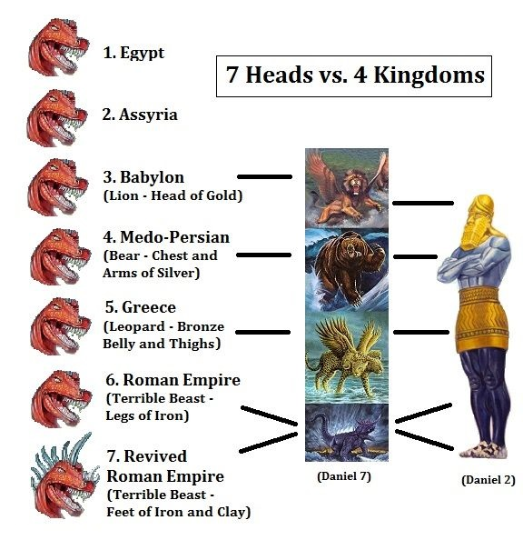
Revelation 17
Mystery Babylon the Great
The Seven Heads
Revelation 17:10. And there are seven kings: five are fallen, and one is, and the other is not yet come; and when he cometh, he must continue a short space. (Cont’d)
And before these four (Babylon, Persia, Greece, and Rome), there had been two other great kingdoms, Egypt and Assyria, both of which also had been perpetual enemies of God, His Word, and His people. Rev. 17:10
But what kingdom, arising after John’s day, is represented by the seventh head?
The particular kingdom prophesied here will exist for only “a short space,” in contrast to the first six.
Notes:
Revelation 17:10-And there are seven kings: five are fallen, and one is, and the other is not yet come; and when he cometh, he must continue a short space.
five are fallen…This has no reference at all to the death of certain emperors or kings, whether by suicide or other means. What is meant is that Egypt, Assyria, Babylon, Persia, and Greece, the first five successive heads of the beast, have passed from history as persecuting powers, or world empires.
The one is ... This, of course, is Rome, the great worldwide power when John wrote.
The other is yet to come ... Alas, there is to be another; and it will come just like all the others came, that is, after its predecessor has fallen, in this case, after the fall of Rome. The significance of this is that the seventh head (the Great Harlot) will not fully appear until after Rome has fallen.

Slide 39
Revelation 17
Mystery Babylon the Great
The Seven Heads
Revelation 17:10. And there are seven kings: five are fallen, and one is, and the other is not yet come; and when he cometh, he must continue a short space. (Cont’d)
The reason why it is difficult to identify this seventh kingdom is probably because it is still future.
The two “legs” of Daniel’s image, though in a different form, are surviving in what today we call “east,” the Communist nations dominated by Russia, and “west,” the capitalist nations led by the United States and, to a lesser degree, by England, France, and Germany.
The two feet of Daniel’s image quite possibly correspond to this particular stage of history. It is the kingdom that “is.”

Slide 40
Revelation 17
Mystery Babylon the Great
The Seven Heads
Revelation 17:10. And there are seven kings: five are fallen, and one is, and the other is not yet come; and when he cometh, he must continue a short space. (Cont’d)
The one which “is not yet come” must, therefore, correspond to the toes of Daniel’s image, the ten kingdoms which, in the last days, arise out of the “foot” stage of the image.
These are also the “ten horns” mentioned in this passage.
It is probably premature to speculate as to their identity, although the political chaos that will follow the miraculous defeat of Gog and Magog in Israel will probably lead to the emergence of a strong new western alliance of ten kingdoms.
This seventh kingdom of John’s particular vision is probably this alliance.

Slide 41
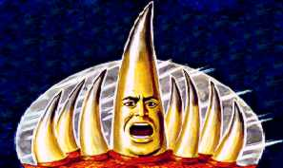
Revelation 17
Mystery Babylon the Great
The Seven Heads
Revelation 17:10. And there are seven kings: five are fallen, and one is, and the other is not yet come; and when he cometh, he must continue a short space. (Cont’d)
This seventh kingdom, composed of the ten-kingdom alliance, will not last very long.
Most likely its duration is the three-and-a-half years of the first half of the Tribulation.

Slide 42
Revelation 17
Mystery Babylon the Great
The Seven Heads
Revelation 17:11. And the beast that was, and is not, even he is the eighth, and is of the seven, and goeth into perdition.
Now there appears an eighth king, or kingdom, which is “of the seven.” This latter king turns out to be the beast himself, arising from the seven heads of the beast.
This strange cycle answers to the equally strange description of the beast as one who “was” and “is not” and yet “shall be” (Rev. 8).
We have already been warned that this beast, this man of sin, will indeed present himself in just such a fashion (Rev. 11:7; 13:3-6, 13:17-18).
Notes:
Rev. 11:7-And when they shall have finished their testimony, the beast that ascendeth out of the bottomless pit shall make war against them, and shall overcome them, and kill them.
Rev. 13:3-6-And I saw one of his heads as it were wounded to death; and his deadly wound was healed: and all the world wondered after the beast.
4And they worshipped the dragon which gave power unto the beast: and they worshipped the beast, saying, Who is like unto the beast? who is able to make war with him?
5And there was given unto him a mouth speaking great things and blasphemies; and power was given unto him to continue forty and two months.
6And he opened his mouth in blasphemy against God, to blaspheme his name, and his tabernacle, and them that dwell in heaven.
Rev. 13:17-18-And that no man might buy or sell, save he that had the mark, or the name of the beast, or the number of his name.
18Here is wisdom. Let him that hath understanding count the number of the beast: for it is the number of a man; and his number is Six hundred threescore and six.

Slide 43
Revelation 17
Mystery Babylon the Great
The Seven Heads
Revelation 17:11. And the beast that was, and is not, even he is the eighth, and is of the seven, and goeth into perdition. (Cont’d)
This beast is both a king and a kingdom, and both are apparently resurrected, even though neither actually died.
Since it is “of the seven,” it partakes of the character of all of them.
It is also noteworthy that all those ancient nations will experience a measure of physical and political renewal in the last days (Isaiah 19:23-25; Jeremiah 49:39).
Notes:
Isaiah 19:23-25-In that day shall there be a highway out of Egypt to Assyria, and the Assyrian shall come into Egypt, and the Egyptian into Assyria, and the Egyptians shall serve with the Assyrians.
24In that day shall Israel be the third with Egypt and with Assyria, even a blessing in the midst of the land:
25Whom the LORD of hosts shall bless, saying, Blessed be Egypt my people, and Assyria the work of my hands, and Israel mine inheritance.
Jeremiah 49:39-But it shall come to pass in the latter days, that I will bring again the captivity of Elam, saith the LORD.

Slide 44
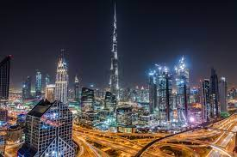
Revelation 17
Mystery Babylon the Great
The Seven Heads
Revelation 17:11. And the beast that was, and is not, even he is the eighth, and is of the seven, and goeth into perdition. (Cont’d)
Babylon will indeed be resurrected as a great city, capital of a worldwide empire.
She will be the eighth of these great kingdoms of the earth, arising out of them even as they all are also reviving.

Slide 45
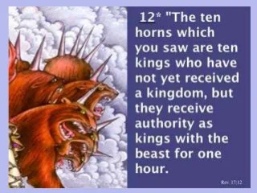
Revelation 17
Mystery Babylon the Great
The Ten Horns
Revelation 17:12. And the ten horns which thou sawest are ten kings, which have received no kingdom as yet; but receive power as kings one hour with the beast.
The ten horns constitute an end-time confederation of kingdoms and will endure for a brief time, probably three-and-a-half years.
Though the individual nations in some cases have existed for centuries, they would not come to power as a united kingdom until this future federation is implemented, and this may well be after the rapture of the Church.
This seventh great kingdom will be formed almost overnight. The ten will receive power as “co-kings” in the kingdom “at one hour.”

Slide 46
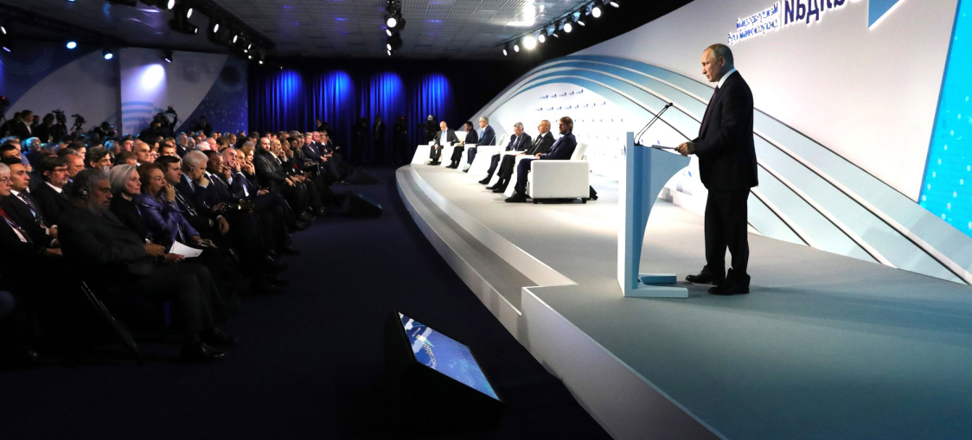
Revelation 17
Mystery Babylon the Great
The Ten Horns
Revelation 17:12. And the ten horns which thou sawest are ten kings, which have received no kingdom as yet; but receive power as kings one hour with the beast. (Cont’d)
Prominent in the plans and negotiations will be the head of one of these ten nations, the man destined just a few years hence to be recognized as world dictator, the beast, the heir of the seven kingdoms of history and the ten kingdoms of the present.

Slide 47
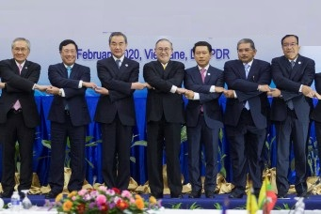
Revelation 17
Mystery Babylon the Great
The Ten Horns
Revelation 17:13. These have one mind, and shall give their power and strength unto the beast.
Although these ten start out as equals, they will gradually come to acknowledge the superiority of the beast and it becomes their set purpose to surrender all to him.

Slide 48
Revelation 17
Mystery Babylon the Great
The Ten Horns
Revelation 17:13. These have one mind, and shall give their power and strength unto the beast. (Cont’d)
This surrender will include both their armaments and their authority (“power and strength”).
This will not take place overnight, of course, as the ten-nation kingdom will endure for three-and-a-half years
The “ten horns” of Daniel 7:7 are clearly the same ten kings as here in Revelation. Apparently three of these need to be “persuaded” before they also have “one mind.” (Daniel 7:24).
While this internal dissension is being quelled, the federated kingdom also must battle against outside nations (Daniel 11:40-44).
Notes:
Daniel 7:7 –After this I saw in the night visions, and behold a fourth beast, dreadful and terrible, and strong exceedingly; and it had great iron teeth: it devoured and brake in pieces, and stamped the residue with the feet of it: and it was diverse from all the beasts that were before it; and it had ten horns.
Daniel 7:24-And the ten horns out of this kingdom are ten kings that shall arise: and another shall rise after them; and he shall be diverse from the first, and he shall subdue three kings.
Daniel 11:40-44-And at the time of the end shall the king of the south push at him: and the king of the north shall come against him like a whirlwind, with chariots, and with horsemen, and with many ships; and he shall enter into the countries, and shall overflow and pass over.
41He shall enter also into the glorious land, and many countries shall be overthrown: but these shall escape out of his hand, even Edom, and Moab, and the chief of the children of Ammon.
42He shall stretch forth his hand also upon the countries: and the land of Egypt shall not escape.
43But he shall have power over the treasures of gold and of silver, and over all the precious things of Egypt: and the Libyans and the Ethiopians shall be at his steps.
44But tidings out of the east and out of the north shall trouble him: therefore he shall go forth with great fury to destroy, and utterly to make away many.

Slide 49
Revelation 17
Mystery Babylon the Great
The Ten Horns
Revelation 17:13. These have one mind, and shall give their power and strength unto the beast. (Cont’d)
While all of this is going on, it must not be forgotten that the great judgments of the seals and the trumpets are plaguing all nations, causing much distraction from their political goals and military pursuits.
Then, suddenly, two events will take place which will galvanize all nations into rapid submission to the beast.
The first will be his amazing “resurrection” from Hades.
Then, he will be successful in overcoming and killing God’s two witnesses, who had previously been invincible and unapproachable.

Slide 50
Revelation 17
Mystery Babylon the Great
The Ten Horns
Revelation 17:14. These shall make war with the Lamb, and the Lamb shall overcome them: for he is Lord of lords, and King of kings: and they that are with him are called, and chosen, and faithful.
This is surely one of the great mountain-peak verses of the Bible.
The beast may deceive himself into thinking that he is now the greatest man in history.
But the old dragon has deceived the whole world, even his own man of sin!
He is not the greatest king after all. The Lamb is King of all kings!

Slide 51
Revelation 17
Mystery Babylon the Great
The Ten Horns
Revelation 17:14. These shall make war with the Lamb, and the Lamb shall overcome them: for he is Lord of lords, and King of kings: and they that are with him are called, and chosen, and faithful. (Cont’d)
The dragon may mobilize all these kings of the earth, and their armies, but it will be only to their doom.
The Lamb will overcome them with only a spoken word.
The beast has vast armies at his control, but the Lamb also has armies, with armor of fine linen, white and clean (Revelation 19:14), the righteousness of saints.
These are the very elite of creation, carefully selected and proven, “called and chosen and faithful.” (Romans 8:28; Matthew 22:14; 25:23; 1 Corinthians 3:15; Revelation 22:12).
Notes:
Revelation 19:14-And the armies which were in heaven followed him upon white horses, clothed in fine linen, white and clean.Romans 8:28-
Matthew 22:14-For many are called, but few are chosen.
Matthew 25:23-His lord said unto him, Well done, good and faithful servant; thou hast been faithful over a few things, I will make thee ruler over many things: enter thou into the joy of thy lord.
1 Corinthians 3:15-If any man's work shall be burned, he shall suffer loss: but he himself shall be saved; yet so as by fire.
Revelation 22:12-And, behold, I come quickly; and my reward is with me, to give every man according as his work shall be.

Slide 52
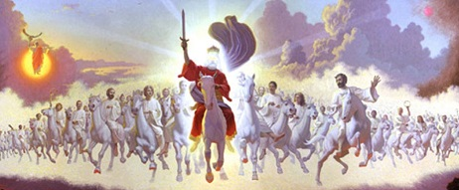
Revelation 17
Mystery Babylon the Great
The Ten Horns
Revelation 17:14. These shall make war with the Lamb, and the Lamb shall overcome them: for he is Lord of lords, and King of kings: and they that are with him are called, and chosen, and faithful. (Cont’d)
Such judgments and discernments must be left to the Lord.
Perhaps other believers remain regretfully at the heavenly throne while these, like Gideon’s 300, go to war.
May we also, as good stewards, be found faithful (1 Cor. 4:2).
Notes:
1 Cor. 4:2-Moreover it is required in stewards, that a man be found faithful.

Slide 53
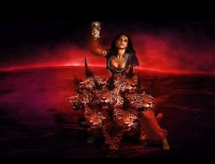
Revelation 17
Mystery Babylon the Great
The Ten Horns
Revelation 17:15. And he saith unto me, The waters which thou sawest, where the whore sitteth, are peoples, and multitudes, and nations, and tongues.
These waters are now explained as symbolic of the many peoples of the world.
The woman is also sitting on the seven heads of the beast, representing seven kingdoms.

Slide 54
Revelation 17
Mystery Babylon the Great
The Ten Horns
Revelation 17:15. And he saith unto me, The waters which thou sawest, where the whore sitteth, are peoples, and multitudes, and nations, and tongues. (Cond’t)
The meaning apparently is that these great world empires are her immediate support, but also that, secondarily, she is further and ultimately supported by all the peoples of the world.
The waters of the troubled sea symbolize the ungodly nations in other scriptures as well (Daniel 7:3; Isaiah 57:20).
Jesus said of the last days that a time would be “upon the earth distress of nations, with perplexity, sea & waves roaring (Luke 21:25).
Notes:
Daniel 7:3-And four great beasts came up from the sea, diverse one from another.
Isaiah 57:20-But the wicked are like the troubled sea, when it cannot rest, whose waters cast up mire and dirt.
Luke 21:25-And there shall be signs in the sun, and in the moon, and in the stars; and upon the earth distress of nations, with perplexity; the sea and the waves roaring;

Slide 55
Revelation 17
Mystery Babylon the Great
The Ten Horns
Revelation 17:16. And the ten horns which thou sawest upon the beast, these shall hate the whore, and shall make her desolate and naked, and shall eat her flesh, and burn her with fire.
Then, suddenly, the ancient whore, reigning proudly over the peoples of the whole world, meets her end.
With the departure of all believers in the true churches before the beginning of the tribulation period, organized religion will quickly be forged into a powerful tool for the support of the political power.

Slide 56
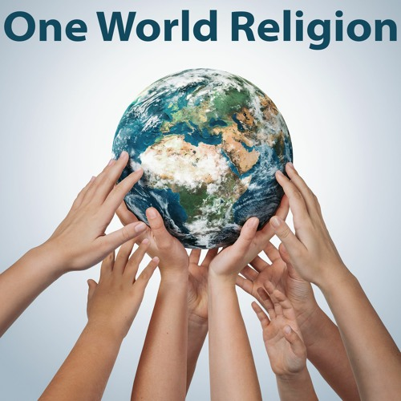
Revelation 17
Mystery Babylon the Great
The Ten Horns
Revelation 17:16. And the ten horns which thou sawest upon the beast, these shall hate the whore, and shall make her desolate and naked, and shall eat her flesh, and burn her with fire.
During the first half of the tribulation, while the beast is attempting to establish his supremacy over his colleagues in the ten-kingdom federated empire, he quickly realizes he can use man’s religious nature to help implement his own ambitions.

Slide 57
Revelation 17
Mystery Babylon the Great
The Ten Horns
Revelation 17:16. And the ten horns which thou sawest upon the beast, these shall hate the whore, and shall make her desolate and naked, and shall eat her flesh, and burn her with fire. (Cont’d)
Then, when he finally attains his goal of global dictatorship at the midpoint of the tribulation, the members of the world’s religious hierarchy hope they will share richly in the fruits of conquest.
However, the beast and the false prophet will quickly let it be known that they neither want nor need this vast humanistic religious complex any more.
Possibly the ten kings also will develop hostility toward this particular religious hierarchy.

Slide 58
Revelation 17
Mystery Babylon the Great
The Ten Horns
Revelation 17:16. And the ten horns which thou sawest upon the beast, these shall hate the whore, and shall make her desolate and naked, and shall eat her flesh, and burn her with fire. (Cont’d)
Consequently, they will eagerly jump at the chance to destroy this despised harlot once the beast gives permission.
With that, the campaign of annihilation will be mounted in full. All the riches of the temples will be confiscated, the buildings burned with fire, the leaders executed.
The old whore will be left desolate and naked.

Slide 59

Revelation 17
Mystery Babylon the Great
The Ten Horns
Revelation 17:17. For God hath put in their hearts to fulfil his will, and to agree, and give their kingdom unto the beast, until the words of God shall be fulfilled.
Herein is an amazing thing, that men should fulfill God’s will even while they oppose His will!” (Psalms 76:10). It was like the men who crucified Jesus (Acts 4:26-28).
God used these ten kings, first of all, to destroy the age-old pseudoscientific system of religious Babylon.
They did this for their own utterly selfish and wicked motives, of course, but nevertheless they accomplished the will of God in the process.
Notes:
Psalms 76:10-Surely the wrath of man shall praise thee: the remainder of wrath shalt thou restrain.
Acts 4:26-28-The kings of the earth stood up, and the rulers were gathered together against the Lord, and against his Christ.
27For of a truth against thy holy child Jesus, whom thou hast anointed, both Herod, and Pontius Pilate, with the Gentiles, and the people of Israel, were gathered together,
28For to do whatsoever thy hand and thy counsel determined before to be done.

Slide 60
Revelation 17
Mystery Babylon the Great
The Ten Horns
Revelation 17:17. For God hath put in their hearts to fulfil his will, and to agree, and give their kingdom unto the beast, until the words of God shall be fulfilled. (Cont’d)
Though the kings certainly do not have such a thing in mind, God is constraining them to unite in this way under the beast in order that His own words might be fulfilled.
In order for “all nations” to be “gathered together” for judgment and destruction at the day of the Lord (note Joel 3:2; Zechariah 14:2), there must first be established a human agency to implement such a convocation.
God’s Word must be fulfilled, whether men intend it so or not.
Notes:
Joel 3:2-I will also gather all nations, and will bring them down into the valley of Jehoshaphat, and will plead with them there for my people and for my heritage Israel, whom they have scattered among the nations, and parted my land.
Zechariah 14:2-For I will gather all nations against Jerusalem to battle; and the city shall be taken, and the houses rifled, and the women ravished; and half of the city shall go forth into captivity, and the residue of the people shall not be cut off from the city.

Slide 61
Revelation 17
Mystery Babylon the Great
The Ten Horns
Revelation 17:18. And the woman which thou sawest is that great city, which reigneth over the kings of the earth.
The final word of the angel to John is that the woman whom he had shown to John in the sign was to be understood as “that great city.” And what city is that? She is “Babylon the great.”
As a system, religious Babylon began at Babel. It finally will reach its zenith of power in rebuilt Babylon, the capital city of the final world empire, the kingdom of the beast.

Slide 62
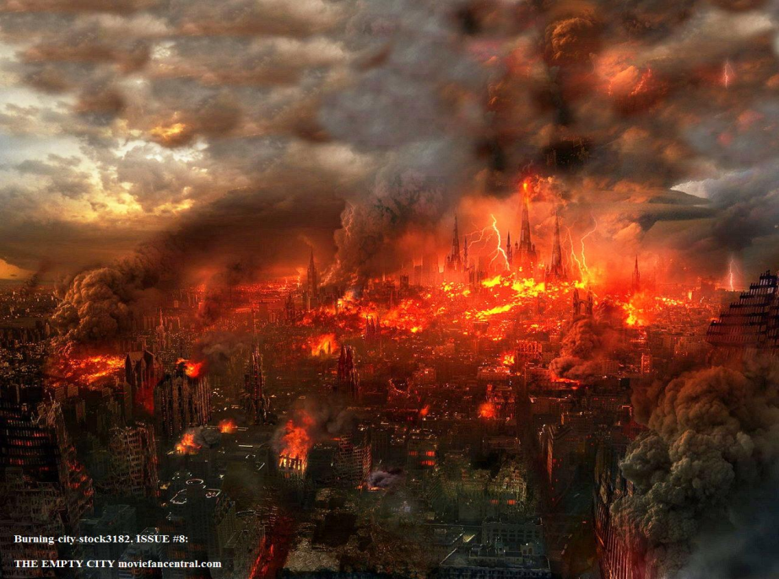
Revelation 17
Mystery Babylon the Great
The Ten Horns
Revelation 17:18. And the woman which thou sawest is that great city, which reigneth over the kings of the earth. (Cond’t)
But it is also there that these same kings will turn on her and destroy her.
Political Babylon must then, also quickly fall.

Slide 63
Revelation 17
Mystery Babylon the Great
The Ten Horns
Revelation 17:18. And the woman which thou sawest is that great city, which reigneth over the kings of the earth. (Cont’d)
It must be emphasized again that Babylon is a city. It says so, plainly, in Revelation 18:10 and 18:21.
Commentators argue that since Isaiah and Jeremiah foretold of Babylon’s permanent destruction, it is impossible for Babylon to be rebuilt in the tribulation.
The prophecies of Isaiah and Jeremiah refer to the future destruction.
The destruction will take place in the time that the stars and sun are darkened (Isaiah 13:1,13:9-10).
Notes:
Isaiah 13:1-The burden of Babylon, which Isaiah the son of Amoz did see.
Isaiah 13:9-10-Behold, the day of the LORD cometh, cruel both with wrath and fierce anger, to lay the land desolate: and he shall destroy the sinners thereof out of it.
10For the stars of heaven and the constellations thereof shall not give their light: the sun shall be darkened in his going forth, and the moon shall not cause her light to shine.

Slide 64
Revelation 17
Mystery Babylon the Great
The Ten Horns
Revelation 17:18. And the woman which thou sawest is that great city, which reigneth over the kings of the earth. (Cont’d)
The city will become as desolate as Sodom and Gomorrah (Isaiah 13:19; Jeremiah 50:40).
It shall become desolate forever, with neither man nor beast entering it any more (Isaiah 13:20; Jeremiah 51:62).
It will be a time of judgment not only for Babylon but for all nations (Isaiah 13:11-13; Jeremiah 51:49).
Its destruction will be followed by universal rest and peace (Isaiah 14:7-8).
Notes:
Isaiah 13:19-And Babylon, the glory of kingdoms, the beauty of the Chaldees' excellency, shall be as when God overthrew Sodom and Gomorrah.
Jeremiah 50:40-As God overthrew Sodom and Gomorrah and the neighbour cities thereof, saith the LORD; so shall no man abide there, neither shall any son of man dwell therein.
Isaiah 13:20-It shall never be inhabited, neither shall it be dwelt in from generation to generation: neither shall the Arabian pitch tent there; neither shall the shepherds make their fold there.
Jeremiah 51:62-Then shalt thou say, O LORD, thou hast spoken against this place, to cut it off, that none shall remain in it, neither man nor beast, but that it shall be desolate for ever.
Isaiah 13:11-13-And I will punish the world for their evil, and the wicked for their iniquity; and I will cause the arrogancy of the proud to cease, and will lay low the haughtiness of the terrible.
12I will make a man more precious than fine gold; even a man than the golden wedge of Ophir.
13Therefore I will shake the heavens, and the earth shall remove out of her place, in the wrath of the LORD of hosts, and in the day of his fierce anger.
Jeremiah 51:49-As Babylon hath caused the slain of Israel to fall, so at Babylon shall fall the slain of all the earth.
Isaiah 14:7-8-The whole earth is at rest, and is quiet: they break forth into singing.
8Yea, the fir trees rejoice at thee, and the cedars of Lebanon, saying, Since thou art laid down, no feller is come up against us.

Slide 65
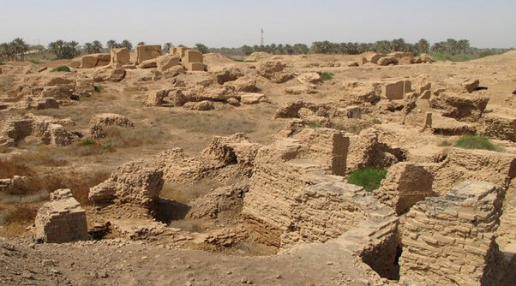
Revelation 17
Mystery Babylon the Great
The Ten Horns
Revelation 17:18. And the woman which thou sawest is that great city, which reigneth over the kings of the earth. (Cont’d)
Its destruction is directly associated also with the casting of Lucifer into Sheol (Isaiah 14:12-15).
Babylon’s stones will never be used in future construction elsewhere (Jeremiah 51:26).
This, however, will require that Babylon somehow be restored to its former magnificence and prominence.
Notes:
Isaiah 14:12-15-How art thou fallen from heaven, O Lucifer, son of the morning! how art thou cut down to the ground, which didst weaken the nations!
13For thou hast said in thine heart, I will ascend into heaven, I will exalt my throne above the stars of God: I will sit also upon the mount of the congregation, in the sides of the north:
14I will ascend above the heights of the clouds; I will be like the most High.
15Yet thou shalt be brought down to hell, to the sides of the pit.
Jeremiah 51:26-And they shall not take of thee a stone for a corner, nor a stone for foundations; but thou shalt be desolate for ever, saith the LORD.

Slide 66
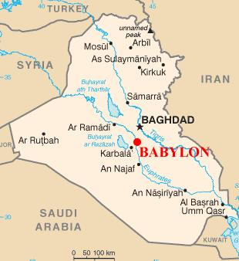
Revelation 17
Mystery Babylon the Great
The Ten Horns
Revelation 17:18. And the woman which thou sawest is that great city, which reigneth over the kings of the earth. (Cont’d)
Babylon is indeed a prime prospect for rebuilding.
Its location is the most ideal in the world for any kind of international center.
Realizing the tremendous tourist potential in a restored Babylon, the Iraqis have already made considerable progress on its reconstruction.

Slide 67
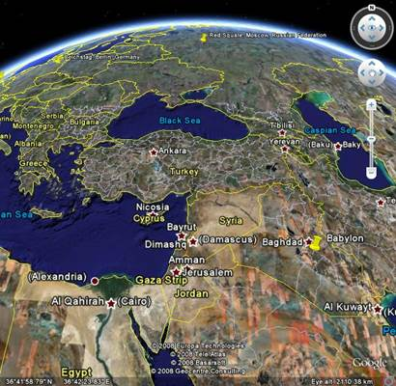
Revelation 17
Mystery Babylon the Great
The Ten Horns
Revelation 17:18. And the woman which thou sawest is that great city, which reigneth over the kings of the earth. (Cont’d)
There is no more ideal location anywhere for a world trade center, a world communications center, a world banking center, a world educational center, or especially, a world capital.

Slide 68
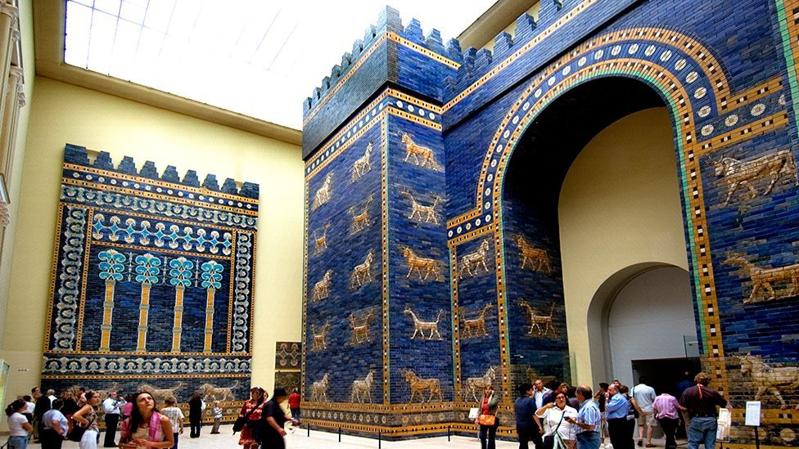
Revelation 17
Mystery Babylon the Great
The Ten Horns
Revelation 17:18. And the woman which thou sawest is that great city, which reigneth over the kings of the earth. (Cont’d)
With all these advantages, and with the head start already made by the Iraqis, it is not far-fetched at all to suggest that the future capital of the “United Nations Kingdom,” the ten-nation federation established at the beginning of the tribulation, would be established there.

Slide 69
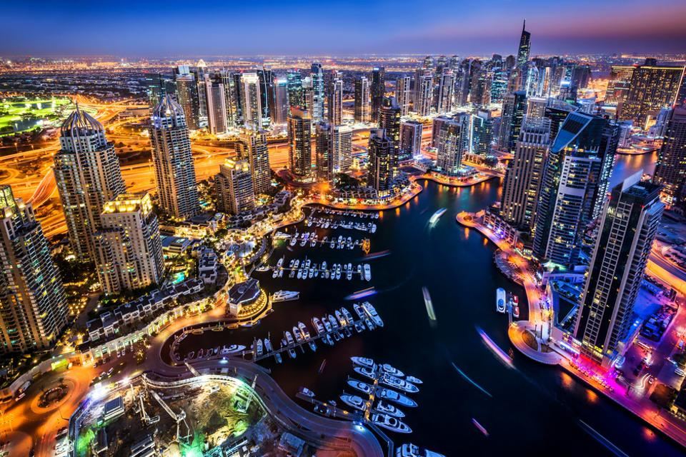
Revelation 17
Mystery Babylon the Great
The Ten Horns
Revelation 17:18. And the woman which thou sawest is that great city, which reigneth over the kings of the earth. (Cont’d)
With modern construction equipment and unlimited wealth at his disposal, the beast can rebuild mighty Babylon almost overnight.

Slide 70
THIS CONCLUDES REVELATION 17

