Slide 1
TITUS
CHAPTER 3
11/7/2022
1

Slide 2
SUMMARY
Titus chapter 3 applies the teachings which Paul gave in chapters 1 and 2. Paul urges Titus to appoint worthy elders to positions of responsibility, to preach sound doctrine and to exemplify in his own life the virtues that are expected of all Christians.
11/7/2022
2

Slide 3
TITUS 3:1- 3:8 INSTRUCTION TO TITUS REMIND THE BELIEVERS
3.1 Put them in mind to be subject to principalities and powers, to obey magistrates, to be ready to every good work,
“Put them in mind” or remind, which means these teachings are not new. These are probably instructions taught by Paul when he was at Crete with Titus. Three specific commands are given in this verse. First, believers are to be "subject to," or submissive to authority figures. Second, Titus is to teach believers “to obey," which is separate from submission. Believers
11/7/2022
3

Slide 4
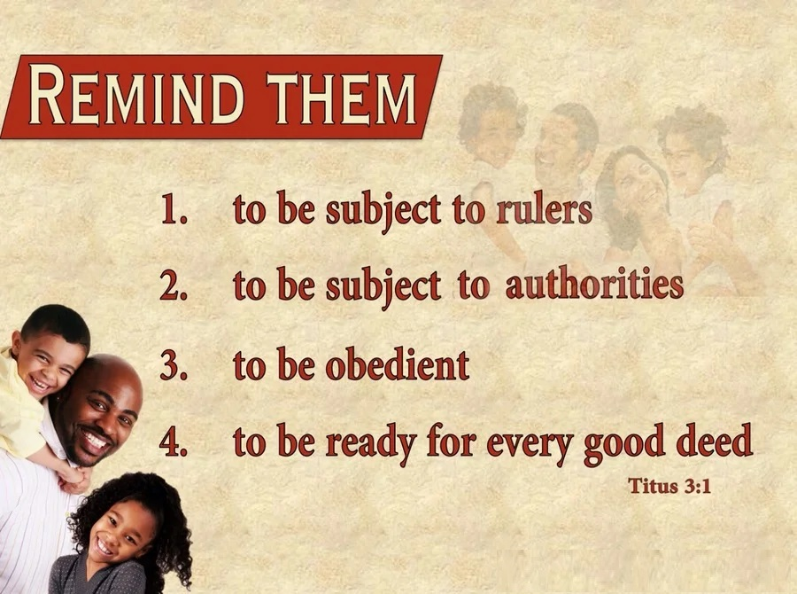
TITUS 3:1- 3:8 INSTRUCTION TO TITUS REMIND THE BELIEVERS
are called to obey God, when the commands of God and men contradict (Acts 5:29). Third, Titus was to teach believers to "be ready" to do good works. Be ready and willing to serve whenever and however the opportunity arises.
11/7/2022
4
Notes:
Acts 5:29-Then Peter and the other apostles answered and said, We ought to obey God rather than men.

Slide 5
TITUS 3:1- 3:8 INSTRUCTION TO TITUS REMIND THE BELIEVERS
3.2 To speak evil of no man, to be no brawlers, but gentle, shewing all meekness unto all men.
This verse continues the list of commands Titus is to remind believers of. Fourth, believers are not to gossip or tear others down with words. Fifth, they are to avoid arguments and not be “brawlers” in church as well as in the world. Such behavior validates our witness in a skeptical, sarcastic society. Sixth, Christians were to be “gentle”. Believers were not to be
11/7/2022
5

Slide 6

TITUS 3:1- 3:8 INSTRUCTION TO TITUS REMIND THE BELIEVERS
violent, or hot-tempered, especially church leaders. Seventh, believers were to extend kindness both to believers and non-believers.
11/7/2022
6

Slide 7
TITUS 3:1- 3:8 INSTRUCTION TO TITUS REMIND THE BELIEVERS
3.3 For we ourselves also were sometimes foolish, disobedient, deceived, serving divers lusts and pleasures, living in malice and envy, hateful, and hating one another.
The verses 1 & 2 lists seven commands encouraging Christians to live better while verse 3 gives a list of seven sins associated with unbelief. Each of these concepts is intentionally contrasted against the other, showing how believers are to live, as opposed to their previous actions.
11/7/2022
7

Slide 8
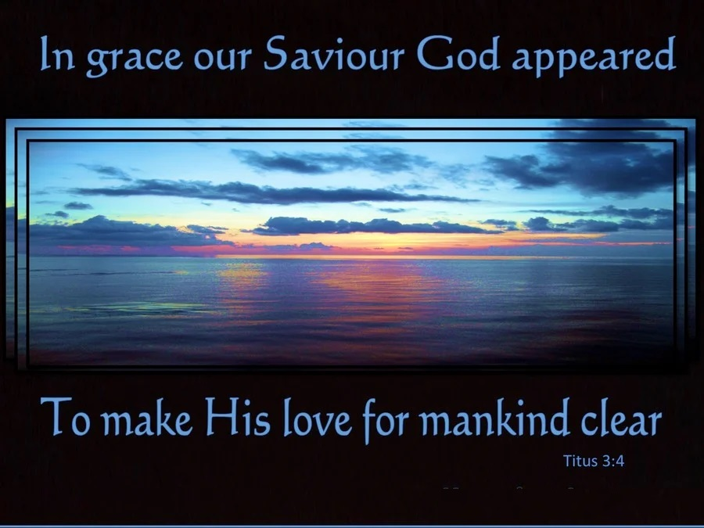
TITUS 3:1- 3:8 INSTRUCTION TO TITUS REMIND THE BELIEVERS
3.4 But after that the kindness and love of God our Saviour toward man appeared,
Verse 4 explains the origin of the change from immoral living to a changed life. Specifically, change is brought on by “the kindness and love of God, our Savior.” God alone is the reason for the the changed life of a believer, not our efforts (Ephesians 2:8–9).
11/7/2022
8
Notes:
Ephesians 2:8–9-For by grace are ye saved through faith; and that not of yourselves: it is the gift of God:
9Not of works, lest any man should boast.

Slide 9
TITUS 3:1- 3:8 INSTRUCTION TO TITUS REMIND THE BELIEVERS
3.5 Not by works of righteousness which we have done, but according to his mercy he saved us, by the washing of regeneration, and renewing of the Holy Ghost;
The phrase "He saved us" specifically implies that God is the source of salvation. This verse also emphasizes how God saves. Being saved is not something we accomplish through our good deeds, but through the “mercy” of God. Salvation comes only from God, and only through God's mercy. The phrase "the washing
11/7/2022
9

Slide 10

TITUS 3:1- 3:8 INSTRUCTION TO TITUS REMIND THE BELIEVERS
of regeneration." This refers to the spiritual cleansing which takes place when a person accepts Christ. At that moment, a person's life is regenerated, or made new. The Holy Spirit renews our life when we come by faith to Christ.
11/7/2022
10

Slide 11
TITUS 3:1- 3:8 INSTRUCTION TO TITUS REMIND THE BELIEVERS
3.6 Which he shed on us abundantly through Jesus Christ our Saviour;
The “He” referred to in this verse is the Holy Spirit. Jesus sent the Holy Spirit, as described in Acts 1:4–5 and here Paul emphasizes that the Holy Spirit was “shed” or poured out "abundantly." Lastly Paul again refers to Jesus Christ as "our Savior." This stresses the fact that both Paul and Titus are followers of Christ, and of the same Savior.
11/7/2022
11
Notes:
Acts 1:4–5 -And, being assembled together with them, commanded them that they should not depart from Jerusalem, but wait for the promise of the Father, which, saith he, ye have heard of me.
5For John truly baptized with water; but ye shall be baptized with the Holy Ghost not many days hence.

Slide 12
TITUS 3:1- 3:8 INSTRUCTION TO TITUS REMIND THE BELIEVERS
3.7 That being justified by his grace, we should be made heirs according to the hope of eternal life.
This verse continues comments on salvation which Paul began in verse 4. Paul states that grace is what justifies us, meaning God's grace declares us forgiven, and reconciled to God. The opportunity for “eternal life” is the result of being “justified” by faith. The result is peace with God. Without faith, there is no justification; without justification, there is no
11/7/2022
12

Slide 13

TITUS 3:1- 3:8 INSTRUCTION TO TITUS REMIND THE BELIEVERS
salvation.
11/7/2022
13

Slide 14
TITUS 3:1- 3:8 INSTRUCTION TO TITUS REMIND THE BELIEVERS
3.8 This is a faithful saying, and these things I will that thou affirm constantly, that they which have believed in God might be careful to maintain good works. These things are good and profitable unto men.
Paul instructs Titus to insist that believers make a purposeful commitment to do good deeds. These “good works” do not earn salvation; good works are the result of salvation. A person changed by God will seek to live for Him. Paul also affirmed that these things were "profitable,"
11/7/2022
14

Slide 15
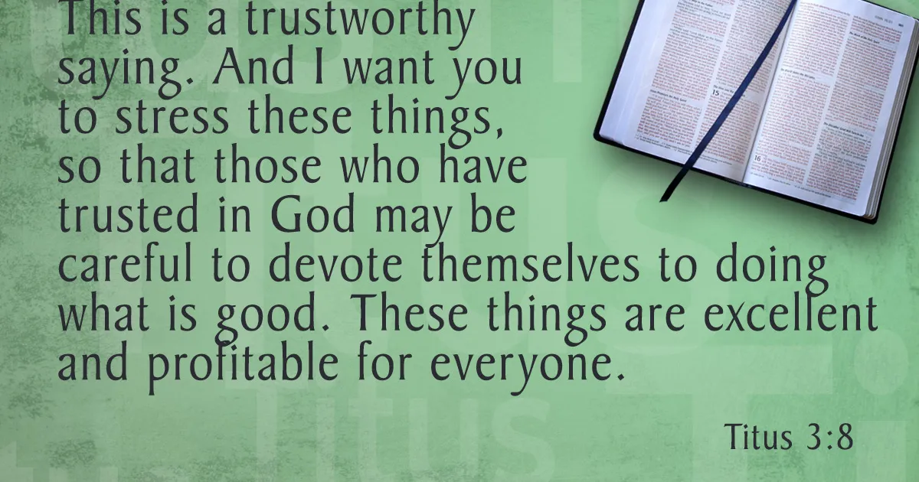
TITUS 3:1- 3:8 INSTRUCTION TO TITUS REMIND THE BELIEVERS
for all people. Not in the sense of money, but that healthy, sound doctrine was beneficial to the church.
11/7/2022
15

Slide 16
TITUS 3:9-3:11 INSTRUCTION TO TITUS AVOID CERTAIN THINGS
3.9 But avoid foolish questions, and genealogies, and contentions, and strivings about the law; for they are unprofitable and vain.
After giving Titus many positive instructions, Paul now speaks of four areas which are to be avoided. First is to “avoid foolish questions” or foolish debates. Bickering over certain issues is poisonous to the Christian life. Second, Titus was to avoid “genealogies”. This seems like a strange point but certain false teachers took
11/7/2022
16

Slide 17
TITUS 3:9-3:11 INSTRUCTION TO TITUS AVOID CERTAIN THINGS
great pride in proving they were descendants of Abraham. God is not concerned with who one’s parents are—He is concerned about our salvation. Third, Titus was commanded to avoid “strife” or quarrels. In other words, don’t be argumentative. Fourth, Titus is to avoid "strivings” or disputes about the law. He should not lose focus by arguing about details of the Jewish law. Instead, he should center his ministry on the good news of Jesus, promoting sound doctrine in the local churches.
11/7/2022
17

Slide 18
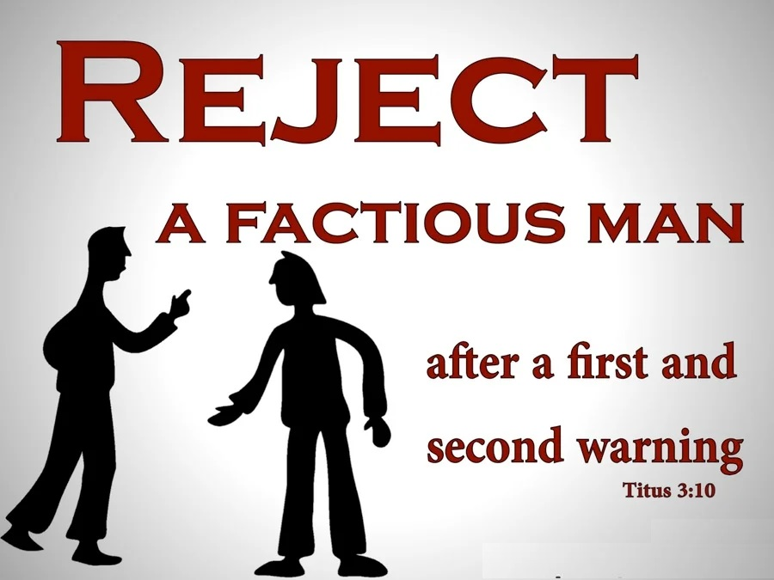
TITUS 3:9-3:11 INSTRUCTION TO TITUS AVOID CERTAIN THINGS
3.10 A man that is an heretick after the first and second admonition reject;
Here, Paul adds a warning about people who insist on stirring up division. Give a first and second warning, then after that have nothing to do with them.
11/7/2022
18

Slide 19
TITUS 3:9-3:11 INSTRUCTION TO TITUS AVOID CERTAIN THINGS
3.11 Knowing that he that is such is subverted, and sinneth, being condemned of himself.
This verse outlines three traits of false teachers. First false teachers are “subverted” or warped. They turn something good in to evil. Second, false teachers are sinful. They are not just innocently mistaken but willfully and intentionally promote incorrect doctrine. Third, is the end result of teaching false doctrine—the false teacher is self condemned.
11/7/2022
19

Slide 20
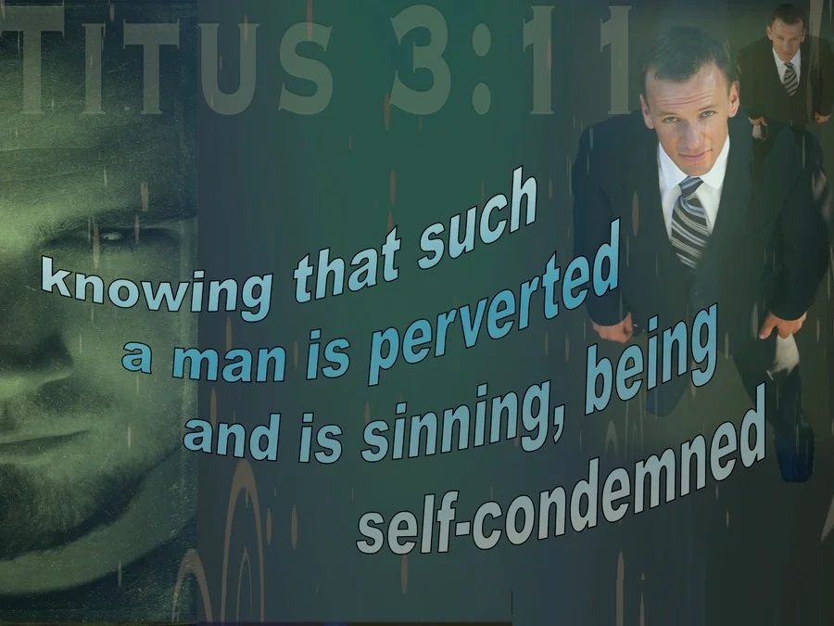
TITUS 3:9-3:11 INSTRUCTION TO TITUS AVOID CERTAIN THINGS
While Titus is to speak against false teachings and false teachers, he does not need to take a false teacher through the process of church discipline (Matthew 18:15–17). The teacher is “condemned of himself” by promoting false and sinful doctrine.
11/7/2022
20
Notes:
Matthew 18:15–17-And he touched her hand, and the fever left her: and she arose, and ministered unto them.
16When the even was come, they brought unto him many that were possessed with devils: and he cast out the spirits with his word, and healed all that were sick:
17That it might be fulfilled which was spoken by Esaias the prophet, saying, Himself took our infirmities, and bare our sicknesses.

Slide 21
TITUS 3:12-15 CLOSING WORDS
3.12 When I shall send Artemas unto thee, or Tychicus, be diligent to come unto me to Nicopolis: for I have determined there to winter.
Verse 12 begins the final instructions and conclusion of Paul's letter to Titus. He states several facts about his current situation. First, Paul plans to send either Artemas or Tychicus to Titus. Second, Paul asks Titus to join him at Nicopolis, a city on the west side of Greece. Paul had decided to spend the winter there.
11/7/2022
21
Notes:
Artemas is not referred to anywhere else in the New Testament.
Tychicus, however, is mentioned four other places. 1) He was with Paul on his trip from Greece to Macedonia (Acts 20:4).
2) He was with Paul and Titus in Rome, 3) He delivered letters to Ephesus (Ephesians 6:21) and 4) He delivered letters to the Colossians Christians (Colossians 4:7).

Slide 22
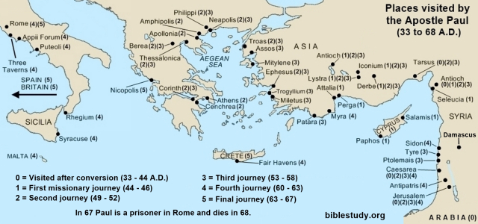
TITUS 3:12-15 CLOSING WORDS
11/7/2022
22
Notes:
The ancient city of Nicopolis was founded by Augustus Caesar, whose camp happened to be pitched there the night before the famous fight with Antony (31 B.C.). After his victory he built a city on the exact spot where his army had encamped ("Victory City"). On the hill now called Michalitzi.
Nicopolis, is now called Prebeza.
It is 436 miles from Nicopolis to Crete or about the same as from Atlanta to Disney World.

Slide 23
TITUS 3:12-15 CLOSING WORDS
3.13 Bring Zenas the lawyer and Apollos on their journey diligently, that nothing be wanting unto them.
In verse 13 Paul continues his request to Titus. Zenas and Apollos were in Crete at this time with Titus. They may have delivered the book of Titus from Paul to Titus himself. Titus was to help them finance their trip further in to Crete. The lawyer Zenas is not mentioned anywhere else in the Bible. Both were certainly Christians. Zenas was likely a Gentile, and Apollos Jewish.
11/7/2022
23
Notes:
Apollos is mentioned in both Acts and 1 Corinthians. In Acts 18:24, we read that he was from Alexandria, well-educated in Scripture, and well-spoken. More than likely, Apollos had been baptized by John the Baptist (Acts 18:25). Priscilla and Aquila then taught Him about Jesus (Acts 18:26).

Slide 24
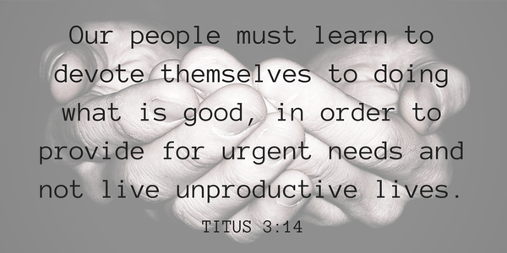
TITUS 3:12-15 CLOSING WORDS
3.14 And let ours also learn to maintain good works for necessary uses, that they be not unfruitful.
Here Paul adds a plea. Christians should be diligent in pursuing good works for the necessary care of those in need and should not be unproductive.
11/7/2022
24

Slide 25
TITUS 3:12-15 CLOSING WORDS
3.15 All that are with me salute thee. Greet them that love us in the faith. Grace be with you all. Amen. (It was written to Titus, ordained the first bishop of the church of the Cretians, from Nicopolis of Macedonia.)
In this concluding verse of his letter to Titus, Paul sends the love of the Christian church in Nicopolis to the fellow believers on Crete. Paul says this greeting is meant both for Titus and other believers throughout the island. This phrase is likely an encouragement to have the entire letter read in all of the local
11/7/2022
25

Slide 26

TITUS 3:12-15 CLOSING WORDS
churches of Crete. Finally, Paul ends with his usual phrase, "Grace be with you all."
11/7/2022
26

Slide 27
THIS CONCLUDES
TITUS
CHAPTER 3
11/7/2022
27

