Slide 1


Slide 2
Revelation 10
Bitter-Sweet Inheritance
Introduction
In a similar way to which chapter 7 stood between the sixth and seventh seal judgments, chapter 10 is placed between the sixth and seventh trumpets and sets the stage for the final trumpet. These interludes encourage God’s people in the midst of the fury and horror of divine judgment, and remind them that God is still in sovereign control of all events. During the interludes God comforts His people with the knowledge that He has not forgotten them, and that they will ultimately be victorious.
The theme of this chapter appears to be the declaration of God’s intention and right to take possession of the earth—both land and sea—and to bring to fulfillment the many prophetic themes found in Scripture which point to the establishment of God’s kingdom on earth.

Slide 3
Revelation 10
Bitter-Sweet Inheritance
Introduction (Con’t)
The earth is ravaged, multitudes are slain, and the world’s inhabitants are benumbed with both wickedness and fear.
All the judgments had ensued when the Lamb received the title scroll from the hand of God (Revelation 5:7).
The inheritance of the world was His, by right of both creation and blood redemption (Hebrews 1:2).
He must still wrest His dominion from Satan, with all his host of fallen angels and wicked men.
It is appropriate that at this midpoint of Christ’s work of reclamation, John be given a fresh vision of the mighty Redeemer and His sure victory.
Notes:
Revelation 5:7-And he came and took the book out of the right hand of him that sat upon the throne
Hebrews 1:2-Hath in these last days spoken unto us by his Son, whom he hath appointed heir of all things, by whom also he made the worlds;

Slide 4
Revelation 10
Bitter-Sweet Inheritance
The Rainbow Crown
John had already witnessed a glorious coronation.
Golden crowns (Rev. 4:4), laid down before the throne of the Creator (Rev. 4:10).
The Lamb received a glorious crown as He rode forth on the great white horse of heaven (Rev. 6:2).
And once again he sees the mighty Conqueror who once had worn a crown of thorns, but now He was crowned with God’s rainbow.
Notes:
Rev. 4:4-And round about the throne were four and twenty seats: and upon the seats I saw four and twenty elders sitting, clothed in white raiment; and they had on their heads crowns of gold.
Rev. 4:10-The four and twenty elders fall down before him that sat on the throne, and worship him that liveth for ever and ever, and cast their crowns before the throne, saying,
Rev. 6:2-And I saw, and behold a white horse: and he that sat on him had a bow; and a crown was given unto him: and he went forth conquering, and to conquer.

Slide 5
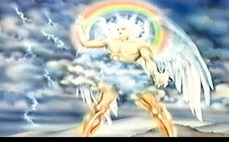
Revelation 10
Bitter-Sweet Inheritance
The Rainbow Crown
Revelation 10:1. And I saw another mighty angel come down from heaven, clothed with a cloud: and a rainbow was upon his head, and his face was as it were the sun, and his feet as pillars of fire:
This mighty angel can be none other than the Lord Jesus Christ. Some commentaries however believe that this angel is not Christ, but a divine emissary of God.
That He is the same glorified Son of man seen by John at the beginning of the Apocalypse is clear from three striking marks of identification. (Rev. 1:7, 15-16).
1) “Behold He cometh with clouds”
2) “His face was like the sun”
3) “His feet were as pillars of fire”
Notes:
Rev. 1:7-Behold, he cometh with clouds; and every eye shall see him, and they also which pierced him: and all kindreds of the earth shall wail because of him. Even so, Amen.
Rev. 1:15-16-And his feet like unto fine brass, as if they burned in a furnace; and his voice as the sound of many waters.
16And he had in his right hand seven stars: and out of his mouth went a sharp twoedged sword: and his countenance was as the sun shineth in his strength.

Slide 6
Revelation 10
Bitter-Sweet Inheritance
The Rainbow Crown
Revelation 10:1. And I saw another mighty angel come down from heaven, clothed with a cloud: and a rainbow was upon his head, and his face was as it were the sun, and his feet as pillars of fire: (Cont’d)
But there is something new this time. The beautiful rainbow encircles the head of Christ.
The definite article in the original - “the rainbow” - indicates that it is the bow specially associated with God (Genesis 9:13; Ezekiel 1:28).
In the Old Testament, the same word is used both for the rainbow and for a weapon, thus suggesting that God is a God of both grace and judgment (Rev. 7:14; Heb. 10:29).
John saw Him coming down from heaven to stand once again on earth.
Notes:
Genesis 9:13-I do set my bow in the cloud, and it shall be for a token of a covenant between me and the earth.
Ezekiel 1:28-As the appearance of the bow that is in the cloud in the day of rain, so was the appearance of the brightness round about. This was the appearance of the likeness of the glory of the LORD. And when I saw it, I fell upon my face, and I heard a voice of one that spake.
Rev. 7:14-And I said unto him, Sir, thou knowest. And he said to me, These are they which came out of great tribulation, and have washed their robes, and made them white in the blood of the Lamb.
Heb. 10:29-Of how much sorer punishment, suppose ye, shall he be thought worthy, who hath trodden under foot the Son of God, and hath counted the blood of the covenant, wherewith he was sanctified, an unholy thing, and hath done despite unto the Spirit of grace?

Slide 7
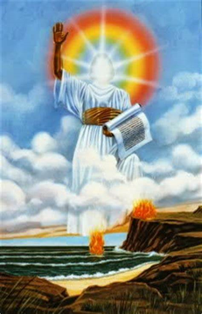
Revelation 10
Bitter-Sweet Inheritance
The Little Book and Seven Thunders
Revelation 10:2. And he had in his hand a little book open: and he set his right foot upon the sea, and his left foot on the earth,
This little book is different from the scroll held by the Lamb. The contents of this little book are consumable and digestible by John whereas it is almost certain that he could never have ingested the full contents of the seven-sealed scroll.
Whereas the Lamb’s book was originally sealed, this book is open.

Slide 8
Revelation 10
Bitter-Sweet Inheritance
The Little Book and Seven Thunders
Revelation 10:2. And he had in his hand a little book open: and he set his right foot upon the sea, and his left foot on the earth, (Cont’d)
When the mighty Lord reaches the earth, He stands astride the earth and the sea, thus demonstrating his authority and claiming ownership of both.
The sea is his, and he made it: and his hands formed the dry land. (Psalm 95:5)
He is also their Redeemer and their Inheritor (Col. 1:20).
We who are His by right of redemption are joint heirs with Him (Romans 8:17; Hebrews 9:15; 2 Timothy 2:12; Revelation 1:6; 2:27).
Notes:
Col. 1:20-And, having made peace through the blood of his cross, by him to reconcile all things unto himself; by him, I say, whether they be things in earth, or things in heaven.
Romans 8:17-And if children, then heirs; heirs of God, and joint-heirs with Christ; if so be that we suffer with him, that we may be also glorified together.
Hebrews 9:15-And for this cause he is the mediator of the new testament, that by means of death, for the redemption of the transgressions that were under the first testament, they which are called might receive the promise of eternal inheritance.
2 Timothy 2:12-If we suffer, we shall also reign with him: if we deny him, he also will deny us:
Revelation 1:6-And hath made us kings and priests unto God and his Father; to him be glory and dominion for ever and ever. Amen.
Revelation 2:27-And he shall rule them with a rod of iron; as the vessels of a potter shall they be broken to shivers: even as I received of my Father.

Slide 9
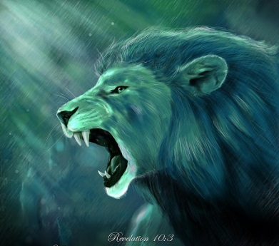
Revelation 10
Bitter-Sweet Inheritance
The Little Book and Seven Thunders
Revelation 10:3. And cried with a loud voice, as when a lion roareth: and when he had cried, seven thunders uttered their voices.
There is no record of what He cried with a loud voice, but the context would indicate that it was a mighty claim of ownership.
No recorded human response to His cry, and the dwellers on earth continue blindly in their rebellion.
The only response was a great sevenfold thundering from heaven.
It is probable that these seven thunderous voices which followed the great cry of the Lord as He stood on earth, were nothing less than seven pronouncements from the very throne of God.

Slide 10
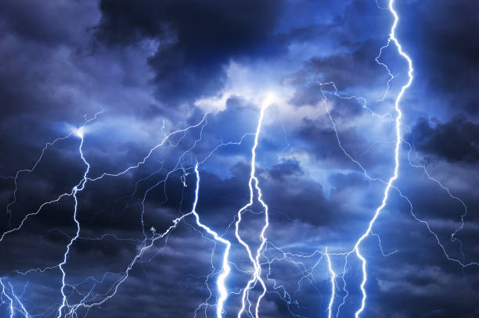
Revelation 10
Bitter-Sweet Inheritance
The Little Book & Seven Thunders
Revelation 10:3. And cried with a loud voice, as when a lion roareth: and when he had cried, seven thunders uttered their voices. (Cont’d)
The seven thunders clearly correspond to the sevenfold “voice of the Lord,” as recorded in Psalms 29.
Psalms 29 is a magnificent vision of the terrestrial and celestial phenomena which occurred at the great Flood.
There was mercy in that judgment and so will there be in this.
We are not told what the seven thunders uttered.
The very context demands that the message be one of great physical judgment.
There is a hint that the judgment to be delayed a while.

Slide 11
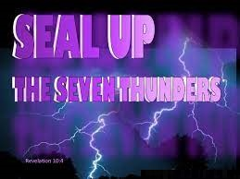
Revelation 10
Bitter-Sweet Inheritance
The Little Book and Seven Thunders
Revelation 10:4. And when the seven thunders had uttered their voices, I was about to write: and I heard a voice from heaven saying unto me, Seal up those things which the seven thunders uttered, and write them not.
Although John’s primary purpose in writing Revelation is to reveal, here he is commanded to omit the utterance of the seven thunders from the biblical record.
John, is allowed to hear what the thunders utter, even though told not to write it down for his readers.

Slide 12
Revelation 10
Bitter-Sweet Inheritance
The Little Book and Seven Thunders
Revelation 10:4. And when the seven thunders had uttered their voices, I was about to write: and I heard a voice from heaven saying unto me, Seal up those things which the seven thunders uttered, and write them not. (Cont’d)
What the seven thunders utter is apparently of great importance and divine privacy. This argues for identifying the thunders with the very voice of God Himself in that they evidently declare the mystery of God which must remain a mystery throughout the centuries from the day of John to the time of the end.
Each of the seven thunders uttered a unique message, although we cannot be dogmatic on this point. The seven thunders and their seven utterances are an indication of the completeness of judgment which attend their declaration.

Slide 13
Revelation 10
Bitter-Sweet Inheritance
The Little Book and Seven Thunders
Revelation 10:4. And when the seven thunders had uttered their voices, I was about to write: and I heard a voice from heaven saying unto me, Seal up those things which the seven thunders uttered, and write them not. (Cont’d)
Evidently, God wanted us to know not only that the seven thunders had spoken, but also that the fulfillment of their utterances had been delayed, just as they had at the great Flood (Genesis 7:4).
There is a very similar scene at the end of Daniel’s prophecy (Daniel 12:1-8).
Both Daniel and John seem to have heard terrible words of final judgment on the world of wicked men in the very last days. Both were told to seal up the words for a while. Still three-and-a-half years before final imposition.
Notes:
Genesis 7:4-For yet seven days, and I will cause it to rain upon the earth forty days and forty nights; and every living substance that I have made will I destroy from off the face of the earth.
Daniel 12:1-8-And at that time shall Michael stand up, the great prince which standeth for the children of thy people: and there shall be a time of trouble, such as never was since there was a nation even to that same time: and at that time thy people shall be delivered, every one that shall be found written in the book.
2And many of them that sleep in the dust of the earth shall awake, some to everlasting life, and some to shame and everlasting contempt.
3And they that be wise shall shine as the brightness of the firmament; and they that turn many to righteousness as the stars for ever and ever.
4But thou, O Daniel, shut up the words, and seal the book, even to the time of the end: many shall run to and fro, and knowledge shall be increased.
5Then I Daniel looked, and, behold, there stood other two, the one on this side of the bank of the river, and the other on that side of the bank of the river.
6And one said to the man clothed in linen, which was upon the waters of the river, How long shall it be to the end of these wonders?
7And I heard the man clothed in linen, which was upon the waters of the river, when he held up his right hand and his left hand unto heaven, and sware by him that liveth for ever that it shall be for a time, times, and an half; and when he shall have accomplished to scatter the power of the holy people, all these things shall be finished.
8And I heard, but I understood not: then said I, O my Lord, what shall be the end of these things?

Slide 14
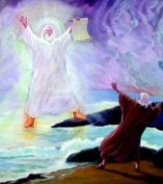
Revelation 10
Bitter-Sweet Inheritance
The Little Book and Seven Thunders
Revelation 10:5. And the angel which I saw stand upon the sea and upon the earth lifted up his hand to heaven.
Christ is still standing on the sea and land when he raises his hand to swear. Raising the hand was a common practice when taking an oath.
The verse indicate Christ raised his right hand, in which case the book would be held in his left hand.

Slide 15
Revelation 10
Bitter-Sweet Inheritance
The Little Book and Seven Thunders
Revelation 10:5. And the angel which I saw stand upon the sea and upon the earth lifted up his hand to heaven. (Cont’d)
God manifests Himself in varied ways, though always through His Son (John 1:18). To John, He has already been seen as the:
Glorified Son of man (Rev. 1:13)
The Creator on His throne (Rev. 4:2, 4:11)
The Lamb in the midst of the elders (Rev. 5:6)
The Angel with the prayers of all the saints (Rev. 8:3)
The seven thunders and the mighty angel of the rainbow crown.
Notes:
John 1:18-No man hath seen God at any time; the only begotten Son, which is in the bosom of the Father, he hath declared him.
Rev. 1:13-And in the midst of the seven candlesticks one like unto the Son of man, clothed with a garment down to the foot, and girt about the paps with a golden girdle.
Rev. 4:2-And immediately I was in the spirit: and, behold, a throne was set in heaven, and one sat on the throne.
Rev. 4:11-Thou art worthy, O Lord, to receive glory and honour and power: for thou hast created all things, and for thy pleasure they are and were created.
Rev. 5:6-And I beheld, and, lo, in the midst of the throne and of the four beasts, and in the midst of the elders, stood a Lamb as it had been slain, having seven horns and seven eyes, which are the seven Spirits of God sent forth into all the earth.
Rev. 8:3-And another angel came and stood at the altar, having a golden censer; and there was given unto him much incense, that he should offer it with the prayers of all saints upon the golden altar which was before the throne.

Slide 16
Revelation 10
Bitter-Sweet Inheritance
The Little Book and Seven Thunders
Revelation 10:5. And the angel which I saw stand upon the sea and upon the earth lifted up his hand to heaven. (Cont’d)
John has just heard Him as the thunders, and now again his attention is directed to Him as the angel astride the land and sea.
This act of lifting His hand identifies him yet more clearly with the angel, seen by Daniel (Daniel 12:7).
The identification is beyond doubt. But there is one great difference.
In Daniel’s case, he “saw this great vision” (Daniel 10:8), of God. John saw Him, however, not in a vision but in reality.
Notes:
Daniel 12:7-And I heard the man clothed in linen, which was upon the waters of the river, when he held up his right hand and his left hand unto heaven, and sware by him that liveth for ever that it shall be for a time, times, and an half; and when he shall have accomplished to scatter the power of the holy people, all these things shall be finished.
Daniel 10:8-Therefore I was left alone, and saw this great vision, and there remained no strength in me: for my comeliness was turned in me into corruption, and I retained no strength.

Slide 17
Revelation 10
Bitter-Sweet Inheritance
Time No Longer
Revelation 10:6. And sware by him that liveth for ever and ever, who created heaven, and the things that therein are, and the earth, and the things that therein are, and the sea, and the things which are therein, that there should be time no longer:
The one who “liveth for ever and ever” is the Creator. There can be none greater. “Because He could swear by no greater, he sware by himself” (Hebrews 6:13).
Emphasis is placed upon the identity of God as Creator, for the declaration in this chapter is intimately connected with God repossessing the title to the earth (both land and sea, indeed the entire creation), which has been marred by the interposition of sin and Satan.

Slide 18
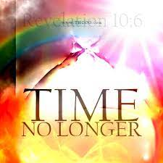
Revelation 10
Bitter-Sweet Inheritance
Time No Longer
Revelation 10:6. And sware by him that liveth for ever and ever, who created heaven, and the things that therein are, and the earth, and the things that therein are, and the sea, and the things which are therein, that there should be time no longer: (Cont’d)
Although the final judgment has been deferred for yet a time and times and half a time(3 1/2 years), there will be no delay beyond that.
Habakkuk set forth the principle of the patience that is needed in regard to prophetic pronouncements of God: “For the vision is yet for an appointed time, but at the end it shall speak, and not lie: though it tarry, wait for it; because it will surely come, it will not tarry.” (Hab. 2:3).

Slide 19

Revelation 10
Bitter-Sweet Inheritance
Time No Longer
Revelation 10:6. And sware by him that liveth for ever and ever, who created heaven, and the things that therein are, and the earth, and the things that therein are, and the sea, and the things which are therein, that there should be time no longer: (Cont’d)
God indeed is long-suffering (2 Peter 3:9). But those who have persisted in hardening their hearts throughout the successive waves of chastisement for three and a half years are surely beyond hope.
Nevertheless, our “God of all grace” (1 Peter 5:10) will endure such vessels of wrath yet another three and a half years, then comes the end.
Notes:
2 Peter 3:9-The Lord is not slack concerning his promise, as some men count slackness; but is longsuffering to us-ward, not willing that any should perish, but that all should come to repentance.
1 Peter 5:10-But the God of all grace, who hath called us unto his eternal glory by Christ Jesus, after that ye have suffered a while, make you perfect, stablish, strengthen, settle you.

Slide 20
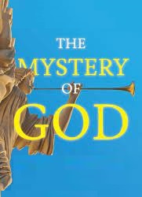
Revelation 10
Bitter-Sweet Inheritance
Time No Longer
Revelation 10:7. But in the days of the voice of the seventh angel, when he shall begin to sound, the mystery of God should be finished, as he hath declared to his servants the prophets.
This refers to the time period during which the seventh angel sounds and the final seven bowl judgments pour forth.
The seventh angel is not yet quite ready, however. The second “woe” has not yet quite run its course (Revelation 11:14) and only then will the seventh angel sound his trumpet (Revelation 11:15).
But what is this “mystery of God?” Although there are a number of mysteries referred to in the New Testament, the context here seems strongly to indicate that this mystery of God refers to the whole purpose and plan of God.
Notes:
Revelation 11:14-The second woe is past; and, behold, the third woe cometh quickly.
Revelation 11:15-And the seventh angel sounded; and there were great voices in heaven, saying, The kingdoms of this world are become the kingdoms of our Lord, and of his Christ; and he shall reign for ever and ever.

Slide 21

Revelation 10
Bitter-Sweet Inheritance
Time No Longer
Revelation 10:7. But in the days of the voice of the seventh angel, when he shall begin to sound, the mystery of God should be finished, as he hath declared to his servants the prophets. (Cont’d)
Why has a holy God allowed evil to thrive for so long?
Why do the righteous suffer?
What is God’s ultimate purpose for Israel, for the Gentiles, for the Church?
All such mysteries of God’s dealing with men will finally be resolved and understood during these days of the sounding of the final trumpet and the final (seventh) bowl was poured forth, “a loud voice came out of the temple in heaven, from the throne, saying, ‘It is done!’ (Rev. 16:17)

Slide 22
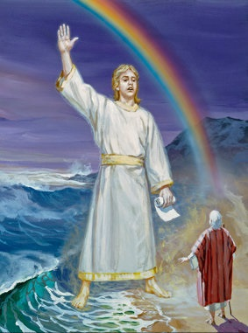
Revelation 10
Bitter-Sweet Inheritance
The End Not Yet
Revelation 10:8. And the voice which I heard from heaven spake unto me again, and said, Go and take the little book which is open in the hand of the angel which standeth upon the sea and upon the earth.
The same voice which instructed John not to write what the seven thunders uttered (Rev. 10:4). The divine authority of this voice is seen in its command which countermanded God’s earlier instructions that John was to record what he saw. Here, the divine authority is seen again in that John boldly approaches a mighty angel and tells him to turn over the book.

Slide 23

Revelation 10
Bitter-Sweet Inheritance
The End Not Yet
Revelation 10:8. And the voice which I heard from heaven spake unto me again, and said, Go and take the little book which is open in the hand of the angel which standeth upon the sea and upon the earth. (Cont’d)
Those who are redeemed must still wait to receive their own inheritance, even as the Lord Jesus Christ still defers to take full possession of His. They can share to a degree in its privileges and responsibilities even while waiting, however, and this seems to be the theme of the next scene.

Slide 24
Revelation 10
Bitter-Sweet Inheritance
The End Not Yet
Revelation 10:8. And the voice which I heard from heaven spake unto me again, and said, Go and take the little book which is open in the hand of the angel which standeth upon the sea and upon the earth. (Cont’d)
The “booklet,” as noted above, seems most likely to represent the particular lot of Christ’s inheritance which is to be awarded to John and, in principle, representing also the appropriate share for each believer.
The Book of Daniel closes with exactly such a promise.
And he said, Go thy way, Daniel: for the words are closed up and sealed till the time of the end. (Daniel 12:9)
But go thou thy way till the end be: for thou shalt rest, and stand in thy lot at the end of the days. (Daniel 12:13)

Slide 25
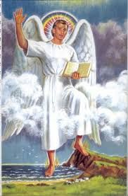
Revelation 10
Bitter-Sweet Inheritance
The End Not Yet
Revelation 10:9. And I went unto the angel, and said unto him, Give me the little book. And he said unto me, Take it, and eat it up; and it shall make thy belly bitter, but it shall be in thy mouth sweet as honey.
John immediately approached the angel to request the book. Note: Believers will all have glorified bodies like that of Christ (Philippians 3:20-21), and thus will be able to move rapidly across space in whatever direction desired. The resurrection body of Christ, although real and physical, was not constrained by present physical force systems - gravitational forces, electromagnetic forces and nuclear forces so ours will not either.
Notes:
Philippians 3:20-21-For our conversation is in heaven; from whence also we look for the Saviour, the Lord Jesus Christ:
21Who shall change our vile body, that it may be fashioned like unto his glorious body, according to the working whereby he is able even to subdue all things unto himself.

Slide 26
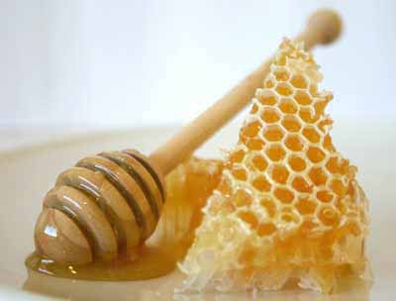
Revelation 10
Bitter-Sweet Inheritance
The End Not Yet
Revelation 10:9. And I went unto the angel, and said unto him, Give me the little book. And he said unto me, Take it, and eat it up; and it shall make thy belly bitter, but it shall be in thy mouth sweet as honey. (Cont’d)
The angel, will immediately gives it to John. However, being a joint-heir with Christ involves sober and bitter responsibilities, as well as great blessings.
This is the very essence of the Word of God. For those who follow it, it is the Word of Life. For those who reject it, it is the Word of Death.
He is instructed by the angel to eat the book (this is something familiar to the experience of other prophets before him). (Psalms 19:10; 119:103; Jeremiah 15:16; Ezekiel 2:8-3:4).
Notes:
Psalms 19:10-More to be desired are they than gold, yea, than much fine gold: sweeter also than honey and the honeycomb.
Psalms 119:103-How sweet are thy words unto my taste! yea, sweeter than honey to my mouth!
Jeremiah 15:16-Thy words were found, and I did eat them; and thy word was unto me the joy and rejoicing of mine heart: for I am called by thy name, O LORD God of hosts.
Ezekiel 2:8-10-But thou, son of man, hear what I say unto thee; Be not thou rebellious like that rebellious house: open thy mouth, and eat that I give thee.
9And when I looked, behold, an hand was sent unto me; and, lo, a roll of a book was therein;
10And he spread it before me; and it was written within and without: and there was written therein lamentations, and mourning, and woe.
1Moreover he said unto me, Son of man, eat that thou findest; eat this roll, and go speak unto the house of Israel.
2So I opened my mouth, and he caused me to eat that roll.
3And he said unto me, Son of man, cause thy belly to eat, and fill thy bowels with this roll that I give thee. Then did I eat it; and it was in my mouth as honey for sweetness.
4And he said unto me, Son of man, go, get thee unto the house of Israel, and speak with my words unto them.

Slide 27

Revelation 10
Bitter-Sweet Inheritance
The End Not Yet
Revelation 10:9. And I went unto the angel, and said unto him, Give me the little book. And he said unto me, Take it, and eat it up; and it shall make thy belly bitter, but it shall be in thy mouth sweet as honey. (Cont’d)
John represents the raptured saints in heaven and the little book he eats represents his own inheritance and likewise the inheritance each of us will receive.
As a glorified joint-heir with Christ (Romans 8:17), he must also “suffer with him,” even in the responsibilities of the inheritance. Joint-heirship with Christ involves not only reigning with him but also judging with Him (Zechariah 14:5; 1 Thessalonians 3:13; Jude 14; Revelation 19:14; 1 Corinthians 6:2; Psalms 149:6-9).
Notes:
Romans 8:17-And if children, then heirs; heirs of God, and joint-heirs with Christ; if so be that we suffer with him, that we may be also glorified together.
Zechariah 14:5-And ye shall flee to the valley of the mountains; for the valley of the mountains shall reach unto Azal: yea, ye shall flee, like as ye fled from before the earthquake in the days of Uzziah king of Judah: and the LORD my God shall come, and all the saints with thee.
1 Thessalonians 3:13-To the end he may stablish your hearts unblameable in holiness before God, even our Father, at the coming of our Lord Jesus Christ with all his saints.
Jude 1:14-And Enoch also, the seventh from Adam, prophesied of these, saying, Behold, the Lord cometh with ten thousands of his saints,
Revelation 19:14-And the armies which were in heaven followed him upon white horses, clothed in fine linen, white and clean.
1 Corinthians 6:2-Do ye not know that the saints shall judge the world? and if the world shall be judged by you, are ye unworthy to judge the smallest matters?
Psalms 149:6-9-Let the high praises of God be in their mouth, and a twoedged sword in their hand;
7To execute vengeance upon the heathen, and punishments upon the people;
8To bind their kings with chains, and their nobles with fetters of iron;
9To execute upon them the judgment written: this honour have all his saints. Praise ye the LORD.

Slide 28
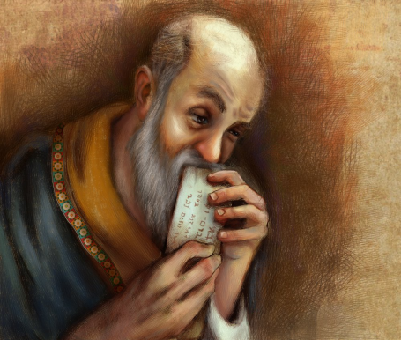
Revelation 10
Bitter-Sweet Inheritance
The End Not Yet
Revelation 10:10. And I took the little book out of the angel’s hand, and ate it up; and it was in my mouth sweet as honey: and as soon as I had eaten it, my belly was bitter.
John totally consumed or devoured the little book.
This symbolic act of eating the little book was given to stress the true bitter-sweet nature of the great honor of sharing in His inheritance.
Note that the little book turned bitter as soon as it was eaten. This indicates further that both the sweet and the bitter aspects of the joint-inheritance were to begin immediately.
The first half of the tribulation period will be a time of observation and preparation. The second half will require full participation.

Slide 29
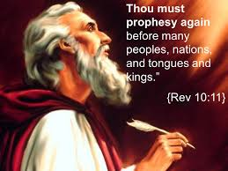
Revelation 10
Bitter-Sweet Inheritance
The End Not Yet
Revelation 10:11. And he said unto me, Thou must prophesy again before many peoples, and nations, and tongues, and kings.
This is a call for John to warn mankind about the bitter judgment in the seventh trumpet and the 7 bowls.
The fourfold designation: peoples, nations, tongues, kings, indicates the global scope of the message John is to prophesize.
Notes:
Revelation 1:11-Saying, I am Alpha and Omega, the first and the last: and, What thou seest, write in a book, and send it unto the seven churches which are in Asia; unto Ephesus, and unto Smyrna, and unto Pergamos, and unto Thyatira, and unto Sardis, and unto Philadelphia, and unto Laodicea.

Slide 30
Revelation 10
Bitter-Sweet Inheritance
The End Not Yet
Revelation 10:11. And he said unto me, Thou must prophesy again before many peoples, and nations, and tongues, and kings. (Cont’d)
But the task was only half finished. He must not only participate in the bitter judgments yet to come, but write about them as well.
Furthermore, “thou must prophesy again” mean to continue what he was then doing, and in the same way. Being an active evangelist in many countries, among many peoples and tongues.
This is not the Great Commission given to all?
Notes:
Revelation 1:11-Saying, I am Alpha and Omega, the first and the last: and, What thou seest, write in a book, and send it unto the seven churches which are in Asia; unto Ephesus, and unto Smyrna, and unto Pergamos, and unto Thyatira, and unto Sardis, and unto Philadelphia, and unto Laodicea.

Slide 31
THIS CONCLUDES REVELATION 10

