Slide 1
EPHESIANS
CHAPTER 6
1/17/2023
1

Slide 2
SUMMARY
The final chapter begins with what might be called an exhortation to "walk in familial harmony." Children, fathers, servants and their masters are all instructed concerning their Christian walk. The last major section of this epistle is a call to "walk in victory", with a charge to stand strong in the power of the Lord's might against the wiles of the devil and spiritual hosts of wickedness. Christians also need to adorn themselves with the whole armor of God. This armor includes the elements of truth, righteousness, the gospel, faith, salvation, and the Word of God.
1/17/2023
2

Slide 3
EPHESIANS 6:1-3 A CALL TO WALK IN FAMILIAL HARMONY-DUTIES OF CHILDREN
6.1 Children, obey your parents in the Lord: for this is right.
Continuing the discussion of submission and service to one another from the previous chapter, Paul now addresses the child/parent relationship. For obvious reasons the instruction given is simple enough even a young child can understand its meaning and application. Children are to obey their parents. The phrase “in the Lord” qualifies the command and simply means because God
1/17/2023
3

Slide 4

EPHESIANS 6:1-3 A CALL TO WALK IN FAMILIAL HARMONY-DUTIES OF CHILDREN (Cond’t)
said so.
1/17/2023
4

Slide 5
EPHESIANS 6:1-3 A CALL TO WALK IN FAMILIAL HARMONY-DUTIES OF CHILDREN (Cond’t)
6.2 Honour thy father and mother; (which is the first commandment with promise;)
The command to obey parents is the fifth of the ten commandments and is found in Exodus 20:12. To "honor" our parents means to treat them as valuable, priceless, and precious. Regard their companionship and counsel as worthwhile. The parenthetical phrase “which is the first commandment with promise” is a comment by Paul and not part of the text of Exodus 20:12. Paul’s view
1/17/2023
5

Slide 6
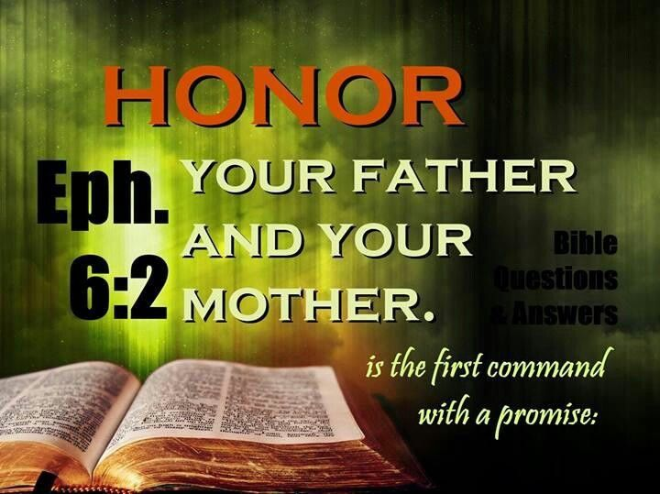
EPHESIANS 6:1-3 A CALL TO WALK IN FAMILIAL HARMONY-DUTIES OF CHILDREN (Cond’t)
suggests this is the first command we as children are asked to obey.
1/17/2023
6

Slide 7
EPHESIANS 6:1-3 A CALL TO WALK IN FAMILIAL HARMONY-DUTIES OF CHILDREN (Cond’t)
6.3 That it may be well with thee, and thou mayest live long on the earth.
The phase “That it may be well with thee” is found in the fifth commandment as recorded in Deuteronomy 5:16. The meaning is they will be more happy, useful, and virtuous if they obey their parents than if they disobey them. Those who are obedient to parents will enjoy longer days on earth. Long life was regarded as a great blessing; and this blessing was promised.
1/17/2023
7

Slide 8
EPHESIANS 6:4 A CALL TO WALK IN FAMILIAL HARMONY-DUTIES OF FATHERS
6.4 And, ye fathers, provoke not your children to wrath: but bring them up in the nurture and admonition of the Lord.
This verse is directed specifically to fathers. Fathers are commanded not to agitate or irritate their children. In practice, this means avoiding unfair and cruel behavior. Godly fathers are not to push their children toward anger. They are given a positive command to "bring them up in the nuture and admonition of the Lord." Christians are expected to be
1/17/2023
8

Slide 9
EPHESIANS 6:4 A CALL TO WALK IN FAMILIAL HARMONY-DUTIES OF FATHERS (Cond’t)
highly involved in raising their children. First, Paul includes nurture or discipline. Discipline involves learning self–control and the ability to restrain from personal desires in order to do what is right. Second, Paul adds admonition or instruction of the Lord. We should be involved in teaching our children about God's ways through both education and example.
1/17/2023
9

Slide 10
EPHESIANS 6:5-8 A CALL TO WALK IN FAMILIAL HARMONY-DUTIES OF SERVANTS
6.5 Servants, be obedient to them that are your masters according to the flesh, with fear and trembling, in singleness of your heart, as unto Christ;
Paul notes the importance of obedience to one's master: Three specific aspects are noted. First, Paul mentions "fear and trembling." The terms do not imply terror or living in dread. Rather, this carries the idea of respect and reverence. Second, Paul adds that service should be done with singleness or
1/17/2023
10

Slide 11

EPHESIANS 6:5-8 A CALL TO WALK IN FAMILIAL HARMONY-DUTIES OF SERVANTS (Cond’t)
sincere heart. A servant should not attempt to deceive a master, but rather genuinely work hard to do his or her best. Third, Paul sets the highest standard possible in stating that a servant's obedience should be as serving Christ.
1/17/2023
11

Slide 12
EPHESIANS 6:5-8 A CALL TO WALK IN FAMILIAL HARMONY-DUTIES OF SERVANTS (Cond’t)
6.6 Not with eyeservice, as menpleasers; but as the servants of Christ, doing the will of God from the heart;
Here Paul addresses the problem of doing things only for the sake of gaining other's approval. He calls this type of behavior as being a "people-pleaser.“ It is not the service that is wrong, but the attitude that is wrong. God's servants are to serve "doing the will of God from the heart."
1/17/2023
12

Slide 13
EPHESIANS 6:5-8 A CALL TO WALK IN FAMILIAL HARMONY-DUTIES OF SERVANTS (Cond’t)
6.7 With good will doing service, as to the Lord, and not to men:
Here, the emphasis is on a person's attitude. The Christian servant must work with a godly attitude regardless of circumstances. A godly attitude is much easier when a servant views his or her work as "to the Lord." We are to do all things for the glory of God (Colossians 3:17).
1/17/2023
13
Notes:
Colossians 3:17-And whatsoever ye do in word or deed, do all in the name of the Lord Jesus, giving thanks to God and the Father by him.

Slide 14
EPHESIANS 6:5-8 A CALL TO WALK IN FAMILIAL HARMONY-DUTIES OF SERVANTS (Cond’t)
6.8 Knowing that whatsoever good thing any man doeth, the same shall he receive of the Lord, whether he be bond or free.
Whenever a Christian serves with good actions, from a good heart, “the same shall he receive of the Lord”. In other words those who bless others will be blessed by the Lord. Godly work habits honor the Lord, show a positive example and open opportunities to share Christ with unbelievers.
1/17/2023
14

Slide 15
EPHESIANS 6:9 A CALL TO WALK IN FAMILIAL HARMONY-DUTIES OF MASTERS
6.9 And, ye masters, do the same things unto them, forbearing threatening: knowing that your Master also is in heaven; neither is there respect of persons with him.
In this verse, the masters of servants are addressed. They too are to serve with good actions, from a good heart. Masters may be in charge, but they are also to lead others according to God's ways. Paul commands them to stop threatening their slaves. Masters should be cautious in treating
1/17/2023
15

Slide 16
EPHESIANS 6:9 A CALL TO WALK IN FAMILIAL HARMONY-DUTIES OF MASTERS (Cond’t)
those over whom they have power. Masters were (and are) accountable to God for their actions toward those they lead. Paul then reminds masters there is no partiality with God. He will not show favor to those with more money or influence. God judges perfectly and righteously.
1/17/2023
16

Slide 17
EPHESIANS 6:10-13 A CALL TO WALK IN VICTORY-STAND STRONG IN THE POWER OF THE LORD
6.10 Finally, my brethren, be strong in the Lord, and in the power of his might.
Paul wraps up his practical teachings with a series of analogies, comparing aspects of the Christian faith to the equipment carried by a soldier. Paul offers an outline of each part of the metaphorical armor of God. Each piece connects to an area of spiritual life important for reliance upon God's strength. Only by relying on God, through these spiritual tools, can we overcome spiritual evil and succeed
1/17/2023
17

Slide 18
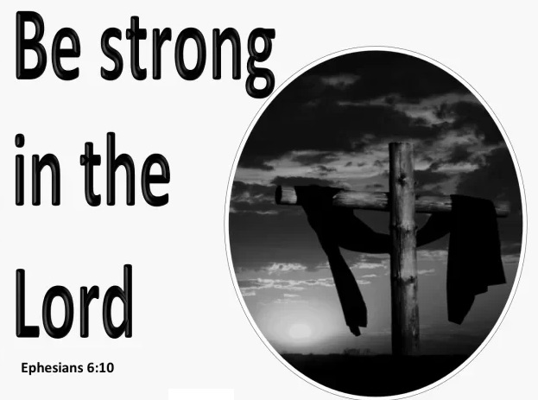
EPHESIANS 6:10-13 A CALL TO WALK IN VICTORY-STAND STRONG IN THE POWER OF THE LORD (Cond’t)
at living in God's will.
1/17/2023
18

Slide 19
EPHESIANS 6:10-13 A CALL TO WALK IN VICTORY-STAND STRONG IN THE POWER OF THE LORD (Cond’t)
6.11 Put on the whole armour of God, that ye may be able to stand against the wiles of the devil.
Paul introduces the armor of God, beginning with two important qualifiers. His admonition to "put on" these pieces is also instructive: Christians have to be deliberate about using these implements. First, believers must plan to utilize all tools available to them. Only with every piece of the armor of God can a believer adequately stand against the
1/17/2023
19

Slide 20
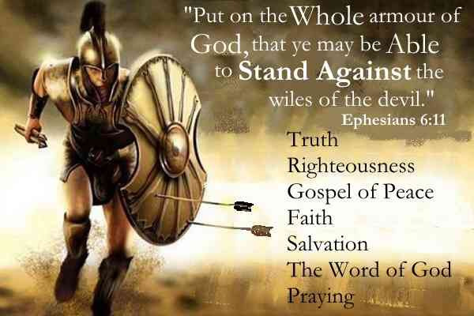
EPHESIANS 6:10-13 A CALL TO WALK IN VICTORY-STAND STRONG IN THE POWER OF THE LORD (Cond’t)
schemes of the Devil. Second, Paul calls the Devil's work against believers “wiles." This indicates a coordinated plan. Paul is not talking about physical violence, but rather a spiritual battle.
1/17/2023
20

Slide 21
EPHESIANS 6:10-13 A CALL TO WALK IN VICTORY-STAND STRONG IN THE POWER OF THE LORD (Cond’t)
6.12 For we wrestle not against flesh and blood, but against principalities, against powers, against the rulers of the darkness of this world, against spiritual wickedness in high places.
This verse describes the spiritual battle that exists in the lives of believers. First, Paul affirms our battle is indeed spiritual, not physical. The enemies we face, ultimately, are not people or objects. The devil may use those as part of his attack, but our true opponent
1/17/2023
21

Slide 22
EPHESIANS 6:10-13 A CALL TO WALK IN VICTORY-STAND STRONG IN THE POWER OF THE LORD (Cond’t)
is not other people: IT IS SIN. Second, Paul identifies our spiritual enemies. This list is commonly interpreted as a vague listing of the ranks within the demonic armies. “Powers” seem to indicate a top level of evil spiritual forces. “Rulers of Darkness” refer to general forces of evil attacking believers. “Principalities" seems to refer to the worldwide nature of this spiritual battle. “Spiritual wickedness in high places" again emphasizes a battle beyond this world.
1/17/2023
22

Slide 23

EPHESIANS 6:10-13 A CALL TO WALK IN VICTORY-STAND STRONG IN THE POWER OF THE LORD (Cond’t)
6.13 Wherefore take unto you the whole armour of God, that ye may be able to withstand in the evil day, and having done all, to stand.
Every piece of God's armor is important. Those believers who put on the full armor of God are promised being able to stand firm against the "evil day" of spiritual attack.
1/17/2023
23

Slide 24
EPHESIANS 6:14-20 A CALL TO WALK IN VICTORY-EQUIPPED WITH THE WHOLE ARMOR OF GOD
6.14 Stand therefore, having your loins girt about with truth, and having on the breastplate of righteousness;
Paul's analogy compares aspects of the Christian faith to the equipment carried by a Roman soldier. Paul mentions the "belt of truth." In ancient time, a belt was tied around the waist rather than buckled. It was thick and sturdy. The rest of a soldier's armor connected to this belt. For the Christian, truth is to be securely connected to us, for our
1/17/2023
24

Slide 25
EPHESIANS 6:14-20 A CALL TO WALK IN VICTORY-EQUIPPED WITH THE WHOLE ARMOR OF GOD (Cond’t)
success. Truth "binds together" everything else we believe and without truth, we just have disjointed, disconnected pieces. Next is the "breastplate of righteousness." The belt would hold the breastplate in place, as well as the scabbard to hold the sword. A Roman's breastplate would typically be made from bronze and would cover the vital body parts (heart, lungs, stomach). Righteousness, or doing what is right, is essential to protecting the life of the believer through spiritual battle.
1/17/2023
25

Slide 26

EPHESIANS 6:14-20 A CALL TO WALK IN VICTORY-EQUIPPED WITH THE WHOLE ARMOR OF GOD (Cond’t)
Also, the breastplate is a primary means of identification, a way for soldiers to recognize each other in battle. Likewise, a Christian's behavior is meant to identify them to the world, and other believers, as a follower of Christ.
1/17/2023
26

Slide 27
EPHESIANS 6:14-20 A CALL TO WALK IN VICTORY-EQUIPPED WITH THE WHOLE ARMOR OF GOD (Cond’t)
6.15 And your feet shod with the preparation of the gospel of peace;
Roman soldiers typically wore sandals which made them ready to run into battle and the ability to go almost anywhere. Shoes also provide traction. The gospel anchors our faith in certain basic, universal truths. Without that, we'd find our foundation slipping. One of the world's most common problems is stress. Yet the peace given through the gospel is the answer to most of our daily
1/17/2023
27

Slide 28
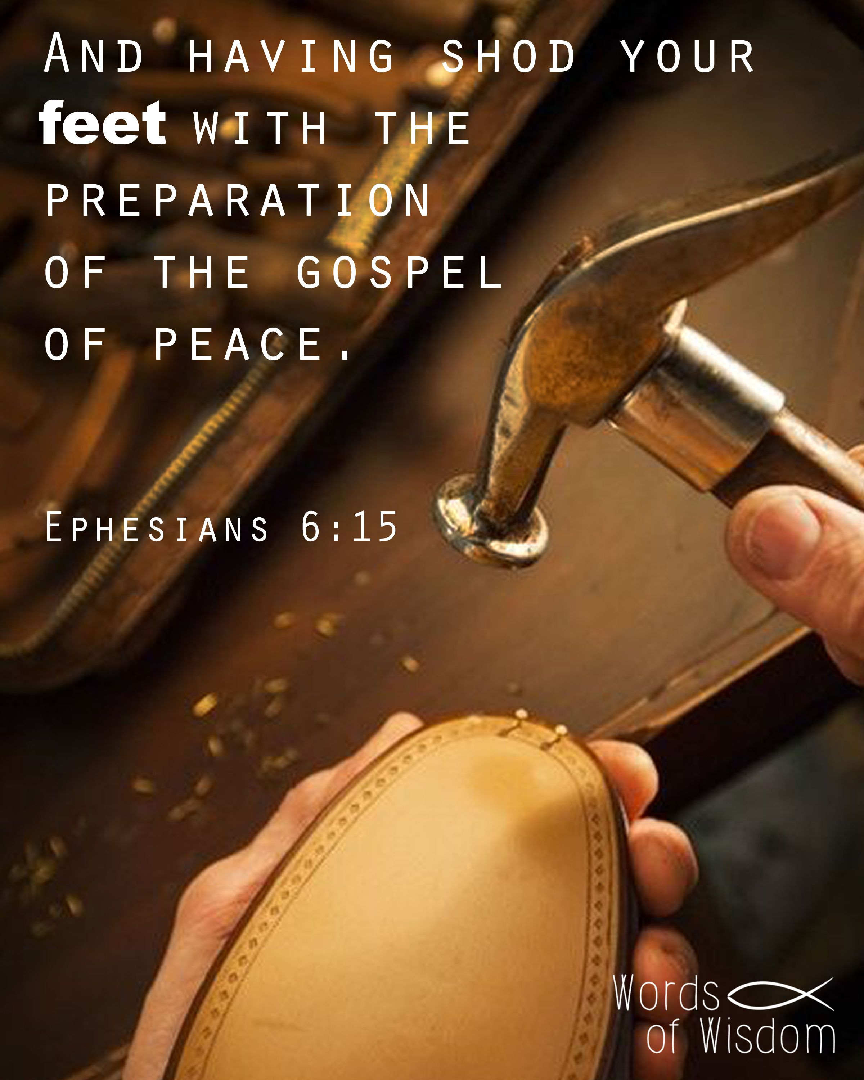
EPHESIANS 6:14-20 A CALL TO WALK IN VICTORY-EQUIPPED WITH THE WHOLE ARMOR OF GOD (Cond’t)
anxiety. We can cast our cares on God because He cares for us (1 Peter 5:7). Further, connecting the concept of "shoes" with the gospel of peace also suggest the idea of believers taking the gospel into daily battles, sharing it wherever they go (Matthew 28:18–20).
1/17/2023
28
Notes:
1 Peter 5:7-Casting all your care upon him; for he careth for you.
Matthew 28:18–20-And Jesus came and spake unto them, saying, All power is given unto me in heaven and in earth.
19Go ye therefore, and teach all nations, baptizing them in the name of the Father, and of the Son, and of the Holy Ghost:
20Teaching them to observe all things whatsoever I have commanded you: and, lo, I am with you alway, even unto the end of the world. Amen.

Slide 29
EPHESIANS 6:14-20 A CALL TO WALK IN VICTORY-EQUIPPED WITH THE WHOLE ARMOR OF GOD (Cond’t)
6.16 Above all, taking the shield of faith, wherewith ye shall be able to quench all the fiery darts of the wicked.
The beauty of a Roman shield was its ability to resist nearly any type of attack. In this context, Paul notes that the shield of faith "can quench all the fiery darts of the wicked." Faith of believers is what deflects the attacks of the wicked. Note, the shield is also the only defensive piece of armor which can also protect other people.
1/17/2023
29

Slide 30
EPHESIANS 6:14-20 A CALL TO WALK IN VICTORY-EQUIPPED WITH THE WHOLE ARMOR OF GOD (Cond’t)
6.17 And take the helmet of salvation, and the sword of the Spirit, which is the word of God:
The helmet does more to put a soldier at ease than almost any other piece of armor. Paul associates the helmet in the armor of God with salvation. Salvation is ultimately the best protection against Satan, since nothing, even Satan, can separate us from the love of God in Christ (Romans 8:37–39). In addition, Paul mentions "the sword of the Spirit, which is
1/17/2023
30
Notes:
Romans 8:37–39-Nay, in all these things we are more than conquerors through him that loved us.
38For I am persuaded, that neither death, nor life, nor angels, nor principalities, nor powers, nor things present, nor things to come,
39Nor height, nor depth, nor any other creature, shall be able to separate us from the love of God, which is in Christ Jesus our Lord.

Slide 31

EPHESIANS 6:14-20 A CALL TO WALK IN VICTORY-EQUIPPED WITH THE WHOLE ARMOR OF GOD (Cond’t)
the word of God." This is the first offensive weapon mentioned. The sword was used to kill and defeat enemies during attack. In the same way, God's Word helps to defeat our enemies during spiritual attacks.
1/17/2023
31
Notes:
Romans 8:37–39-

Slide 32
EPHESIANS 6:14-20 A CALL TO WALK IN VICTORY-EQUIPPED WITH THE WHOLE ARMOR OF GOD (Cond’t)
6.18 Praying always with all prayer and supplication in the Spirit, and watching thereunto with all perseverance and supplication for all saints;
After describing the pieces of the armor of God, Paul adds another important part of spiritual battle: PRAYER. Prayer is essential to winning spiritual battles. Why? Prayer connects us to the power of God, which is necessary to defeat spiritual enemies.
1/17/2023
32

Slide 33
EPHESIANS 6:14-20 A CALL TO WALK IN VICTORY-EQUIPPED WITH THE WHOLE ARMOR OF GOD (Cond’t)
Paul then notes some specific applications of prayer in this verse and the next. First, believers are to pray "in the Spirit." Our prayers are not merely our thoughts or about our desires, but are to be done in submission to God. Second, we are to keep alert (watching). There is never a good time to set prayer aside. It's a tool we need to have in constant use (1 Thessalonians 5:17). Third, prayer is something to do "with all perseverance." We do not pray once each day
1/17/2023
33
Notes:
1 Thessalonians 5:17-Pray without ceasing.

Slide 34

EPHESIANS 6:14-20 A CALL TO WALK IN VICTORY-EQUIPPED WITH THE WHOLE ARMOR OF GOD (Cond’t)
and then stop. We are to talk with God persistently and about all matters. Nothing is too big or too small to discuss with the Lord. Finally, Paul highlights the importance of praying for the “supplication for all saints.” We should pray for our own needs, but also the needs of others.
1/17/2023
34
Notes:
1 Thessalonians 5:17-

Slide 35
EPHESIANS 6:14-20 A CALL TO WALK IN VICTORY-EQUIPPED WITH THE WHOLE ARMOR OF GOD (Cond’t)
6.19 And for me, that utterance may be given unto me, that I may open my mouth boldly, to make known the mystery of the gospel,
Paul adds a request for personal prayer. As Paul prepares to end his letter, he takes time to request prayer for his life and work in Rome. The first area of prayer he mentions is for boldness. His goal was not personal comfort, but effective ability to evangelize those around him. Notice also that his prayer to share the gospel included a request for the
1/17/2023
35

Slide 36
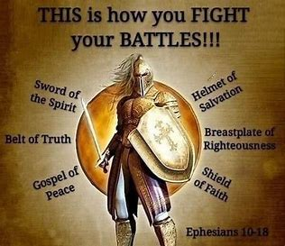
EPHESIANS 6:14-20 A CALL TO WALK IN VICTORY-EQUIPPED WITH THE WHOLE ARMOR OF GOD (Cond’t)
right words to share. Without the truths of the word, there is no gospel.
1/17/2023
36

Slide 37
EPHESIANS 6:14-20 A CALL TO WALK IN VICTORY-EQUIPPED WITH THE WHOLE ARMOR OF GOD (Cond’t)
6.20 For which I am an ambassador in bonds: that therein I may speak boldly, as I ought to speak.
Paul considered himself an ambassador from and for Christ. He represented Him, he was sent by Him, and entrusted by Him with the Gospel. The apostle beseeches the saints to pray for him; since he was an ambassador in bonds, that he might speak boldly and freely and that he might use boldness in delivering his message of Jesus Christ.
1/17/2023
37

Slide 38
EPHESIANS 6:21-24 A CALL TO WALK IN VICTORY-CONCLUSION
6.21 But that ye also may know my affairs, and how I do, Tychicus, a beloved brother and faithful minister in the Lord, shall make known to you all things:
"But that ye also may know my affairs, and how I do"- Paul desired that both his worldly and spiritual affairs be made known to the readers of his letter. He did this by sending accounts by way of Tychicus. Tychicus was of Asia, who accompanied the apostle in his travels, and went with him to Rome. He was sent to several places to relate news
1/17/2023
38

Slide 39
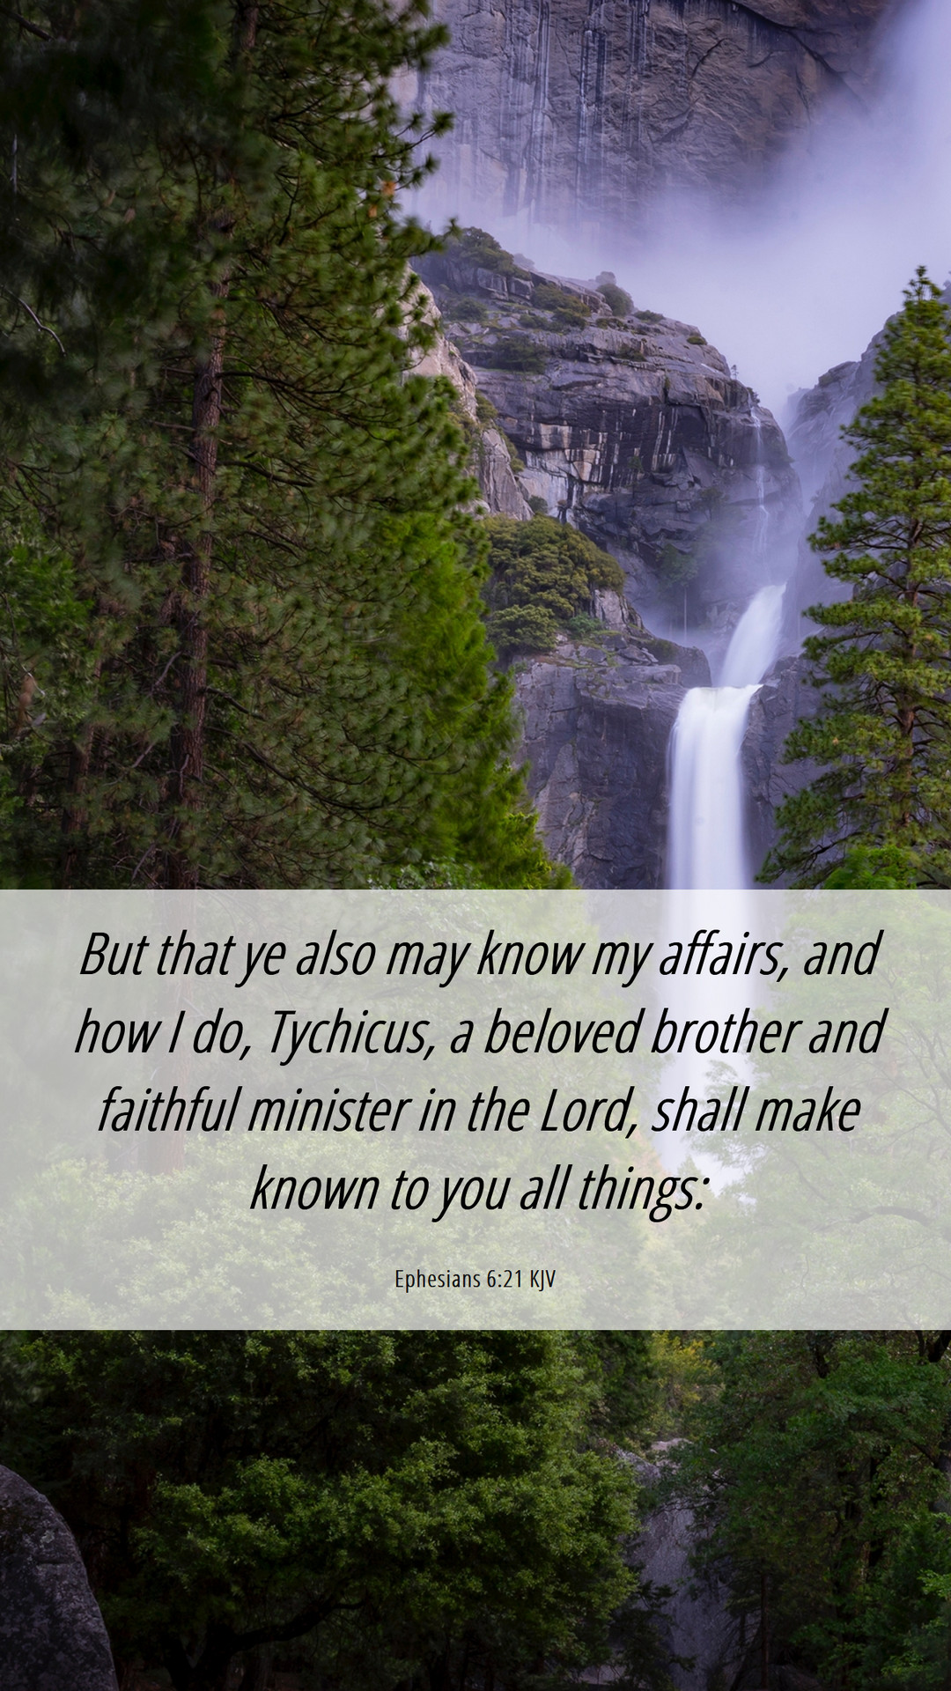
EPHESIANS 6:21-24 A CALL TO WALK IN VICTORY-CONCLUSION (Cond’t)
concerning Paul and to know the state of the churches. Paul calls him "a beloved brother“ and a "faithful minister in the Lord“. There was no doubt he would faithfully relate all things concerning the apostle, and what he said would be true.
1/17/2023
39

Slide 40
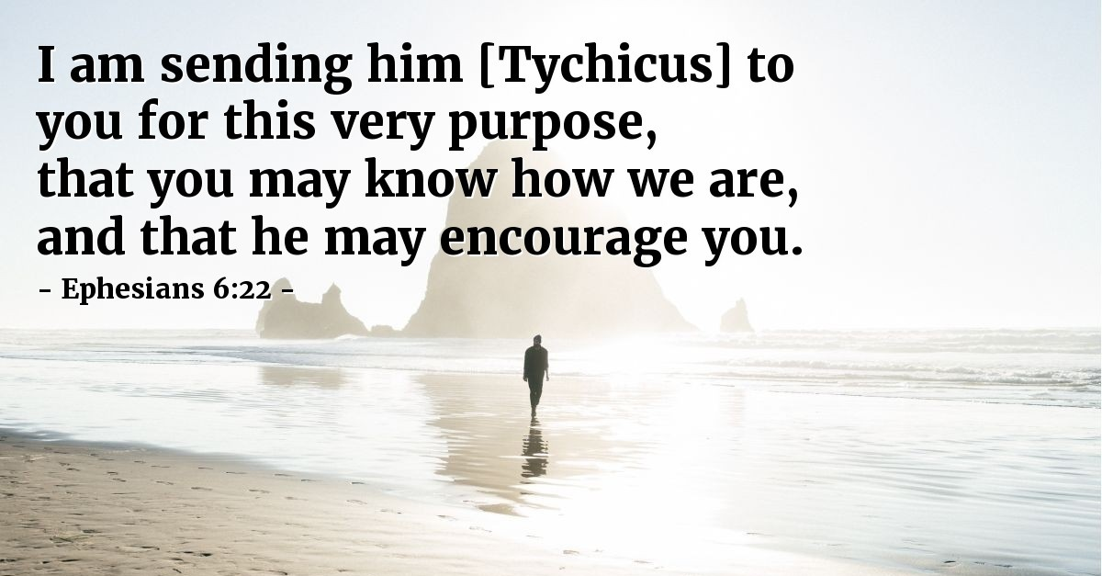
EPHESIANS 6:21-24 A CALL TO WALK IN VICTORY-CONCLUSION (Cond’t)
6.22 Whom I have sent unto you for the same purpose, that ye might know our affairs, and that he might comfort your hearts.
Tychicus was sent to Ephesus that the people would know how they were and to encourage their hearts. Paul wanted him to build up the Ephesian believers with encouraging stories and teachings.
1/17/2023
40

Slide 41
EPHESIANS 6:21-24 A CALL TO WALK IN VICTORY-CONCLUSION (Cond’t)
6.23 Peace be to the brethren, and love with faith, from God the Father and the Lord Jesus Christ.
Paul offers his concluding words in verses 23 and 24 with another mention of peace. In addition to peace, Paul offered "love with faith." These traits are acknowledged as "from God the Father and the Lord Jesus Christ." Paul opened the letter with a dual emphasis on Father and Christ and concludes it the same way.
1/17/2023
41

Slide 42

EPHESIANS 6:21-24 A CALL TO WALK IN VICTORY-CONCLUSION (Cond’t)
6.24 Grace be with all them that love our Lord Jesus Christ in sincerity. Amen. (To the Ephesians written from Rome, by Tychicus.)
As with many of his letters, Paul ends his letter with “grace be with all them that love our Lord Jesus Christ in sincerity.” Grace is a driving theme in Paul's ministry and in this letter in particular.
1/17/2023
42

Slide 43
THIS CONCLUDES
EPHESIANS
CHAPTER 6
1/17/2023
43

