Slide 1
II TIMOTHY
CHAPTER 1
8/22/2022
1

Slide 2
PURPOSE
Paul’s Second Epistle to Timothy emphasizes the power that comes from having a testimony of Jesus Christ. It also contains a prophecy of the “perilous times” that would exist in the days of Paul and Timothy as well as in the last days. To help Timothy with the challenges he faced, Paul encouraged him to trust in the scriptures and in church leaders and to rely on true doctrine. At the close of the letter, Paul mentioned a significant number of people—some who had wronged him and others who had served faithfully alongside him.
8/22/2022
2

Slide 3
SUMMARY
In chapter 1 Paul defines himself as an apostle of Jesus Christ by the will of God, according to the promise of life which is in Christ Jesus. God has not given us a spirit of fear. Paul invites Timothy to share his sufferings. Paul’s and Timothy’s holy call is not according to their works, but to the purpose and grace of God. Our savior Jesus Christ has abolished death and brought life and immortality to light through the gospel. Paul instructs Timothy to stand firm in the faith and the
8/22/2022
3

Slide 4
SUMMARY (Cond’t)
integrity of God’s word. Christians must keep believing and spreading the Gospel until the coming of Christ.
8/22/2022
4

Slide 5
2 TIMOTHY 1
Outline
WHO IS SENDING THE LETTER
PAUL’S RELATIONSHIP WITH TIMOTHY
MAINTAIN A FRESH RELATIONSHIP WITH GOD
JOIN PAUL
YOU HAVE BEEN CHOSEN
CHRIST IS ABLE

Slide 6
2 TIMOTHY 1
Outline (Cond’t)
VII. STAND IN THE FACE OF REJECTION
VIII. SUPPORT IS SUPPLIED

Slide 7
II TIMOTHY 1:1 WHO IS SENDING THE LETTER
1.1 Paul, an apostle of Jesus Christ by the will of God, according to the promise of life which is in Christ Jesus,
Paul’s introduction here is like his other letters, with an immediate declaration that he is an apostle according to the will of God, not according to his own ambition or man’s choice. The statement “according to the promise of life” is unique compared to greetings in Paul’s other letters. It was appropriate here because Paul was imprisoned again in Rome and he expected
8/22/2022
7

Slide 8
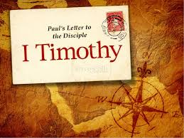
II TIMOTHY 1:1 WHO IS SENDING THE LETTER (Cond’t)
to be executed. Therefore, this promise of life was especially precious to him.
8/22/2022
8

Slide 9
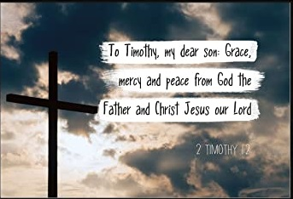
II TIMOTHY 1:2-4 PAUL’S RELATIONSHIP WITH TIMOTHY
1.2 To Timothy, my dearly beloved son: Grace, mercy, and peace, from God the Father and Christ Jesus our Lord.
Here Paul’s thought are about his spiritual family – about Timothy, a beloved son. Most likely referring to leading Timothy to faith in Christ.
8/22/2022
9

Slide 10

II TIMOTHY 1:2-4 PAUL’S RELATIONSHIP WITH TIMOTHY (Cond’t)
This verse also includes an appeal for "Grace, mercy, and peace“ which are especially needed by those in the ministry. The mention of "God the Father and Christ Jesus our Lord" together emphasis their co-equal existence.
8/22/2022
10

Slide 11
II TIMOTHY 1:2-4 PAUL’S RELATIONSHIP WITH TIMOTHY (Cond’t)
1.3 I thank God, whom I serve from my forefathers with pure conscience, that without ceasing I have remembrance of thee in my prayers night and day;
Paul recalls his godly ancestry. He, like Timothy, had been trained as a child to serve God, and his service had always been rendered with a good conscience. Paul undoubtedly prayed for Timothy often, and when he did he thanked God for his friend. I remember you
8/22/2022
11

Slide 12
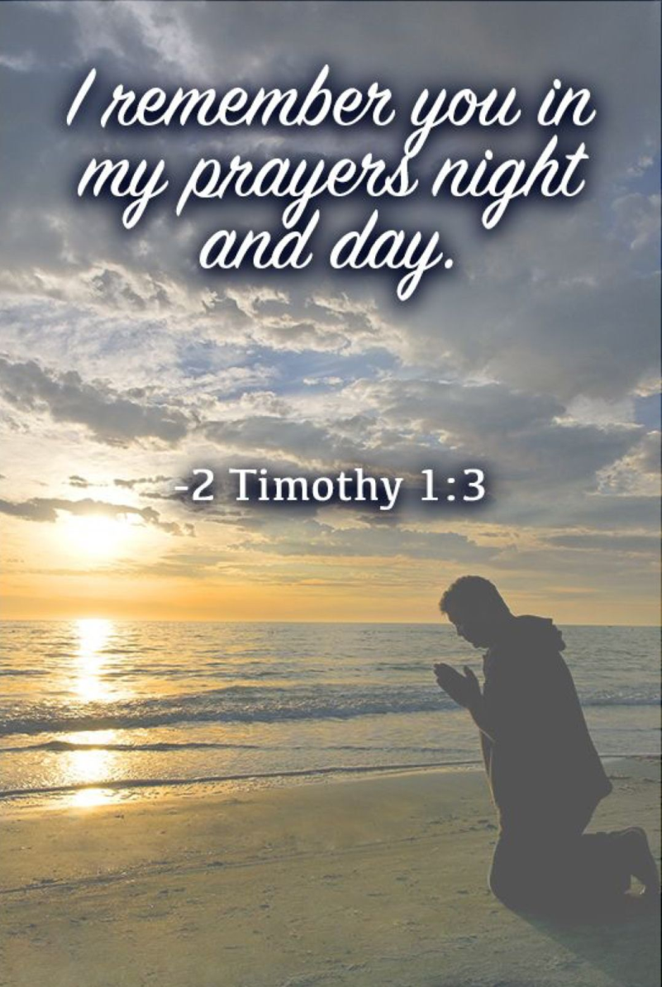
II TIMOTHY 1:2-4 PAUL’S RELATIONSHIP WITH TIMOTHY (Cond’t)
in my prayers night and day.
8/22/2022
12

Slide 13

II TIMOTHY 1:2-4 PAUL’S RELATIONSHIP WITH TIMOTHY (Cond’t)
1.4 Greatly desiring to see thee, being mindful of thy tears, that I may be filled with joy;
Paul continues his encouragement from the previous verse. Here, he acknowledges Timothy's grief over Paul's imprisonment. In his writing, "tears" represent profound sadness for Paul.
8/22/2022
13

Slide 14
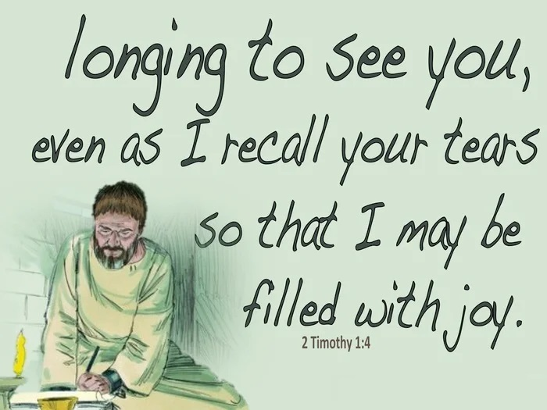
II TIMOTHY 1:2-4 PAUL’S RELATIONSHIP WITH TIMOTHY (Cond’t)
Paul's desire to see Timothy was not only for Timothy's sake, but also for his own. The very sight of his dearly beloved son Timothy would fill him with joy amidst all his troubles and afflictions he endured for the Gospel.
8/22/2022
14

Slide 15
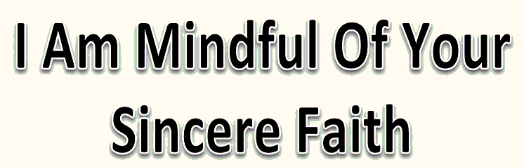
II TIMOTHY 1:5 TIMOTHY’S FAITH
1.5 When I call to remembrance the unfeigned faith that is in thee, which dwelt first in thy grandmother Lois, and thy mother Eunice; and I am persuaded that in thee also.
There is great blessing in having a godly heritage. What a testimony to the faithful foundational work of Lois and Eunice who knew the value of bringing up children in the ways of the Lord.
8/22/2022
15

Slide 16

II TIMOTHY 1:6-7 MAINTAIN A FRESH RELATIONSHIP WITH GOD
1.6 Wherefore I put thee in remembrance that thou stir up the gift of God, which is in thee by the putting on of my hands.
The gift which Timothy had received was the Holy Spirit; and through him, a particular power to preach and defend the truth. Paul may have had a special prayer for Timothy thus referring to “the putting on of my hands”.
8/22/2022
16

Slide 17
II TIMOTHY 1:6-7 MAINTAIN A FRESH RELATIONSHIP WITH GOD (Cond’t)
1.7 For God hath not given us the spirit of fear; but of power, and of love, and of a sound mind.
This verse is an exhortation from Paul to Timothy as well as to every believer, especially in this world where fear has gripped the lives of many. Nothing should cause a believer to fear. God has given us the power to overcome the spirit of fear with boldness, the power to love in this world of uncertainty and a sound mind to
8/22/2022
17

Slide 18

II TIMOTHY 1:6-7 MAINTAIN A FRESH RELATIONSHIP WITH GOD (Cond’t)
help control things around us. These three: power, love, and sound mind make a person’s life successful, profitable, and restorative.
8/22/2022
18

Slide 19
II TIMOTHY 1:8 JOIN PAUL
1.8 Be not thou therefore ashamed of the testimony of our Lord, nor of me his prisoner: but be thou partaker of the afflictions of the gospel according to the power of God;
There were two reasons that Paul urged Timothy not to be ashamed. First, he was not to be ashamed of "the testimony of our Lord" and the glorious gospel of salvation. Second, he was not to be distressed, discomforted, fearful, or embarrassed about Paul's imprisonment, who often considered himself a prisoner for Christ's
8/22/2022
19

Slide 20
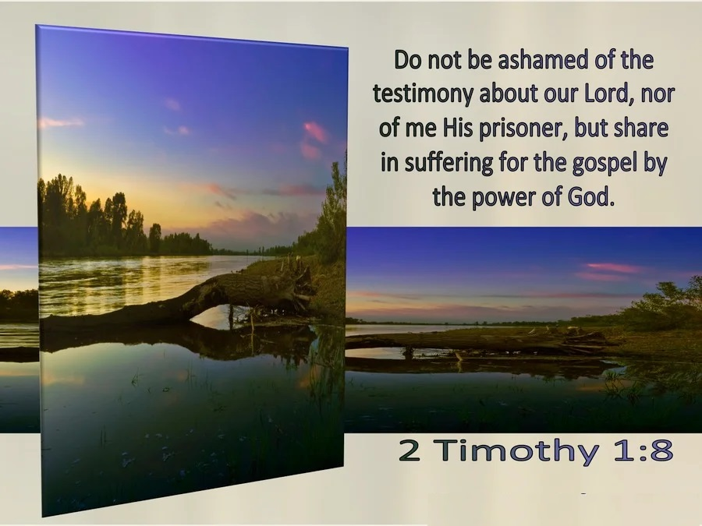
II TIMOTHY 1:8 JOIN PAUL (Cond’t)
sake. Paul proved, over and again, that God's grace is sufficient in every difficulty and dangerous situations.
8/22/2022
20

Slide 21
II TIMOTHY 1:9-11 YOU HAVE BEEN CHOSEN
1.9 Who hath saved us, and called us with an holy calling, not according to our works, but according to his own purpose and grace, which was given us in Christ Jesus before the world began,
We were not saved because of our goodness or achievements. We were not redeemed because of anything we did. We were not adopted into God's family due to any merit that came from us. Those of us “in Christ Jesus “ were saved and called before we were even born. It is hard
8/22/2022
21

Slide 22
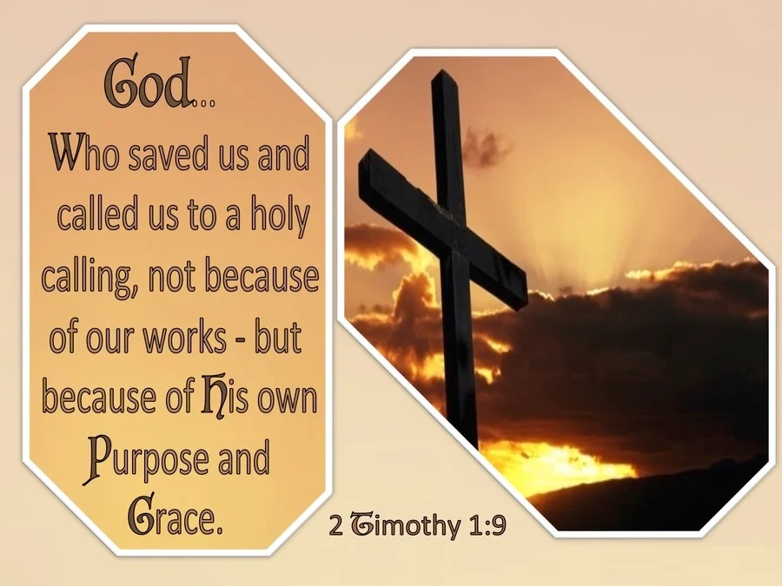
II TIMOTHY 1:9-11 YOU HAVE BEEN CHOSEN (Cond’t)
for our minds to comprehend this but our hearts can embrace it.
8/22/2022
22

Slide 23
II TIMOTHY 1:9-11 YOU HAVE BEEN CHOSEN (Cond’t)
1.10 But is now made manifest by the appearing of our Saviour Jesus Christ, who hath abolished death, and hath brought life and immortality to light through the gospel:
Paul reminds Timothy that God's redemption plan now has been revealed by the appearing of our Savior Christ Jesus. He abolished death, through the sacrifice of Himself, and brought life through Christ who died for our sin, was buried, and raised the third day.
8/22/2022
23

Slide 24
II TIMOTHY 1:9-11 YOU HAVE BEEN CHOSEN (Cond’t)
1.11 Whereunto I am appointed a preacher, and an apostle, and a teacher of the Gentiles.
Here we are given the three key roles in which Paul served. A “preacher” delivers sermons on religious topics to an assembly of people. The term "apostle" means one sent who authenticated the gospel of Christ. A "teacher," refers to someone who gives instructions. He was especially sent to the Gentiles to proclaim the doctrines of eternal life, the resurrection and the word.
8/22/2022
24

Slide 25
II TIMOTHY 1:12-14 CHRIST IS ABLE
1.12 For the which cause I also suffer these things: nevertheless I am not ashamed: for I know whom I have believed, and am persuaded that he is able to keep that which I have committed unto him against that day.
Paul explains in the opening words of this verse that he is suffering deeply because of the gospel of Christ. But far from complaining he is reminding Timothy that all who live godly lives in defense of the gospel of Christ, will suffer in this world. But the glory of the gospel and the
8/22/2022
25

Slide 26
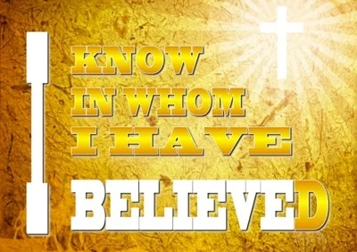
II TIMOTHY 1:12-14 CHRIST IS ABLE (Cond’t)
eternal truths that it contains far outweigh the pain of persecution in this world. At the end, Paul had no nagging uncertainty, no shadow of doubt, no waning confidence in the Lord.
8/22/2022
26

Slide 27

II TIMOTHY 1:12-14 CHRIST IS ABLE (Cond’t)
1.13 Hold fast the form of sound words, which thou hast heard of me, in faith and love which is in Christ Jesus.
“Sound words” here is referring to sound doctrines for the servants of the Lord. The words which the apostle spoke were not from men, but were a revelation from Christ.
8/22/2022
27

Slide 28
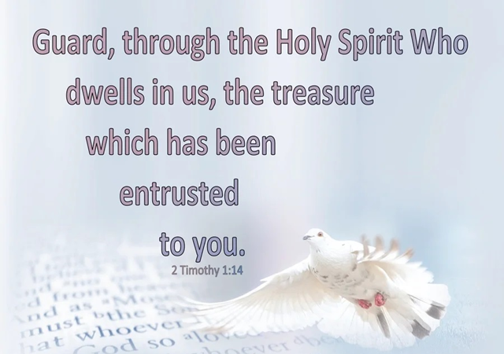
II TIMOTHY 1:12-14 CHRIST IS ABLE (Cond’t)
1.14 That good thing which was committed unto thee keep by the Holy Ghost which dwelleth in us.
"That good thing" here is the gospel which long ago had been committed to Timothy when he became a preacher of the word of God. The gospel should be kept pure and incorrupt so that it would not be snatched away from the churches by false teachers.
8/22/2022
28

Slide 29
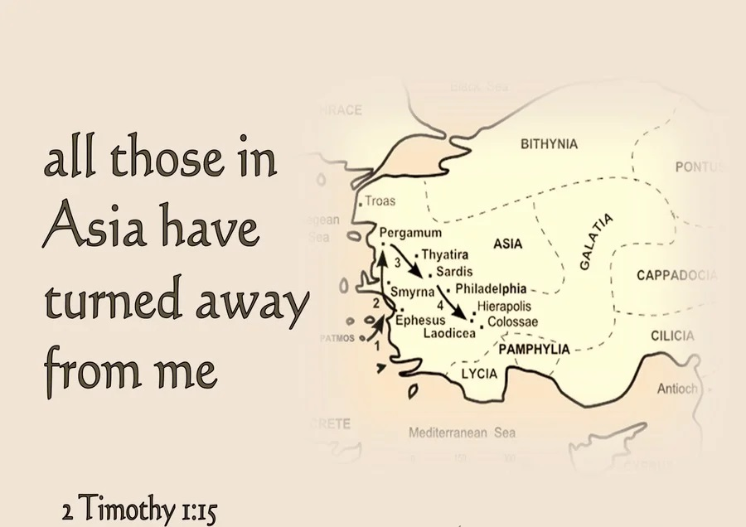
II TIMOTHY 1:15 STAND IN THE FACE OF REJECTION
1.15 This thou knowest, that all they which are in Asia be turned away from me; of whom are Phygellus and Hermogenes.
Paul impressing on this young pastor, that faithfulness is a vital characteristic of godly men and women. Phygellus was one of the Christians who deserted Paul at the
8/22/2022
29

Slide 30

II TIMOTHY 1:15 STAND IN THE FACE OF REJECTION (Cond’t)
time of his 2nd imprisonment in Rome. Paul mentions him and Hermogenes being among those in Asia who turned away from him. When Paul was brought before the Roman Tribunal, they did nothing to stand by him or support him. Paul felt they had turned their backs and deserted him.
8/22/2022
30

Slide 31
II TIMOTHY 1:16-18 SUPPORT IS SUPPLIED
1.16 The Lord give mercy unto the house of Onesiphorus; for he oft refreshed me, and was not ashamed of my chain:
Paul again switches topics, this time from those who have deserted him to a person who had blessed him. Not only was Onesiphorus not ashamed to be associate with a despised criminal like Paul, he provided much-needed comfort and support. He likely brought food and drink to Paul, frequently visiting him in jail. His ministry was one of presence,
8/22/2022
31

Slide 32
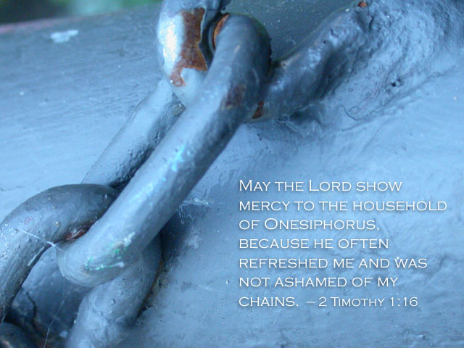
II TIMOTHY 1:16-18 SUPPORT IS SUPPLIED (Cond’t)
focusing on encouragement to Paul during his most difficult days.
8/22/2022
32
Notes:
According to the Orthodox tradition, Onesiphorus was a bishop at Colophon and later at Corinth. He supposedly became a martyr in Parium near Ephesus. However, these details are traditions from outside of Scripture and are uncertain. This is the only biblical book that speaks of Onesiphorus and his actions.

Slide 33
II TIMOTHY 1:16-18 SUPPORT IS SUPPLIED (Cond’t)
1.17 But, when he was in Rome, he sought me out very diligently, and found me.
Onesiphorus was from Asia, (probably an Ephesian) who at times had business in Rome. When in Rome he sought out the apostle, who had been confined in prison. He had to search diligently in order to locate Paul. Here was a true friend, one that stuck closer than a brother.
8/22/2022
33

Slide 34
II TIMOTHY 1:16-18 SUPPORT IS SUPPLIED (Cond’t)
1.18 The Lord grant unto him that he may find mercy of the Lord in that day: and in how many things he ministered unto me at Ephesus, thou knowest very well.
When Paul prayed that Onesiphorus would find mercy from the Lord, "on that day", he was referring to the Day of Christ when Jesus will return in the clouds. The last part of the verse adds extra insight into this man's service. In addition to his ministry to Paul in Rome. Onesiphorus had been an important
8/22/2022
34

Slide 35
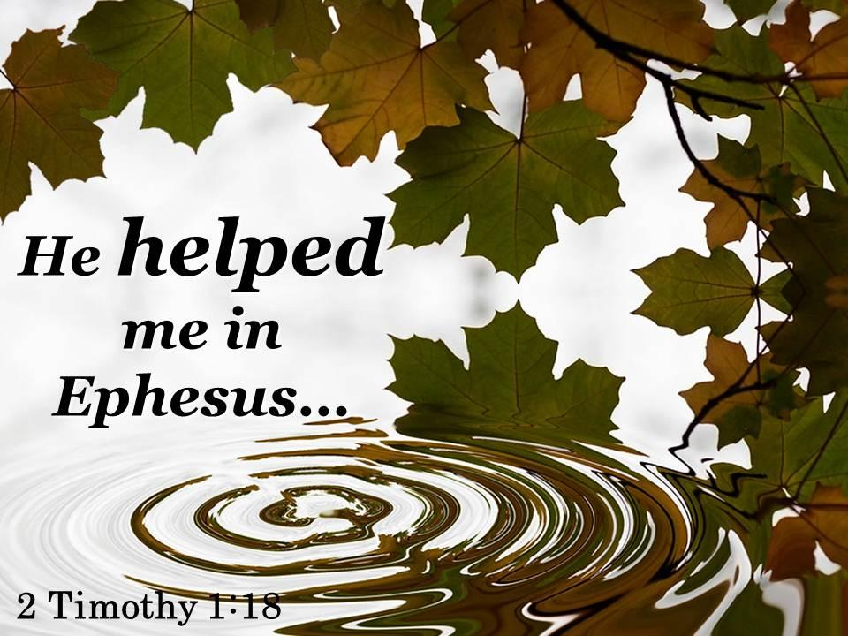
II TIMOTHY 1:16-18 SUPPORT IS SUPPLIED (Cond’t)
servant in Ephesus where Timothy served and likely where Onesiphorus lived. He was a man whose passion was to serve the Lord, whether at home or away.
8/22/2022
35

Slide 36
THIS CONCLUDES
II TIMOTHY CHAPTER 1
8/22/2022
36

