Slide 1
EPHESIANS
CHAPTER 4
1/1/2023
1

Slide 2
SUMMARY
Beginning with Chapter 4, Paul exhorts the Ephesians to walk in a manner worthy of their
calling. Paul pleads with them to maintain the unity of the Spirit in the bond of peace. Perhaps as motivation, Paul reminds them of the gracious gifts Christ gave His church. The last half of this chapter addresses the need to "walk in purity". They are to speak with truth and grace and work hard to help those in need.
1/1/2023
2

Slide 3
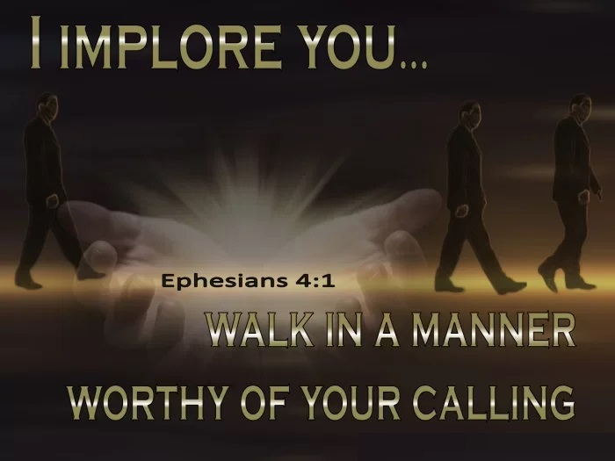
EPHESIANS 4:1-7 THE WALK - PRESERVING THE UNITY OF THE SPIRIT
4.1 I therefore, the prisoner of the Lord, beseech you that ye walk worthy of the vocation wherewith ye are called,
"Vocation" is calling and we are called to be separated unto Christ and walk in Him. A Christian's walk should match his doctrine.
1/1/2023
3

Slide 4
EPHESIANS 4:1-7 THE WALK - PRESERVING THE UNITY OF THE SPIRIT (Cond’t)
4.2 With all lowliness and meekness, with longsuffering, forbearing one another in love;
Living in a manner worthy of Christ's calling includes four traits described in this verse. First, the Ephesians—and all Christians—are to live in lowliness (humility). Second, believers are to live with meekness (gentleness). Third, believers are to exhibit longsuffering (patience). Fourth, believers are to forbear one another in love (live with love toward one another).
1/1/2023
4

Slide 5
EPHESIANS 4:1-7 THE WALK - PRESERVING THE UNITY OF THE SPIRIT (Cond’t)
4.3 Endeavouring to keep the unity of the Spirit in the bond of peace.
This verse adds an additional characteristic to the 4 mentioned in the previous verse. Passion for unity with other Christians. Paul often spoke of Christians as being together as a body is one unit made of separate members. This unity should also take place "in the bond of peace."
1/1/2023
5

Slide 6
EPHESIANS 4:1-7 THE WALK - PRESERVING THE UNITY OF THE SPIRIT (Cond’t)
4.4 There is one body, and one Spirit, even as ye are called in one hope of your calling;
This verse begins a classic repetition of "ones," running through verse 6. By repeating the concept of "one-ness," and "unity," it emphasizes the closeness and harmony we are meant to demonstrate as believers. First, every saved believer in Christ is a member of one body, even if they consider themselves part of some secondary denomination. Second,
1/1/2023
6

Slide 7

EPHESIANS 4:1-7 THE WALK - PRESERVING THE UNITY OF THE SPIRIT (Cond’t)
the Holy Spirit is the one and only spiritual force which unites all believers in Christ. Third, all believers are called to a future eternity with Christ.
1/1/2023
7

Slide 8
EPHESIANS 4:1-7 THE WALK - PRESERVING THE UNITY OF THE SPIRIT (Cond’t)
4.5 One Lord, one faith, one baptism,
This brief verse adds three more "ones" to those shared in verse 4.
"one Lord" is a clear reference to Jesus.
"one faith" is referring to salvation.
"one baptism" identifies a person as a follower of Christ, one who has accepted Jesus as Lord.
1/1/2023
8

Slide 9
EPHESIANS 4:1-7 THE WALK - PRESERVING THE UNITY OF THE SPIRIT (Cond’t)
4.6 One God and Father of all, who is above all, and through all, and in you all.
Paul adds a seventh and final "one". Christians are all saved by the grace of one unique God. God is over all, above all, through all, and in all. This phrasing is used to cover every possible aspect God could be sovereign over.
1/1/2023
9

Slide 10
EPHESIANS 4:1-7 THE WALK - PRESERVING THE UNITY OF THE SPIRIT (Cond’t)
4.7 But unto every one of us is given grace according to the measure of the gift of Christ.
In this verse Paul returns again to the theme of grace, this time focusing on spiritual gifts. While our faith is unified under a single God, God brings each person exactly what they need, depending on who and where they are. In other words, God's grace is given out personally.
1/1/2023
10

Slide 11
EPHESIANS 4:8-16 THE WALK - EDIFYING THE BODY OF CHRIST
4.8 Wherefore he saith, When he ascended up on high, he led captivity captive, and gave gifts unto men.
Paul quotes Psalm 68:18 in this verse. The quote itself references two actions fulfilled in Jesus. First is the ascension of Jesus. Second, Jesus "gave gifts to men." All believers have at least one spiritual gift. The focus of Paul's teaching is not on how many gifts, or even which gifts, a person has. Rather, the point is
1/1/2023
11
Notes:
Psalm 68:18-Thou hast ascended on high, thou hast led captivity captive: thou hast received gifts for men; yea, for the rebellious also, that the LORD God might dwell among them.
Some spiritual gifts are listed in Scripture (Ephesians 4:11; Romans 12:4–8; 1 Corinthians 12:4–11), while it's possible there are others not explicitly mentioned in the Bible.

Slide 12

EPHESIANS 4:8-16 THE WALK - EDIFYING THE BODY OF CHRIST (Cond't)
that Christians should strive to use the gifts God has given in order to serve others.
1/1/2023
12

Slide 13
EPHESIANS 4:8-16 THE WALK - EDIFYING THE BODY OF CHRIST (Cond’t)
4.9 (Now that he ascended, what is it but that he also descended first into the lower parts of the earth?
This verse and the next adds an interesting side-note to his main flow of the passage. The change in topic is abrupt enough that most translations include these words in parentheses. Paul is simply arguing that the use of the phrase “ascended” from earth to heaven implies a previous corresponding descent, which must be from heaven to earth.
1/1/2023
13

Slide 14
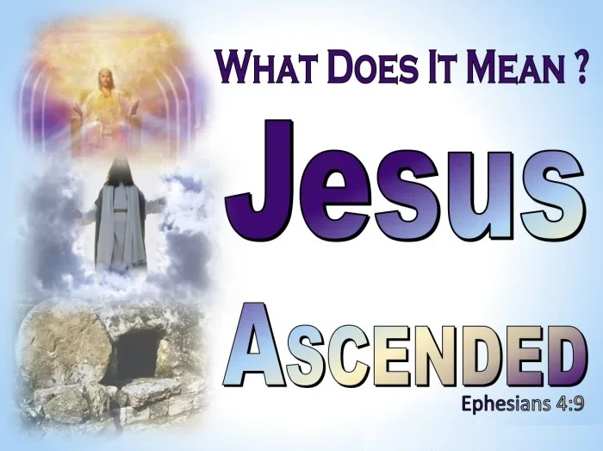
EPHESIANS 4:8-16 THE WALK - EDIFYING THE BODY OF CHRIST (Cond’t)
“The lower parts of the earth”—This may mean either the regions of the earth, as “lower” than heaven, or the regions beneath the earth (Hades).
1/1/2023
14

Slide 15
EPHESIANS 4:8-16 THE WALK - EDIFYING THE BODY OF CHRIST (Cond’t)
4.10 He that descended is the same also that ascended up far above all heavens, that he might fill all things.)
Here Paul uses the reference "above all the heavens" to denote an area beyond the known physical world. The final phrase "that he might fill all things" implies the sense of completion (Colossians 1:18–19; 2:9).
1/1/2023
15
Notes:
Colossians 1:18–19- And he is the head of the body, the church: who is the beginning, the firstborn from the dead; that in all things he might have the preeminence.
19 For it pleased the Father that in him should all fulness dwell;
Colossians 2:9- For in him dwelleth all the fulness of the Godhead bodily.

Slide 16
EPHESIANS 4:8-16 THE WALK - EDIFYING THE BODY OF CHRIST (Cond’t)
4.11 And he gave some, apostles; and some, prophets; and some, evangelists; and some, pastors and teachers;
Some spiritual leaders Christ gives as "gifts" to the church. Notice these leaders are given by God and there are a variety. Apostles primarily traveled to share the gospel and start new congregations. Pastors and teachers focus on leading a particular congregation or possibly groups of local churches. All pastors
1/1/2023
16

Slide 17
EPHESIANS 4:8-16 THE WALK - EDIFYING THE BODY OF CHRIST (Cond’t)
and teachers must have the ability to effectively communicate God's Word to others. Evangelists are literally those who share the good news. It is important to note we now live in a time after this initial period of apostles and prophets. Though people today may serve in similar ways, they are different from the actual apostles and prophets of the New Testament.
1/1/2023
17

Slide 18
EPHESIANS 4:8-16 THE WALK - EDIFYING THE BODY OF CHRIST (Cond’t)
4.12 For the perfecting of the saints, for the work of the ministry, for the edifying of the body of Christ:
The overall mission for every Christian leader is “for the perfecting of the saints for the work of ministry." This involves the idea of training believers to serve God here on earth. The reason church leaders are to train every believer to serve others is "for the edifying of the body of Christ.“ In this way,
1/1/2023
18

Slide 19

EPHESIANS 4:8-16 THE WALK - EDIFYING THE BODY OF CHRIST (Cond’t)
every believer is growing in maturity and making disciples of others.
1/1/2023
19

Slide 20
EPHESIANS 4:8-16 THE WALK - EDIFYING THE BODY OF CHRIST (Cond’t)
4.13 Till we all come in the unity of the faith, and of the knowledge of the Son of God, unto a perfect man, unto the measure of the stature of the fulness of Christ:
This verse adds additional reasons church leaders are to equip believers to serve. First, Paul wants believers to live in unity. Second, believers are to grow in "knowledge of the Son of God." The focus of church leaders is preparing
1/1/2023
20

Slide 21
EPHESIANS 4:8-16 THE WALK - EDIFYING THE BODY OF CHRIST (Cond’t)
Christians to serve others, in practical ways. Third, Paul wants every believer to grow in maturity. Obviously, Paul is referring to spiritual growth, which includes increases in the fruit of the Spirit (Galatians 5:22–23) and our love for both God and others (Matthew 22:37–40). The end goal is to have the "fullness of Christ."
1/1/2023
21
Notes:
Galatians 5:22–23-But the fruit of the Spirit is love, joy, peace, longsuffering, gentleness, goodness, faith,
23Meekness, temperance: against such there is no law.
Matthew 22:37–40-Jesus said unto him, Thou shalt love the Lord thy God with all thy heart, and with all thy soul, and with all thy mind.
38This is the first and great commandment.
39And the second is like unto it, Thou shalt love thy neighbour as thyself.
40On these two commandments hang all the law and the prophets.

Slide 22
EPHESIANS 4:8-16 THE WALK - EDIFYING THE BODY OF CHRIST (Cond’t)
4.14 That we henceforth be no more children, tossed to and fro, and carried about with every wind of doctrine, by the sleight of men, and cunning craftiness, whereby they lie in wait to deceive;
One positive result from maturity in a believer is not being tricked by false teaching. Those who are "no more children" but have matured can stand against lies and deceit. Paul's analogy of being "tossed to and fro” by
1/1/2023
22

Slide 23

EPHESIANS 4:8-16 THE WALK - EDIFYING THE BODY OF CHRIST (Cond’t)
waves and "carried about with every wind of doctrine" is a warning against false doctrine. Those who are immature can easily be fooled into thinking false teaching is accurate.
1/1/2023
23

Slide 24
EPHESIANS 4:8-16 THE WALK - EDIFYING THE BODY OF CHRIST (Cond’t)
4.15 But speaking the truth in love, may grow up into him in all things, which is the head, even Christ:
Another sign of maturity in a Christian is the ability to speak the truth in love. To speak the truth in love includes how Christians communicate with believers and unbelievers alike. Believers are called to live in harmony with one another as family. With unbelievers, we are told to be ready at all times to "be
1/1/2023
24

Slide 25

EPHESIANS 4:8-16 THE WALK - EDIFYING THE BODY OF CHRIST (Cond’t)
ready always to give an answer to everyman that asketh you a reason of the hope that is in you with meekness and fear:" (1 Peter 3:15) letting God's Spirit work boldly in us and through us to help others come to faith in Christ.
1/1/2023
25

Slide 26
EPHESIANS 4:8-16 THE WALK - EDIFYING THE BODY OF CHRIST (Cond’t)
4.16 From whom the whole body fitly joined together and compacted by that which every joint supplieth, according to the effectual working in the measure of every part, maketh increase of the body unto the edifying of itself in love.
After describing Christ as the head, in verse 15, Paul now discusses the rest of the spiritual "body" of the church. Each individual part must work together, according to its design
1/1/2023
26

Slide 27

EPHESIANS 4:8-16 THE WALK - EDIFYING THE BODY OF CHRIST (Cond’t)
and purpose, and in the intended way, in order for the body to function properly. A healthy body, functioning in harmony, makes the body grow and attracts others to the gospel of Christ, and people are added to the family of God (Acts 2:47).
1/1/2023
27
Notes:
Acts 2:47-Praising God, and having favour with all the people. And the Lord added to the church daily such as should be saved.

Slide 28
EPHESIANS 4:17-19 THE WALK - NOT AS THE GENTILES WALK
4.17 This I say therefore, and testify in the Lord, that ye henceforth walk not as other Gentiles walk, in the vanity of their mind,
Now Paul transitions to a new section in verses 17–32. He contrasts the new life believers have in Christ, as opposed to the old life of the world. The goals of unbelievers have no point or purpose. In contrast, believers live with a clear purpose: to glorify God through making disciples.
1/1/2023
28

Slide 29
EPHESIANS 4:17-19 THE WALK - NOT AS THE GENTILES WALK (Cond’t)
4.18 Having the understanding darkened, being alienated from the life of God through the ignorance that is in them, because of the blindness of their heart:
Unbelievers are given two characteristics in this verse. First, their ability to understand what is right is blocked from them because of the blindness of their heart. Second, an unbeliever lives a life with a heart hardened against God, so they cannot understand what God tries to teach them (1 Corinthians 2:14).
1/1/2023
29
Notes:
1 Corinthians 2:14-But the natural man receiveth not the things of the Spirit of God: for they are foolishness unto him: neither can he know them, because they are spiritually discerned.

Slide 30
EPHESIANS 4:17-19 THE WALK - NOT AS THE GENTILES WALK (Cond’t)
4.19 Who being past feeling have given themselves over unto lasciviousness, to work all uncleanness with greediness.
Unbelievers are numb and desensitized to sin. They can do wrong and have little or no conviction of wrongdoing. Also, unbelievers have put themselves under the control of their sexual urges. This reference to sexual immorality is general and could include a variety of practices. Sin is not only
1/1/2023
30

Slide 31

EPHESIANS 4:17-19 THE WALK - NOT AS THE GENTILES WALK (Cond’t)
destructive, it is addictive.
1/1/2023
31

Slide 32

EPHESIANS 4:20-32 THE WALK - AS LEARNED FROM CHRIST
4.20 But ye have not so learned Christ;.
This verse begins with "but," in order to remind believers that this is not how they are to live. The separation between what we were and what we are is profound, and it should be reflected in our lives as Christians.
1/1/2023
32

Slide 33

EPHESIANS 4:20-32 THE WALK - AS LEARNED FROM CHRIST (Cond’t)
4.21 If so be that ye have heard him, and have been taught by him, as the truth is in Jesus:
Paul's writing here is instructive. He clarifies that this truth—a changed life, with freedom from the power of sin —is for those who have heard the gospel and come to know Christ.
1/1/2023
33

Slide 34

EPHESIANS 4:20-32 THE WALK - AS LEARNED FROM CHRIST (Cond’t)
4.22 That ye put off concerning the former conversation the old man, which is corrupt according to the deceitful lusts;
Paul next calls believers to consciously strive towards a more Christ-like life. The "old self" is the old way of life they practiced prior to their conversion. The "old self" is marked by evil brought on by misplaced, deceptive urges.
1/1/2023
34

Slide 35

EPHESIANS 4:20-32 THE WALK - AS LEARNED FROM CHRIST (Cond’t)
4.23 And be renewed in the spirit of your mind;
Christians can separate themselves from the sin and deception of their former life. This transformation is only possible through Christ for those who have committed their mind to Him.
1/1/2023
35

Slide 36
EPHESIANS 4:20-32 THE WALK - AS LEARNED FROM CHRIST (Cond’t)
4.24 And that ye put on the new man, which after God is created in righteousness and true holiness.
Believers are to “put on the new man” meaning we are to be renewed in knowledge after the image of our creator. The Lord is righteous and expects His followers to seek to do what is right as well. Believers should also live holy lives. Holiness means to be set apart, clean and distinct from the world. Believers are to control their bodies "in sanctification and honour" (1 Thessalonians 4:4). Holiness
1/1/2023
36
Notes:
I Thes 4:4- That every one of you should know how to possess his vessel in sanctification and honour;
Here sanctification means (holiness, consecration, dedication to God)

Slide 37

EPHESIANS 4:20-32 THE WALK - AS LEARNED FROM CHRIST (Cond’t)
means to be set apart, clean, and distinct from what surrounds it. Believers are to live holy lives as followers of Christ.
1/1/2023
37

Slide 38
EPHESIANS 4:20-32 THE WALK - AS LEARNED FROM CHRIST (Cond’t)
4.25 Wherefore putting away lying, speak every man truth with his neighbour: for we are members one of another.
In the preceding verses, Paul has described sin as both corrupting and deceptive. Since Christians are called to live lives distinctly different than we did prior to our salvation, Paul concludes that the new man includes putting away falsehood. This means not being self-deceptive, dishonest, or scheming in our Christian lives. We are to also treat one
1/1/2023
38

Slide 39
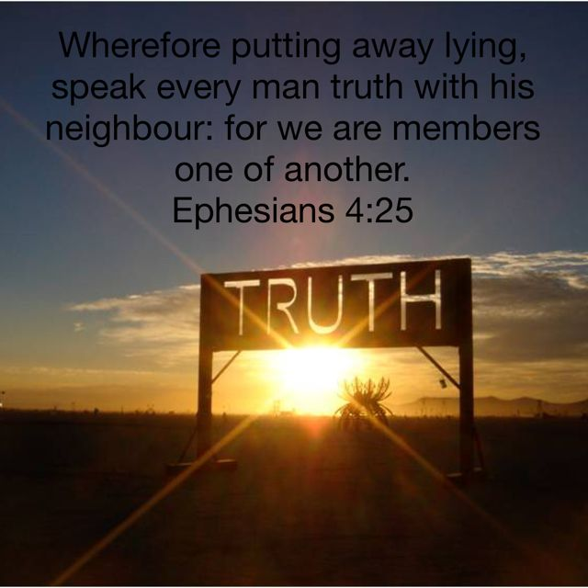
EPHESIANS 4:20-32 THE WALK - AS LEARNED FROM CHRIST (Cond’t)
another well as believers because we belong to one another and are ultimately one body.
1/1/2023
39

Slide 40
EPHESIANS 4:20-32 THE WALK - AS LEARNED FROM CHRIST (Cond’t)
4.26 Be ye angry, and sin not: let not the sun go down upon your wrath:
First, anger is not necessarily wrong. Anger itself is not a sin; there are some things Christians ought to be angry about. Second, uncontrolled anger quickly leads to doing wrong. One way to control anger is don't let anger sit unresolved by letting too much time go by before dealing with anger. Believers are to make dealing with anger a priority. Otherwise, bitterness or the desire for vengeance will grow, leading to more sinful
1/1/2023
40

Slide 41

EPHESIANS 4:20-32 THE WALK - AS LEARNED FROM CHRIST (Cond’t)
thoughts.
1/1/2023
41

Slide 42
EPHESIANS 4:20-32 THE WALK - AS LEARNED FROM CHRIST (Cond’t)
4.27 Neither give place to the devil.
Paul has just instructed Christians not to let anger sit unresolved. Being angry is not a sin, in and of itself, but it can open us to sin if we don't handle it in a spiritual way. Paul's warning here flows from anger, specifically, to the broader idea of not giving Satan any openings into our lives. Believers should strive to keep Satan out of every aspect of our lives. As believers, we must guard against any area of life that could be used to compromise our integrity and witness for Christ. "your
1/1/2023
42

Slide 43

EPHESIANS 4:20-32 THE WALK - AS LEARNED FROM CHRIST (Cond’t)
adversary the devil, as a roaring lion, walketh about, seeking whom he may devour:" (1 Peter 5:8).
1/1/2023
43

Slide 44
EPHESIANS 4:20-32 THE WALK - AS LEARNED FROM CHRIST (Cond’t)
4.28 Let him that stole steal no more: but rather let him labour, working with his hands the thing which is good, that he may have to give to him that needeth.
Part of denying the Devil a foothold in our lives comes through our practical actions as believers. The first step was to stop doing what was wrong. Here Paul says “let him that stole steal no more.” Paul specifies that "theft" involves more than just taking physical objects from others. Work done ought to be
1/1/2023
44

Slide 45

EPHESIANS 4:20-32 THE WALK - AS LEARNED FROM CHRIST (Cond’t)
"honest.“ As always, Paul frames Christian conduct in terms of what it allows us to do for others. In this case, an honest living allows a believer to share what they have with those who cannot support themselves.
1/1/2023
45

Slide 46
EPHESIANS 4:20-32 THE WALK - AS LEARNED FROM CHRIST (Cond’t)
4.29 Let no corrupt communication proceed out of your mouth, but that which is good to the use of edifying, that it may minister grace unto the hearers.
Paul transitions from a contrast between stealing and hard work in the previous verse to contrasting corrupting speech with encouraging speech. In both cases, his intent is to explain how Christians need to make a conscious effort to live differently after salvation. Just as stealing is associated with unbelievers, so also corrupting talk is
1/1/2023
46

Slide 47

EPHESIANS 4:20-32 THE WALK - AS LEARNED FROM CHRIST (Cond’t)
associated with those who do not know Christ. Instead of using "corrupting" or negative talk, we are to speak in beneficial ways about meaningful things. We are to speak in ways appropriate to the situation we are in. The goal is to show grace to those who are listen- ing to our words by making it our intent to help others through our words.
1/1/2023
47

Slide 48
EPHESIANS 4:20-32 THE WALK - AS LEARNED FROM CHRIST (Cond’t)
4.30 And grieve not the holy Spirit of God, whereby ye are sealed unto the day of redemption.
Paul instructs not to cause the Holy Spirit grief. In short, believers can make the Spirit sad by our sinful actions. This ties together several critical ideas. First, it means saved Christians are still capable of sin. Second, it means that God does, in fact, care about how we live our lives once we are saved. Third, it ties into eternal security because we will not be cast aside as a result of sin. However,
1/1/2023
48

Slide 49

EPHESIANS 4:20-32 THE WALK - AS LEARNED FROM CHRIST (Cond’t)
eternal security is not a license to sin. Fourth, we need not fear losing the Spirit (Romans 8:38–39), but should fear grieving the Spirit.
1/1/2023
49
Notes:
Romans 8:38–39-For I am persuaded, that neither death, nor life, nor angels, nor principalities, nor powers, nor things present, nor things to come,
39 Nor height, nor depth, nor any other creature, shall be able to separate us from the love of God, which is in Christ Jesus our Lord.

Slide 50
EPHESIANS 4:20-32 THE WALK - AS LEARNED FROM CHRIST (Cond’t)
4.31 Let all bitterness, and wrath, and anger, and clamour, and evil speaking, be put away from you, with all malice:
Six areas of sin Christians should make a conscious effort to avoid. First is bitterness, a defect in our attitude which can cause trouble with other people. Bitterness is closely related to jealousy and to dissatisfaction. Second to be "put away" is wrath which implies something hot, fierce, and passionate. Wrath which boils over to the point that it controls us, causing us to act wildly or carelessly.
1/1/2023
50

Slide 51
EPHESIANS 4:20-32 THE WALK - AS LEARNED FROM CHRIST (Cond’t)
Third, Paul notes anger. His reference here is to worldly type of anger, which results from frustrations in life. Irritations and annoyances cannot always be avoided, but we can work to limit how much anger we express in our lives. Fourth is clamour. This term implies noise, commotion, and uproar (Acts 23:9). Believers are not to be known as obnoxious, riotous, troublemaking, annoying people. Fifth, Paul warns against evil speaking or slander, which involves speaking lies about others. The concept of slander doesn't only include lies,
1/1/2023
51
Notes:
Acts 23:9-And there arose a great cry: and the scribes that were of the Pharisees' part arose, and strove, saying, We find no evil in this man: but if a spirit or an angel hath spoken to him, let us not fight against God.

Slide 52
EPHESIANS 4:20-32 THE WALK - AS LEARNED FROM CHRIST (Cond’t)
however. Any attempt to put others down, in an inappropriate way, is still "slander.“ Sixth, Paul adds malice which implies evil intent. The word carries the idea of deliberate harm, or an intent to injure. This attitude actively hopes to see others suffer consequences, harms, or troubles. Malice is the attitude which leads to revenge. Believers are not to be known for evil, but are to overcome evil with good.
1/1/2023
52

Slide 53
EPHESIANS 4:20-32 THE WALK - AS LEARNED FROM CHRIST (Cond’t)
4.32 And be ye kind one to another, tenderhearted, forgiving one another, even as God for Christ's sake hath forgiven you.
As Christians we should exhibit kindness. The focus is for genuine compassion for other believers in the congregation. We should be tenderhearted, showing sympathy. Believers are not to be known for a harsh attitude, but rather for having compassion toward others. Paul commands believers to forgive one another. Forgiveness is a unique characteristic of the Christian faith. Paul’s instruction comes
1/1/2023
53

Slide 54

EPHESIANS 4:20-32 THE WALK - AS LEARNED FROM CHRIST (Cond’t)
with an explanation, referring to the forgiveness believers have received from Christ.
1/1/2023
54

Slide 55
THIS CONCLUDES
EPHESIANS
CHAPTER 4
1/1/2023
55

