Slide 1
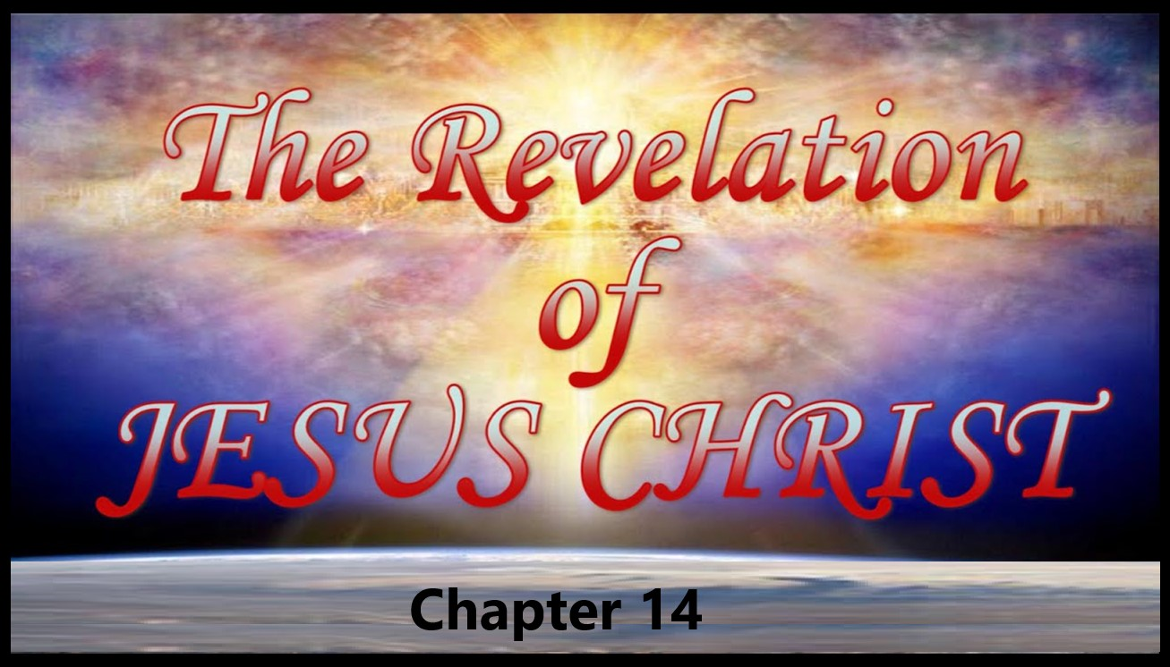

Slide 2
Revelation 14
The Everlasting Gospel
Introduction
In chapter 13, the future looked very bleak for the saints of God. The Beast arose from the sea, empowered by the dragon, and was given authority over the saints. The False Prophet aided the Beast in his dominance and worldwide worship. An image of the Beast was made and everyone was required to worship the image at the cost of one’s life.
Here in this chapter the focus moves back from the earth, under the control of the Beast, to the heavenly realm where the justice and sovereignty of God are once again emphasized. The ultimate judge is on His throne, redeeming men from the midst of the Tribulation.

Slide 3
Revelation 14
The Everlasting Gospel
Introduction (Cond’t)
In stark contrast to the fearsome power of the beast, as described in the thirteenth chapter of Revelation, the fourteenth chapter assures us of the greater power of the Lamb (Psalm 37:35-40).
Redemption of the Hundred and Forty-four Thousand
Before the great judgment began, a protective seal had been placed on the foreheads of 144,000 chosen ones out of the tribes of Israel (Revelation 7:2-4; 9:4).
Notes:
Psalm 37:35-40-I have seen the wicked in great power, and spreading himself like a green bay tree.
36Yet he passed away, and, lo, he was not: yea, I sought him, but he could not be found.
37Mark the perfect man, and behold the upright: for the end of that man is peace.
38But the transgressors shall be destroyed together: the end of the wicked shall be cut off.
39But the salvation of the righteous is of the LORD: he is their strength in the time of trouble.
40And the LORD shall help them, and deliver them: he shall deliver them from the wicked, and save them, because they trust in him.
Revelation 7:2-4-And I saw another angel ascending from the east, having the seal of the living God: and he cried with a loud voice to the four angels, to whom it was given to hurt the earth and the sea,
3Saying, Hurt not the earth, neither the sea, nor the trees, till we have sealed the servants of our God in their foreheads.
4And I heard the number of them which were sealed: and there were sealed an hundred and forty and four thousand of all the tribes of the children of Israel.
Revelation 9:4-And it was commanded them that they should not hurt the grass of the earth, neither any green thing, neither any tree; but only those men which have not the seal of God in their foreheads.

Slide 4
Revelation 14
The Everlasting Gospel
Outline
The 144,000 Servants Of God
Three Angels With Three Messages
Second Three Angels: The Harvest Of Wrath

Slide 5
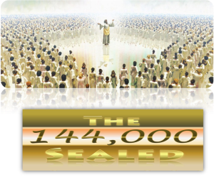
Revelation 14
The Everlasting Gospel
The 144,000 Servants Of God
Revelation 14:1. And I looked, and lo, a Lamb stood on the mount Sion, and with him an hundred forty and four thousand, having his Father’s name written in their foreheads.
Ten times John uses the formula: “And I looked” (or “saw” or “beheld”) and “lo” (or “behold”) (Revelation 4:1; 5:6; 6:2; 6:5, 6:8; 7:9; 14:1, 14:14; 15:5; 19:11).
The Lamb is there with them, in their midst, on the holy mountain of Zion a.k.s. “the City of David”, having come finally not only to claim, but also to possess, His own dominion.

Slide 6
Revelation 14
The Everlasting Gospel
The 144,000 Servants Of God
Revelation 14:1. And I looked, and lo, a Lamb stood on the mount Sion, and with him an hundred forty and four thousand, having his Father’s name written in their foreheads. (Cond’t)
Many commentators spiritualize this passage, taking it to be a vision of heaven and glorified saints. The fact is, however, that Zion (or Sion) always refers in Scripture either to the actual mountain on which Jerusalem was built, or to Jerusalem herself personified.
This generalization probably even applies to Hebrews 12:22-24, a passage often interpreted to refer to heaven.

Slide 7
Revelation 14
The Everlasting Gospel
The 144,000 Servants Of God
Revelation 14:1. And I looked, and lo, a Lamb stood on the mount Sion, and with him an hundred forty and four thousand, having his Father’s name written in their foreheads. (Cont’d)
The city of the living God, the heavenly Jerusalem, will one day indeed come down out of heaven when the Lord returns to the air.
Thus, both Hebrews 12:22-24 and Revelation 14:1-5 refer to the great future gathering of all the saints on Mount Zion in Jerusalem when Christ returns to earth at the end of the tribulation period.
The still-living saints who have survived the tribulation will also be there and chief among these will be the 144,000.
Notes:
Hebrews 12:22-24-But ye are come unto mount Sion, and unto the city of the living God, the heavenly Jerusalem, and to an innumerable company of angels,
23To the general assembly and church of the firstborn, which are written in heaven, and to God the Judge of all, and to the spirits of just men made perfect,
24And to Jesus the mediator of the new covenant, and to the blood of sprinkling, that speaketh better things than that of Abel.
Revelation 14:1-5 -And I looked, and, lo, a Lamb stood on the mount Zion, and with him an hundred forty and four thousand, having his Father's name written in their foreheads.
2And I heard a voice from heaven, as the voice of many waters, and as the voice of a great thunder: and I heard the voice of harpers harping with their harps:
3And they sung as it were a new song before the throne, and before the four beasts, and the elders: and no man could learn that song but the hundred and forty and four thousand, which were redeemed from the earth.
4These are they which were not defiled with women; for they are virgins. These are they which follow the Lamb whithersoever he goeth. These were redeemed from among men, being the firstfruits unto God and to the Lamb.
5And in their mouth was found no guile: for they are without fault before the throne of God.

Slide 8
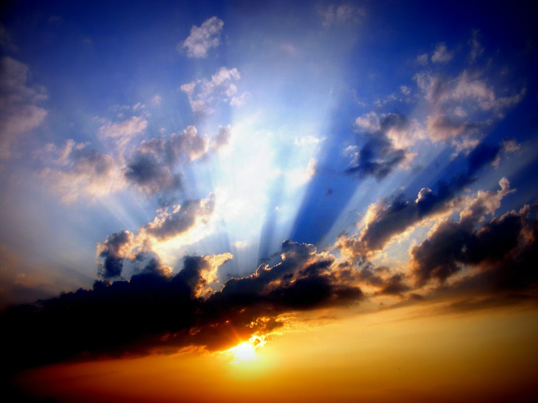
Revelation 14
The Everlasting Gospel
The 144,000 Servants Of God
Revelation 14:2. And I heard a voice from heaven, as the voice of many waters, and as the voice of a great thunder: and I heard the voice of harpers harping with their harps.
Once again the mighty voice from heaven heard as the sound of thunder (Revelation 6:1) and the sound of roaring waters (Revelation 1:15). The voice this time, however, was not that of the cherub or even of the one on the throne, but of the entire assembly, chanting a beautiful song of majesty and holiness. The melodious sound of the harp also poured through the heavenly throng, accompanying the song of the host.
Notes:
Revelation 6:1-And I saw when the Lamb opened one of the seals, and I heard, as it were the noise of thunder, one of the four beasts saying, Come and see.
Revelation 1:15-And his feet like unto fine brass, as if they burned in a furnace; and his voice as the sound of many waters.

Slide 9
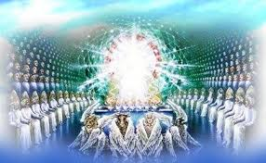
Revelation 14
The Everlasting Gospel
The 144,000 Servants Of God
Revelation 14:3. And they sung as it were a new song before the throne, and before the four beasts, and the elders: and no man could learn that song but the hundred and forty and four thousand, which were redeemed from the earth.
The song was a new song, never heard before in earth or heaven. It is uniquely appropriate to the unique body of 144,000 dedicated Christian witnesses.
The song which they would sing no one else could ever really “learn”. Only the 144,000 could truly understand its meaning.

Slide 10
Revelation 14
The Everlasting Gospel
The 144,000 Servants Of God
Revelation 14:3. And they sung as it were a new song before the throne, and before the four beasts, and the elders: and no man could learn that song but the hundred and forty and four thousand, which were redeemed from the earth. (Cond’t)
Although the words of the song of the 144,000 are not recorded, it surely dwells in part at least on the great truth that they had been “redeemed from the earth.”
They had been saved after the rapture, at that time in history when man’s greatest persecutions and God’s greatest judgments were on the earth.

Slide 11
Revelation 14
The Everlasting Gospel
The 144,000 Servants Of God
Revelation 14:3. And they sung as it were a new song before the throne, and before the four beasts, and the elders: and no man could learn that song but the hundred and forty and four thousand, which were redeemed from the earth. (cont'd)
Not only had they been redeemed spiritually but they had been redeemed from the very curse on the earth, being protected from pain and death by the guarding seal.
They had apparently even been set free from the very presence of sin in their lives in order to accomplish ministry ordained for them by the Lamb.

Slide 12
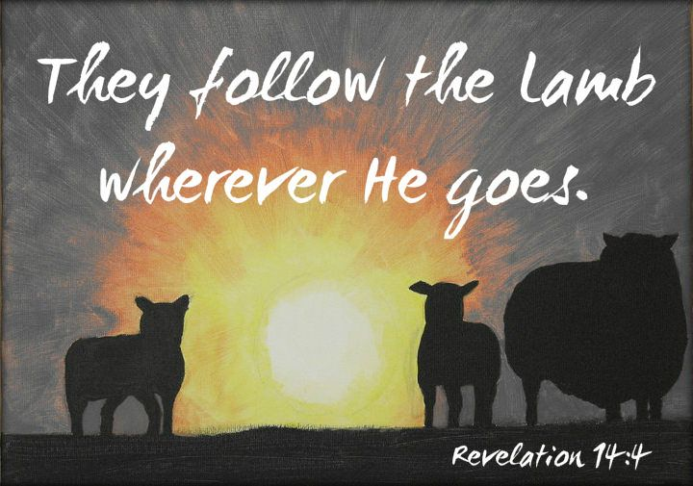
Revelation 14
The Everlasting Gospel
The 144,000 Servants Of God
Revelation 14:4. These are they which were not defiled with women; for they are virgins. These are they which follow the Lamb whithersoever he goeth. These were redeemed from among men, being the firstfruits unto God and to the Lamb.
These identifying marks of the 144,000 are quite specific but commentators have been inclined to spiritualize them and make them apply to whatever group appeals to their own conceit. For example, the Jehovah’s Witnesses maintain that they are the 144,000.

Slide 13
Revelation 14
The Everlasting Gospel
The 144,000 Servants Of God
Revelation 14:4. These are they which were not defiled with women; for they are virgins. These are they which follow the Lamb whithersoever he goeth. These were redeemed from among men, being the firstfruits unto God and to the Lamb. (Cond’t)
But the Scriptures are explicit.
• They are all male Israelites, 12,000 from each tribe.
• They are “servants of God” redeemed from among men.
• They are all virgins
These constitute a rather rigid group of specifications, and one can search the world in vain to identify such a remarkable body of men.

Slide 14
Revelation 14
The Everlasting Gospel
The 144,000 Servants Of God
Revelation 14:4. These are they which were not defiled with women; for they are virgins. These are they which follow the Lamb whithersoever he goeth. These were redeemed from among men, being the firstfruits unto God and to the Lamb.(Cont’d)
The conclusion is that they have not yet been called and sealed.
The fact is that the burden of this special ministry of witnesses during the tribulation period will be so demanding and so urgent that those who exercise it cannot be concerned with either personal comfort or family needs.
They are called the “firstfruits to God and to the Lamb.” This identification must obviously refer to the firstfruits of the tribulation period, and presumably the firstfruits of revived Israel.

Slide 15
Revelation 14
The Everlasting Gospel
The 144,000 Servants Of God
Revelation 14:5. And in their mouth was found no guile: for they are without fault before the throne of God.
Here is further testimony to the single-mindedness of those dedicated servants of God (1 Peter 2:22; James 3:2)
How is it possible that 144,000 men - even redeemed men - could be so wholeheartedly perfect before the Lord? The answer can only be in terms of God’s grace (Genesis 6:8-9; Luke 1:15; Galatians 1:15).
They had not been sinless, for all have sinned, but God had so prepared and protected them that they had never yielded to the sin of sexual defilement.
Their eyes had finally been opened and they had recognized and received the Lord Jesus as the Messiah.
Notes:
1 Peter 2:22-Who did no sin, neither was guile found in his mouth:
James 3:2-For in many things we offend all. If any man offend not in word, the same is a perfect man, and able also to bridle the whole body.
Genesis 6:8-9-But Noah found grace in the eyes of the LORD.
9These are the generations of Noah: Noah was a just man and perfect in his generations, and Noah walked with God.
Luke 1:15-For he shall be great in the sight of the Lord, and shall drink neither wine nor strong drink; and he shall be filled with the Holy Ghost, even from his mother's womb.
Galatians 1:15-But when it pleased God, who separated me from my mother's womb, and called me by his grace,

Slide 16
Revelation 14
The Everlasting Gospel
The 144,000 Servants Of God
Revelation 14:5. And in their mouth was found no guile: for they are without fault before the throne of God. (cont'd)
Their sins had been forgiven so that they were now indeed “without fault before the throne of God,” and were then enabled, still by God’s grace, to continue in the things which they had learned (Jude 1:24).
Notes:
Jude 1:24-Now unto him that is able to keep you from falling, and to present you faultless before the presence of his glory with exceeding joy,

Slide 17
Revelation 14
The Everlasting Gospel
Three Angles With Three Messages
Introduction
Once again John’s attention is directed back to the earth. The threat of death hangs heavy over any who would refuse the beast and follow Christ. Even though the 144,000 witnesses are under God’s protection, most people will be mortally afraid to heed their message or even to befriend them.

Slide 18
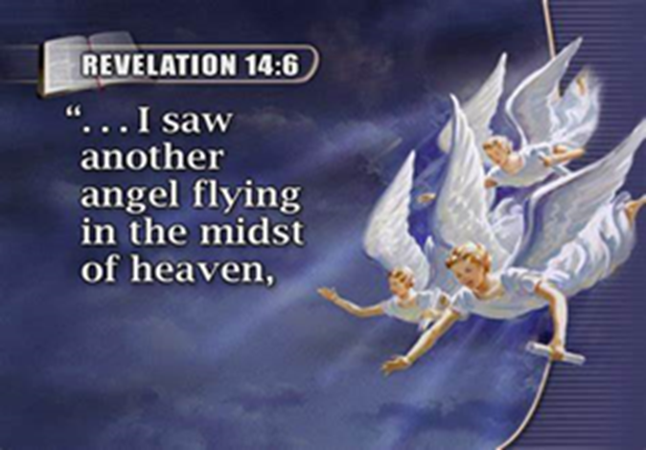
Revelation 14
The Everlasting Gospel
Three Angles With Three Messages
Revelation 14:6. And I saw another angel fly in the midst of heaven, having the everlasting gospel to preach unto them that dwell on the earth, and to every nation, and kindred, and tongue, and people.
Six additional angels now appear on the scene, all with urgent messages or ministries to and concerning all earth- dwellers.

Slide 19
Revelation 14
The Everlasting Gospel
Three Angles With Three Messages
Revelation 14:6. And I saw another angel fly in the midst of heaven, having the everlasting gospel to preach unto them that dwell on the earth, and to every nation, and kindred, and tongue, and people. (cont'd)
The first performs an amazing mission.
At this point in history, conditions apparently have become so extreme as to require an entirely new method of preaching the gospel.
On the other hand, as pointed out previously, the people on earth will no longer be ignorant of God.

Slide 20
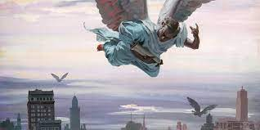
Revelation 14
The Everlasting Gospel
Three Angles With Three Messages
Revelation 14:6. And I saw another angel fly in the midst of heaven, having the everlasting gospel to preach unto them that dwell on the earth, and to every nation, and kindred, and tongue, and people. (cont'd)
God, in His infinite grace, will thus send forth a mighty angel, flying back and forth across the skies, loudly proclaiming the gospel from one place to another, covering every nation and tribe and speaking in every language so that no one at the coming judgment would be able to say he hadn’t heard.
It is the gospel which we are to preach, which believers in all ages were commanded to preach, and which the angel will preach. The gospel is everlasting. It has never been, and will never be, any other gospel.

Slide 21
Revelation 14
The Everlasting Gospel
Three Angles With Three Messages
Revelation 14:7. Saying with a loud voice, Fear God, and give glory to him; for the hour of his judgment is come: and worship him that made heaven, and earth, and the sea, and the fountains of waters.
The gospel is often defined as the substitutionary death, burial, and bodily resurrection of the Lord Jesus Christ (1 Corinthians 15:1-4).
The creation is the foundation of the gospel, the second coming is the blessed hope of the gospel, the cross and the empty tomb constitute the power of the gospel.
The angel calls out with a tremendous shout, able to be heard over a large region on the earth below each time he speaks. His message is the everlasting gospel but emphasizes the coming judgment (2 Thessalonians 1:8).
Notes:
1 Corinthians 15:1-4-Moreover, brethren, I declare unto you the gospel which I preached unto you, which also ye have received, and wherein ye stand;
2By which also ye are saved, if ye keep in memory what I preached unto you, unless ye have believed in vain.
3For I delivered unto you first of all that which I also received, how that Christ died for our sins according to the scriptures;
4And that he was buried, and that he rose again the third day according to the scriptures:
2 Thessalonians 1:8-In flaming fire taking vengeance on them that know not God, and that obey not the gospel of our Lord Jesus Christ:

Slide 22
Revelation 14
The Everlasting Gospel
Three Angles With Three Messages
Revelation 14:7. Saying with a loud voice, Fear God, and give glory to him; for the hour of his judgment is come: and worship him that made heaven, and earth, and the sea, and the fountains of waters.(Cont’d)
Lest any think it strange or inappropriate that the gospel proclamation of the angel stresses creation, they should realize that the world’s inhabitants had been indoctrinated for several generations with the godless philosophy of evolution. If Christ is not the Creator, He can hardly be the savior or the coming King. These men of the last days must first be called back to believe in a true creation and therefore a real Creator God before they can ever be constrained to come to Him as Savior.

Slide 23
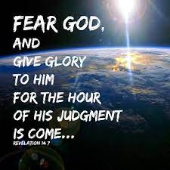
Revelation 14
The Everlasting Gospel
Three Angles With Three Messages
Revelation 14:7. Saying with a loud voice, Fear God, and give glory to him; for the hour of his judgment is come: and worship him that made heaven, and earth, and the sea, and the fountains of waters.(Cont’d)
Another reason for emphasizing the creation component of the gospel will be to reach those people whose isolated cultures have hitherto precluded them from contact with the Scriptures or knowledge about Christ.
Paul, when he witnessed to pagans, first preached the gospel of creation (Acts 14:14-17; 17:22-30).
Notes:
Acts 14:14-17-Which when the apostles, Barnabas and Paul, heard of, they rent their clothes, and ran in among the people, crying out,
15And saying, Sirs, why do ye these things? We also are men of like passions with you, and preach unto you that ye should turn from these vanities unto the living God, which made heaven, and earth, and the sea, and all things that are therein:
16Who in times past suffered all nations to walk in their own ways.
17Nevertheless he left not himself without witness, in that he did good, and gave us rain from heaven, and fruitful seasons, filling our hearts with food and gladness.
Acts 17:22-30-Then Paul stood in the midst of Mars' hill, and said, Ye men of Athens, I perceive that in all things ye are too superstitious.
23For as I passed by, and beheld your devotions, I found an altar with this inscription, TO THE UNKNOWN GOD. Whom therefore ye ignorantly worship, him declare I unto you.
24God that made the world and all things therein, seeing that he is Lord of heaven and earth, dwelleth not in temples made with hands;
25Neither is worshipped with men's hands, as though he needed any thing, seeing he giveth to all life, and breath, and all things;
26And hath made of one blood all nations of men for to dwell on all the face of the earth, and hath determined the times before appointed, and the bounds of their habitation;
27That they should seek the Lord, if haply they might feel after him, and find him, though he be not far from every one of us:
28For in him we live, and move, and have our being; as certain also of your own poets have said, For we are also his offspring.
29Forasmuch then as we are the offspring of God, we ought not to think that the Godhead is like unto gold, or silver, or stone, graven by art and man's device.
30And the times of this ignorance God winked at; but now commandeth all men every where to repent:

Slide 24
Revelation 14
The Everlasting Gospel
Three Angles With Three Messages
Revelation 14:8. And there followed another angel, saying, Babylon is fallen, is fallen, that great city, because she made all nations drink of the wine of the wrath of her fornication.
The second of the six angels apparently follows the first wherever he flies, proclaiming an important message to inform men that mighty Babylon and all she represents are doomed.
Modern Babylon is merely a reincarnation of ancient Babylon, perpetuating the humanistic and “superhumanistic” world system, uniting mankind in a great religious, commercial, cultural, and political rebellion against God.

Slide 25
Revelation 14
The Everlasting Gospel
Three Angles With Three Messages
Revelation 14:8. And there followed another angel, saying, Babylon is fallen, is fallen, that great city, because she made all nations drink of the wine of the wrath of her fornication. (Cond’t)
This unspeakable spiritual adultery has been the deadly heritage received from Mother Babylon by all her spiritual children - all the nations of the world (Jeremiah 51:7; Isaiah 14:4-9).
Thus the angel both warns and encourages the inhabitants of earth.
Notes:
Jeremiah 51:7-Babylon hath been a golden cup in the LORD'S hand, that made all the earth drunken: the nations have drunken of her wine; therefore the nations are mad.
Isaiah 14:4-9-That thou shalt take up this proverb against the king of Babylon, and say, How hath the oppressor ceased! the golden city ceased!
5The LORD hath broken the staff of the wicked, and the sceptre of the rulers.
6He who smote the people in wrath with a continual stroke, he that ruled the nations in anger, is persecuted, and none hindereth.
7The whole earth is at rest, and is quiet: they break forth into singing.
8Yea, the fir trees rejoice at thee, and the cedars of Lebanon, saying, Since thou art laid down, no feller is come up against us.
9Hell from beneath is moved for thee to meet thee at thy coming: it stirreth up the dead for thee, even all the chief ones of the earth; it hath raised up from their thrones all the kings of the nations.

Slide 26
Revelation 14
The Everlasting Gospel
Three Angles With Three Messages
Revelation 14:8. And there followed another angel, saying, Babylon is fallen, is fallen, that great city, because she made all nations drink of the wine of the wrath of her fornication. (Cont’d)
The actual fall of Babylon will occur at the end of the tribulation, but the pronouncement is made by the second angel, again and again assuring men on earth that Babylon will soon be destroyed.

Slide 27
Revelation 14
The Everlasting Gospel
Three Angles With Three Messages
Revelation 14:9. And the third angel followed them, saying with a loud voice, If any man worship the beast and his image, and receive his mark in his forehead, or in his hand.
A third angel follows the first two, warning the dwellers on earth still more urgently concerning the dangers of following the beast.
Each message reinforces and emphasizes the one before.
• The first proclaims the everlasting gospel and warns of impending judgment.
• The second assures men that the mighty Babylonish empire of the beast is about to fall.
• The third warns men against yielding individually to the commands of the beast.

Slide 28
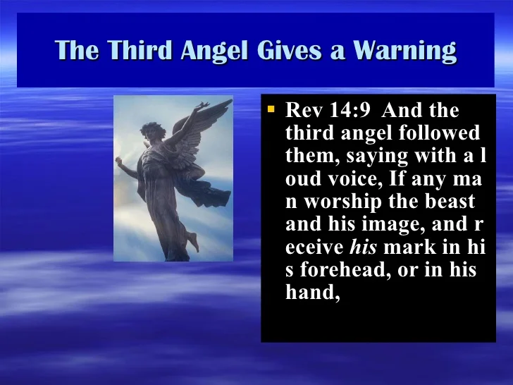
Revelation 14
The Everlasting Gospel
Three Angles With Three Messages
Revelation 14:9. And the third angel followed them, saying with a loud voice, If any man worship the beast and his image, and receive his mark in his forehead, or in his hand. (Cont’d)
The beast and his prophet have threatened capital punishment to every person who refuses to obey the beast and to bow down to his image in the temple at Jerusalem.

Slide 29
Revelation 14
The Everlasting Gospel
; Three Angles With Three Messages
;;;
Revelation 14:10. The same shall drink of the wine of the wrath of God, which is poured out without mixture into the cup of his indignation; and he shall be tormented with fire and brimstone in the presence of the holy angels, and in the presence of the Lamb.
The sentence to be pronounced is fearsome indeed. As the nations have drunk of the wine of the wrath of Babylon’s fornication, so now shall they drink of the wine of God’s wrath.
God’s wrath is now unadulterated and unmitigated.
The Lord Jesus Himself had once drained the cup of God’s indignation, substituting His own sufferings for those who deserved them.

Slide 30
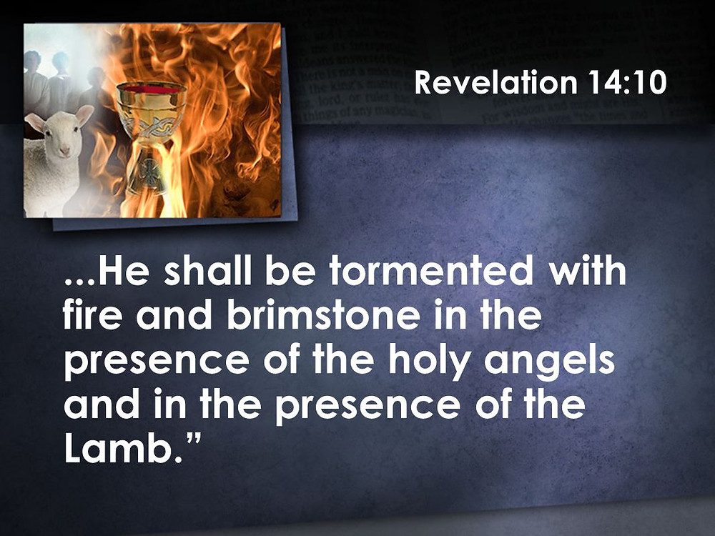
Revelation 14
The Everlasting Gospel
Three Angles With Three Messages
Revelation 14:10. The same shall drink of the wine of the wrath of God, which is poured out without mixture into the cup of his indignation; and he shall be tormented with fire and brimstone in the presence of the holy angels, and in the presence of the Lamb.(Cont’d)
But now they had all willfully rejected His great sacrifice and so they must themselves drink the cup of God’s wrath (Psalm 75:8).
They must themselves suffer in the very presence of the Lamb as well as that of the holy angels.
Their destined suffering is to be very real and severe, and the torment is one of physical suffering in “fire and brimstone.”
Notes:
Psalm 75:8-For in the hand of the LORD there is a cup, and the wine is red; it is full of mixture; and he poureth out of the same: but the dregs thereof, all the wicked of the earth shall wring them out, and drink them.

Slide 31
Revelation 14
The Everlasting Gospel
Three Angles With Three Messages
Revelation 14:10. The same shall drink of the wine of the wrath of God, which is poured out without mixture into the cup of his indignation; and he shall be tormented with fire and brimstone in the presence of the holy angels, and in the presence of the Lamb.(Cont’d)
This is such a frequent theme in Scripture (Daniel 7:11; Ezekiel 20:47-48; Isaiah 66:24; Matthew 3:12; 13:50; Mark 9:43-49; and Jude 1:7) that it is folly to ignore it.
The bodies of the unsaved dead are to be resurrected (Revelation 20:5, 12-15; John 5:29, etc.) and thus must be physical bodies, capable of being “tormented” in physical flames.
Notes:
Daniel 7:11-I beheld then because of the voice of the great words which the horn spake: I beheld even till the beast was slain, and his body destroyed, and given to the burning flame.
Ezekiel 20:47-48-And say to the forest of the south, Hear the word of the LORD; Thus saith the Lord GOD; Behold, I will kindle a fire in thee, and it shall devour every green tree in thee, and every dry tree: the flaming flame shall not be quenched, and all faces from the south to the north shall be burned therein.
48And all flesh shall see that I the LORD have kindled it: it shall not be quenched.
Isaiah 66:24-And they shall go forth, and look upon the carcases of the men that have transgressed against me: for their worm shall not die, neither shall their fire be quenched; and they shall be an abhorring unto all flesh.
Matthew 3:12-Whose fan is in his hand, and he will throughly purge his floor, and gather his wheat into the garner; but he will burn up the chaff with unquenchable fire.
Matthew 13:50-And shall cast them into the furnace of fire: there shall be wailing and gnashing of teeth.
Mark 9:43-49-And if thy hand offend thee, cut it off: it is better for thee to enter into life maimed, than having two hands to go into hell, into the fire that never shall be quenched:
44Where their worm dieth not, and the fire is not quenched.
45And if thy foot offend thee, cut it off: it is better for thee to enter halt into life, than having two feet to be cast into hell, into the fire that never shall be quenched:
46Where their worm dieth not, and the fire is not quenched.
47And if thine eye offend thee, pluck it out: it is better for thee to enter into the kingdom of God with one eye, than having two eyes to be cast into hell fire:
48Where their worm dieth not, and the fire is not quenched.
49For every one shall be salted with fire, and every sacrifice shall be salted with salt.
Jude 1:7-Even as Sodom and Gomorrha, and the cities about them in like manner, giving themselves over to fornication, and going after strange flesh, are set forth for an example, suffering the vengeance of eternal fire.
Revelation 20:5-But the rest of the dead lived not again until the thousand years were finished. This is the first resurrection.
Revelation 20:12-15-And I saw the dead, small and great, stand before God; and the books were opened: and another book was opened, which is the book of life: and the dead were judged out of those things which were written in the books, according to their works.
13And the sea gave up the dead which were in it; and death and hell delivered up the dead which were in them: and they were judged every man according to their works.
14And death and hell were cast into the lake of fire. This is the second death.
15And whosoever was not found written in the book of life was cast into the lake of fire.
John 5:29-And shall come forth; they that have done good, unto the resurrection of life; and they that have done evil, unto the resurrection of damnation.

Slide 32
Revelation 14
The Everlasting Gospel
Three Angles With Three Messages
Revelation 14:11. And the smoke of their torment ascendeth up for ever and ever: and they have no rest day nor night, who worship the beast and his image, and whosoever receiveth the mark of his name.
The doctrine of eternal punishment may be objectionable to modern intellectuals and cultists, but this resistance cannot offset the fact that the Bible clearly teaches it.
If perhaps the fires were not physical, or the resurrected bodies were not physical, at least the torment is real and eternal.

Slide 33
Revelation 14
The Everlasting Gospel
Three Angles With Three Messages
Revelation 14:11. And the smoke of their torment ascendeth up for ever and ever: and they have no rest day nor night, who worship the beast and his image, and whosoever receiveth the mark of his name. (Cond’t)
The torment involves not only the fire and the smoke of burning but also eternal fatigue, with no prospect of sleep or respite.
Since the context in this passage has to do with the beast-worshipers of the last half of the tribulation, the angel pointedly reminds them again that everlasting punishment awaits all who receive the mark.

Slide 34
Revelation 14
The Everlasting Gospel
kThree Angles With Three Messages
Revelation 14:11. And the smoke of their torment ascendeth up for ever and ever: and they have no rest day nor night, who worship the beast and his image, and whosoever receiveth the mark of his name.(Cont’d)
One other point is worth noting. Modern science has demonstrated the principle of conservation of matter and energy to be the most certain and universal principle of science. Matter and energy can change forms but can be neither created nor annihilated. Every human being ever conceived, possessing a divinely-created human soul and spirit, that will exist forever somewhere.

Slide 35
Revelation 14
The Everlasting Gospel
Three Angles With Three Messages
Revelation 14:12. Here is the patience of the saints: here are they that keep the commandments of God, and the faith of Jesus.
“Here,” says John, is the object of the age long patience of all the saints. The gospel promises are accomplished, the judgment is come, the humanistic world system is fallen, and all the ungodly are in hell and their patience is justified at last.
“Here,” he says further, are all the godly (“they that keep God’s commandments and the faith of Jesus.”)
If one truly believes on Jesus, he will keep His commandments (John 14:21).
If one truly loves God’s commandments, he will believe on Jesus (John 6:28-29).
Notes:
John 14:21-He that hath my commandments, and keepeth them, he it is that loveth me: and he that loveth me shall be loved of my Father, and I will love him, and will manifest myself to him.
John 6:28-29-Then said they unto him, What shall we do, that we might work the works of God?
29Jesus answered and said unto them, This is the work of God, that ye believe on him whom he hath sent.

Slide 36
Revelation 14
The Everlasting Gospel
Three Angles With Three Messages
Revelation 14:13. And I heard a voice from heaven saying unto me, Write, Blessed are the dead which die in the Lord from henceforth: Yea, saith the Spirit, that they may rest from their labours; and their works do follow them.
There is an important interval between the first three angels and the last three angels here in Chapter 14. The Holy Spirit speaks and the Son of man acts.
There is a particular promise to the martyrs of this last half of the tribulation. This is the second of the seven “beatitudes” of Revelation (the others in Revelation 1:3; 16:15; 19:9; 20:6; 22:7; 22:14), promising a blessing to those who die in the Lord “henceforth”.
Notes:
Revelation 1:3-Blessed is he that readeth, and they that hear the words of this prophecy, and keep those things which are written therein: for the time is at hand.
Revelation 16:15-Behold, I come as a thief. Blessed is he that watcheth, and keepeth his garments, lest he walk naked, and they see his shame.
Revelation 19:9-And he saith unto me, Write, Blessed are they which are called unto the marriage supper of the Lamb. And he saith unto me, These are the true sayings of God.
Revelation 20:6-Blessed and holy is he that hath part in the first resurrection: on such the second death hath no power, but they shall be priests of God and of Christ, and shall reign with him a thousand years.
Revelation 22:7-Behold, I come quickly: blessed is he that keepeth the sayings of the prophecy of this book.
Revelation 22:14-Blessed are they that do his commandments, that they may have right to the tree of life, and may enter in through the gates into the city.

Slide 37
Revelation 14
The Everlasting Gospel
Three Angles With Three Messages
Revelation 14:13. And I heard a voice from heaven saying unto me, Write, Blessed are the dead which die in the Lord from henceforth: Yea, saith the Spirit, that they may rest from their labours; and their works do follow them. (Cond’t)
The voice from heaven which first pronounced the blessing is unidentified, but now comes an echoing response from none other than the Spirit of God.
The Spirit’s message in this case is a very wonderful promise. Once this life is done, whether at death or at the rapture, our labors are over (1 Corinthians 15:58; Matthew 25:21; 1 Corinthians 3:14-15).
Notes:
1 Corinthians 15:58-Therefore, my beloved brethren, be ye stedfast, unmoveable, always abounding in the work of the Lord, forasmuch as ye know that your labour is not in vain in the Lord.
Matthew 25:21-His lord said unto him, Well done, thou good and faithful servant: thou hast been faithful over a few things, I will make thee ruler over many things: enter thou into the joy of thy lord.
1 Corinthians 3:14-15-If any man's work abide which he hath built thereupon, he shall receive a reward.
15If any man's work shall be burned, he shall suffer loss: but he himself shall be saved; yet so as by fire.

Slide 38
Revelation 14
The Everlasting Gospel
Three Angles With Three Messages
Revelation 14:13. And I heard a voice from heaven saying unto me, Write, Blessed are the dead which die in the Lord from henceforth: Yea, saith the Spirit, that they may rest from their labours; and their works do follow them.(Cont’d)
One of the most blessed promises of Scripture is that the good works we do “in the Lord” while we are still in the flesh can still bear fruit and be credited to our “work record” even after we die (1 Corinthians 3:8).
One of the most challenging incentives to faithfulness in labor and seed-sowing is the possibility that some of our own ministries in these last days may bear fruit even after the rapture.
Notes:
1 Corinthians 3:8-Now he that planteth and he that watereth are one: and every man shall receive his own reward according to his own labour.

Slide 39
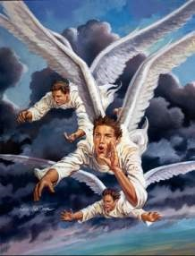
Revelation 14
The Everlasting Gospel
Second Three Angles: The Harvest Of Wrath
Revelation 14:14. And I looked, and behold a white cloud, and upon the cloud one sat like unto the Son of man, having on his head a golden crown, and in his hand a sharp sickle.
Still in the interval between the two sets of three angels, John views an amazing scene. The same Son of man whom he had seen at the beginning (Revelation 1:13) appears again.
Now John sees Him again as He is and will be forever, as the glorified Son of man.
Notes:
Revelation 1:13-And in the midst of the seven candlesticks one like unto the Son of man, clothed with a garment down to the foot, and girt about the paps with a golden girdle.

Slide 40
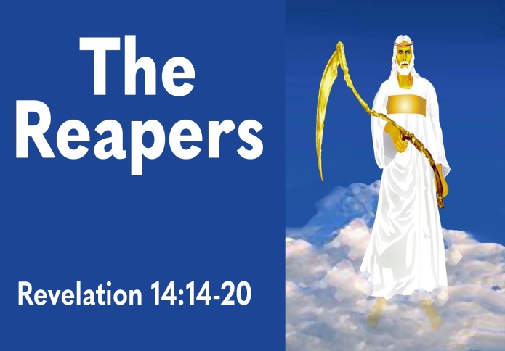
Revelation 14
The Everlasting Gospel
Second Three Angles: The Harvest Of Wrath
Revelation 14:15. And another angel came out of the temple, crying with a loud voice to him that sat on the cloud, Thrust in thy sickle, and reap: for the time is come for thee to reap; for the harvest of the earth is ripe.
It is time for the second group of three angels described in this verse to bring their messages of judgment. The first three angels had warned the earth of imminent judgment; the last three speak of the implementation of that judgment, ordering and arranging the coming battle of the great day of God at Armageddon.

Slide 41
Revelation 14
The Everlasting Gospel
Second Three Angles: The Harvest Of Wrath
Revelation 14:15. And another angel came out of the temple, crying with a loud voice to him that sat on the cloud, Thrust in thy sickle, and reap: for the time is come for thee to reap; for the harvest of the earth is ripe. (Cont’d)
The last three angels now make their appearances in rapid succession. The first one emerges from a waiting period in the temple (probably the earthly temple) to cry out to the Son of man on the cloud.
The angel had perhaps been observing the abominable defilement of the temple by the beast and his image, and so cries up to the heavens, entreating the Lord not to delay any longer.
A created angel cannot, of course, command the Son of man to proceed with judgment, so that his cry should be regarded as a plea rather than as a demand.

Slide 42
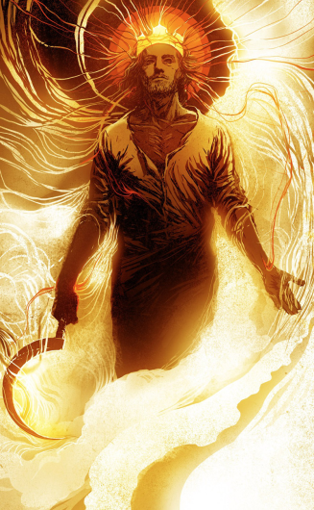
Revelation 14
The Everlasting Gospel
Second Three Angles: The Harvest Of Wrath
Revelation 14:16. And he that sat on the cloud thrust in his sickle on the earth; and the earth was reaped.
The “reaping of the earth” is apparently something different than “gathering the vine of the earth” (verse 19), though the great sickle of judgment is used in both.
The first reaping is apparently a “harvest” of grain, the second a “vintage” of grapes. The first is cut and threshed, the second is gathered for the winepress.
Probably the first refers to all the worldwide judgments of the second half of the tribulation

Slide 43
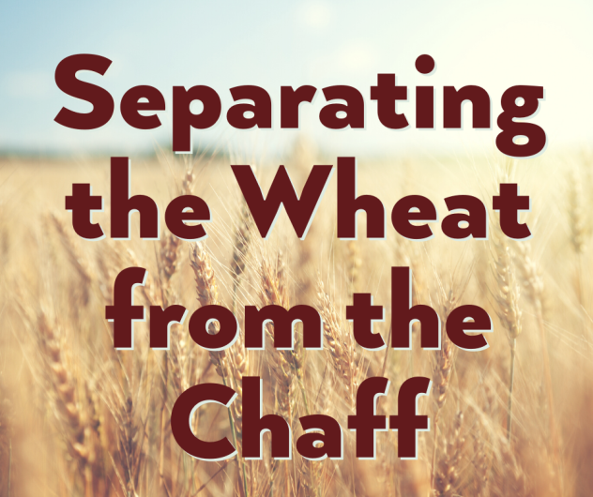
Revelation 14
The Everlasting Gospel
Second Three Angles: The Harvest Of Wrath
Revelation 14:16. And he that sat on the cloud thrust in his sickle on the earth; and the earth was reaped. (Cont'd)
The second refers more specifically to the final judgment of the beast and all his followers at Armageddon.
The climax of this reaping of the earth at Babylon is described in Revelation 17 and 18, but was long ago prophesied also by Jeremiah (Jeremiah 51:33).
The harvesting of Babylon will separate wheat and chaff (Matthew 13:40-42).
Notes:
Jeremiah 51:33-For thus saith the LORD of hosts, the God of Israel; The daughter of Babylon is like a threshingfloor, it is time to thresh her: yet a little while, and the time of her harvest shall come.
Matthew 13:40-42-As therefore the tares are gathered and burned in the fire; so shall it be in the end of this world.
41The Son of man shall send forth his angels, and they shall gather out of his kingdom all things that offend, and them which do iniquity;
42And shall cast them into a furnace of fire: there shall be wailing and gnashing of teeth.

Slide 44
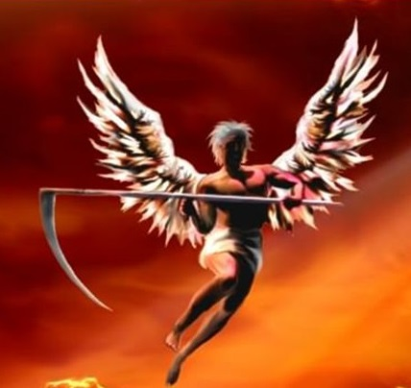
Revelation 14
The Everlasting Gospel
Second Three Angles: The Harvest Of Wrath
Revelation 14:17. And another angel came out of the temple which is in heaven, he also having a sharp sickle.
The harvest of the earth has been undertaken by the Son of man Himself, quite possibly because He is still seeking to save that which is lost.
To another angel, however, He assigns the task of reaping “the vine of the earth,” casting these all into the trampling of the vintage of the great winepress of the wrath of God.

Slide 45
Revelation 14
The Everlasting Gospel
Second Three Angles: The Harvest Of Wrath
Revelation 14:17. And another angel came out of the temple which is in heaven, he also having a sharp sickle. (Cond’t)
Possibly this is one of the “presence angels” (see Revelation 8:2) since he was in the temple of God’s presence in the heavenlies.
He is assigned a ministry quite close to that of the Son of man Himself, wielding the great sickle of judgment.
Notes:
Revelation 8:2-And I saw the seven angels which stood before God; and to them were given seven trumpets.

Slide 46
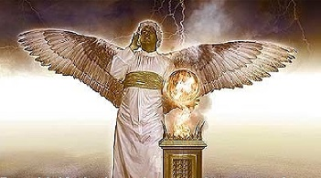
Revelation 14
The Everlasting Gospel
Second Three Angles: The Harvest Of Wrath
Revelation 14:18. And another angel came out from the altar, which had power over fire; and cried with a loud cry to him that had the sharp sickle, saying, Thrust in thy sharp sickle, and gather the clusters of the vine of the earth; for her grapes are fully ripe.
Finally the sixth angel of Revelation 14 appears and this angel, like the fourth, is on the earth, assigned evidently to attend the altar in the temple at Jerusalem.
As the fourth angel had entreated the Son of man to thrust in His sickle and reap the harvest of the earth, so now the sixth angel will beseech the fifth angel, sent by the Son of man, to thrust in his sickle and gather the vintage of the earth.

Slide 47

Revelation 14
The Everlasting Gospel
Second Three Angles: The Harvest Of Wrath
Revelation 14:18. And another angel came out from the altar, which had power over fire; and cried with a loud cry to him that had the sharp sickle, saying, Thrust in thy sharp sickle, and gather the clusters of the vine of the earth; for her grapes are fully ripe. (Cont'd)
The “vine of the earth” contrasts diametrically with the vine of heaven. Jesus said “I am the true vine” (John 15:1).
The fruit of the “vine of the earth,” however, yields sour grapes and bitter wine and is about to be trampled in the divine presses.
The false vine, with all its branches visibly joined to it by the tell-tale “mark,” can only refer to the great counterfeit system of Antichrist.
Notes:
John 15:1-I am the true vine, and my Father is the husbandman.

Slide 48
Revelation 14
The Everlasting Gospel
Second Three Angles: The Harvest Of Wrath
Revelation 14:19. And the angel thrust in his sickle into the earth, and gathered the vine of the earth, and cast it into the great winepress of the wrath of God.
The thrusting of the sickle to cut the vine of the earth obviously speaks of a rapid displacement of all the followers of the beast from their home countries. They are to be gathered to one place (Joel 3:2; Zechariah 14:2; Revelation 16:16;19:19).
The “winepress” into which they are to be cast is the place ordained for ages to be the locale of the last great conflict between Christ and Antichrist (Joel 3:14).
Notes:
Joel 3:2-I will also gather all nations, and will bring them down into the valley of Jehoshaphat, and will plead with them there for my people and for my heritage Israel, whom they have scattered among the nations, and parted my land.
Zechariah 14:2-And it shall come to pass in that day, saith the LORD of hosts, that I will cut off the names of the idols out of the land, and they shall no more be remembered: and also I will cause the prophets and the unclean spirit to pass out of the land.
Revelation 16:16-And he gathered them together into a place called in the Hebrew tongue Armageddon.
Revelation19:19-And I saw the beast, and the kings of the earth, and their armies, gathered together to make war against him that sat on the horse, and against his army.
Joel 3:14-Multitudes, multitudes in the valley of decision: for the day of the LORD is near in the valley of decision.

Slide 49
Revelation 14
The Everlasting Gospel
Second Three Angles: The Harvest Of Wrath
Revelation 14:20. And the winepress was trodden without the city, and blood came out of the winepress, even unto the horse bridles, by the space of a thousand and six hundred furlongs.
As John looks forward in his vision toward the end of the tribulation period, he could hardly have anticipated the awful scene that eventually unfolds in his prophetic vision.
Nothing less than the sudden spilling of the blood of all the unnumbered multitudes massed together in a great body extending through the whole land of Israel is the terrible sight entrusted to him.
The bloodshed is so massive and so quick that the only apt comparison is the spurting of the juice from ripe fruit beneath the feet of the grape-tramplers in a winepress.

Slide 50
Revelation 14
The Everlasting Gospel
Second Three Angles: The Harvest Of Wrath
Revelation 14:20. And the winepress was trodden without the city, and blood came out of the winepress, even unto the horse bridles, by the space of a thousand and six hundred furlongs. (Cont'd)
The hordes of soldiers and civilians, their gaze transfixed on an amazing scene in the heavens, suddenly explode like bursting grapes, and the blood pours from a billion fountains.
This vat of blood will extend for sixteen hundred furlongs, or a distance of approximately 200 miles.
And when the blood suddenly bursts forth from the bodies of these multitudes, in addition to the blood of the horses on which they are mounted, the sea of humanity will become a sea of blood.
Notes:
Furlong = 220 yards or 660 feet
1600 furlongs = 1600 x 660 =105,600 ft or 200 miles

Slide 51
Revelation 14
The Everlasting Gospel
Second Three Angles: The Harvest Of Wrath
Revelation 14:20. And the winepress was trodden without the city, and blood came out of the winepress, even unto the horse bridles, by the space of a thousand and six hundred furlongs. (Cont'd)
All of this will take place “without the city,” so that the Holy City itself will not be polluted with this bath of blood.
The great phalanx (mass) will project deep into Edom, in fact, at least as far as the ancient Edomite stronghold of Bozrah.
• On the north it will extend to and beyond the great plains of Esdraelon, or the valley of Jezreel, near the town of Megiddo.
•The center of the phalanx will be concentrated in the Judaean wilderness opposite Jerusalem, called in Scripture “the valley of Jehoshaphat.”

Slide 52
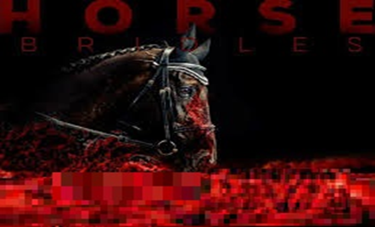
Revelation 14
The Everlasting Gospel
Second Three Angles: The Harvest Of Wrath
Revelation 14:20. And the winepress was trodden without the city, and blood came out of the winepress, even unto the horse bridles, by the space of a thousand and six hundred furlongs. (Cont'd)
It is this great valley in which the blood flows, at its center, will reach the bridles of the horses (Isaiah 34:6; 63:1-4; Revelation 16:14-16; 19:13-15; Joel 3:12-13).
Notes:
Isaiah 34:6-The sword of the LORD is filled with blood, it is made fat with fatness, and with the blood of lambs and goats, with the fat of the kidneys of rams: for the LORD hath a sacrifice in Bozrah, and a great slaughter in the land of Idumea.
Isaiah 63:1-4-Who is this that cometh from Edom, with dyed garments from Bozrah? this that is glorious in his apparel, travelling in the greatness of his strength? I that speak in righteousness, mighty to save.
2Wherefore art thou red in thine apparel, and thy garments like him that treadeth in the winefat?
3I have trodden the winepress alone; and of the people there was none with me: for I will tread them in mine anger, and trample them in my fury; and their blood shall be sprinkled upon my garments, and I will stain all my raiment.
4For the day of vengeance is in mine heart, and the year of my redeemed is come.
Revelation 16:14-16-For they are the spirits of devils, working miracles, which go forth unto the kings of the earth and of the whole world, to gather them to the battle of that great day of God Almighty.
15Behold, I come as a thief. Blessed is he that watcheth, and keepeth his garments, lest he walk naked, and they see his shame.
16And he gathered them together into a place called in the Hebrew tongue Armageddon.
Revelation 19:13-15-And he was clothed with a vesture dipped in blood: and his name is called The Word of God.
14And the armies which were in heaven followed him upon white horses, clothed in fine linen, white and clean.
15And out of his mouth goeth a sharp sword, that with it he should smite the nations: and he shall rule them with a rod of iron: and he treadeth the winepress of the fierceness and wrath of Almighty God.
Joel 3:12-13-Let the heathen be wakened, and come up to the valley of Jehoshaphat: for there will I sit to judge all the heathen round about.
13Put ye in the sickle, for the harvest is ripe: come, get you down; for the press is full, the fats overflow; for their wickedness is great.

Slide 53
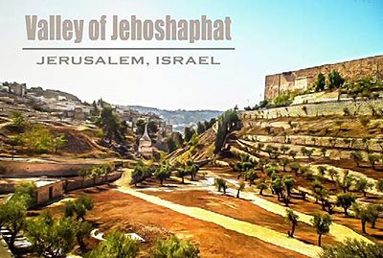
Revelation 14
The Everlasting Gospel
Second Three Angles: The Harvest Of Wrath
Revelation 14:20. And the winepress was trodden without the city, and blood came out of the winepress, even unto the horse bridles, by the space of a thousand and six hundred furlongs. (Cont'd)
But what is the occasion for such an unprecedented assemblage of the armies of the earth in the Holy Land?
It is evident that something of great magnitude has happened in Jerusalem since the installation of the beast’s image in the holy place at the middle of the tribulation.

Slide 54
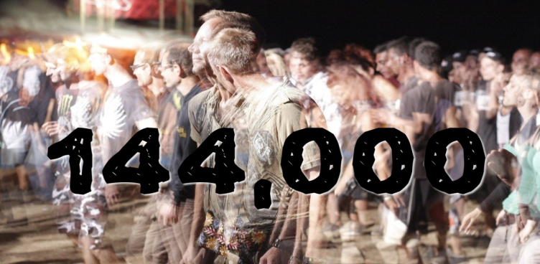
Revelation 14
The Everlasting Gospel
Second Three Angles: The Harvest Of Wrath
Revelation 14:20. And the winepress was trodden without the city, and blood came out of the winepress, even unto the horse bridles, by the space of a thousand and six hundred furlongs. (Cont'd)
Although the Scriptures are not explicit as to how this will all be accomplished, the vision of the 144,000 Israelites on Mount Zion with which this chapter began implies that their return to Jerusalem has something to do with it.
Perhaps (and this is only a speculation) the 144,000, after teaching their people in the wilderness for almost three-and-a-half years, preparing them for the coming of their Messiah, return to Jerusalem to meet Him there when He comes.

Slide 55
THIS CONCLUDES REVELATION 14

