Slide 1


Slide 2
Revelation 13
The Unholy Trinity
Introduction
In the previous chapter, we saw a dragon with seven heads and ten horns who attempted to intercept the promised child and subsequently persecuted the woman who gave birth to the child. The dragon however was not able to destroy the woman. This caused him to become enraged and to make war with her offspring.
Now in chapter 13 the scene shifts to describe a beast who has seven heads and ten horns, who is closely identified with the dragon. He and the false prophet institute a series of deceptions which bring the whole world under the sway of this beast who is the Antichrist.

Slide 3
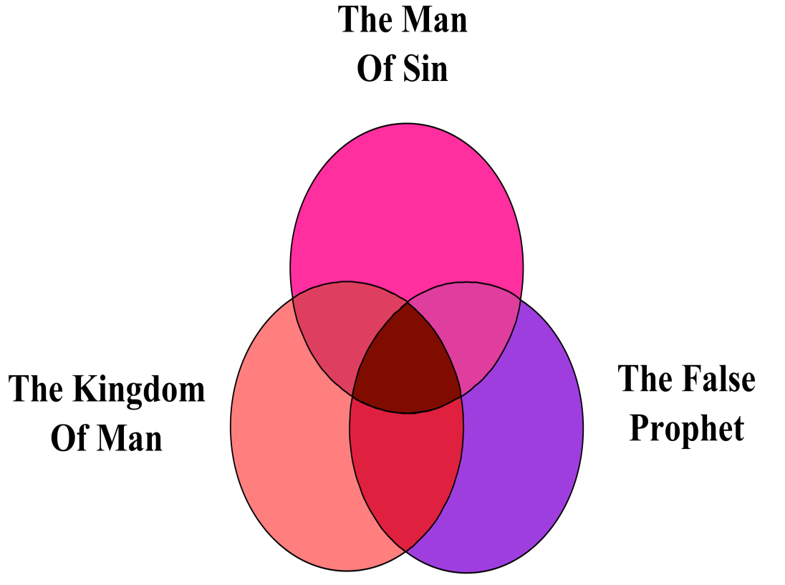
Revelation 13
The Unholy Trinity
Introduction (Cont’d)
Outline for Chapter 13
The Man of Sin
The Kingdom of Man
The False Prophet
Six Hundred Sixty-Six

Slide 4
Revelation 13
The Unholy Trinity
Introduction (Cont’d)
This is another key chapter of the Revelation, describing the rise of two ungodly men who will play two extremely important roles in the climactic events of the end-times.
They are both called “beasts” in this chapter, though later this second is also called the “the false prophet.”
Both receive their brilliance and power from Satan, the old dragon.
The dragon, the beast, and the false prophet seem almost intentionally to be counterfeiting the Father, The Son, and Holy Spirit, respectively.

Slide 5
Revelation 13
The Unholy Trinity
Introduction (Cont’d)
These three willfully and maliciously pull all stops in their last ditch-efforts to dethrone God and destroy His saints.
The first of these wicked men has, of course already been mentioned in Revelation.
God’s two witnesses had been slain by the beast (Rev. 11:7), leading to his assumption of full power for the last forty two months of the tribulation.
Notes:
Rev. 11:7-And when they shall have finished their testimony, the beast that ascendeth out of the bottomless pit shall make war against them, and shall overcome them, and kill them.

Slide 6
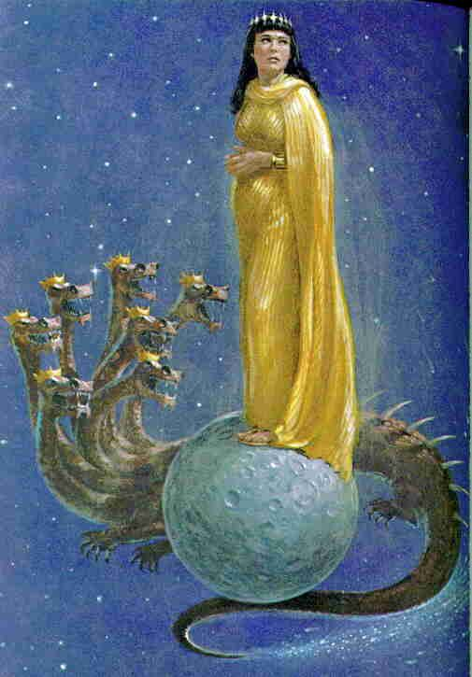
Revelation 13
The Unholy Trinity
The Man of Sin
Revelation 13:1. And I stood upon the sand of the sea, and saw a beast rise up out of the sea, having seven heads and ten horns, and upon his horns ten crowns, and upon his heads the name of blasphemy.
John’s gaze had been fixed, as it were, on the two great signs in the heavens, the sign of the woman and the sign of the dragon.
Even though the word “sign” is not used on this occasion, the whole context makes it evident that the scene is symbolic.
The beast rising out of the sea is not the same as the dragon, however, even though their appearances are similar.

Slide 7
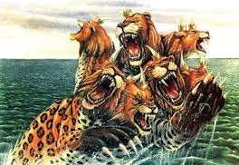
Revelation 13
The Unholy Trinity
The Man of Sin
Revelation 13:1. And I stood upon the sand of the sea, and saw a beast rise up out of the sea, having seven heads and ten horns, and upon his horns ten crowns, and upon his heads the name of blasphemy. (Cont’d)
If the beast from the sea is symbolic, then the sea also must be symbolic. Usually the sea in Scripture, if not more specifically identified, is the great sea west of Israel, that is, the Mediterranean Sea.

Slide 8
Revelation 13
The Unholy Trinity
The Man of Sin
Revelation 13:1. And I stood upon the sand of the sea, and saw a beast rise up out of the sea, having seven heads and ten horns, and upon his horns ten crowns, and upon his heads the name of blasphemy. (Cont’d)
A land mammal ascending from the Mediterranean Sea could only speak of some powerful personage emerging from the peoples of the Mediterranean lands, with the hybrid characteristics of the beast suggesting that he is somehow a product of all of them.
And four great beasts came up from the sea, diverse one from another. Dan. 7:3
These great beasts, which are four, are four kings, which shall arise out of the earth. Dan. 7:17
Notes:
Dan. 7:3-And four great beasts came up from the sea, diverse one from another.
Dan. 7:17-These great beasts, which are four, are four kings, which shall arise out of the earth.

Slide 9
Revelation 13
The Unholy Trinity
The Man of Sin
Revelation 13:2. And the beast which I saw was like unto a leopard, and his feet were as the feet of a bear, and his mouth as the mouth of a lion: and the dragon gave him his power, and his seat, and great authority.
John would remind us again that he was actually witnessing this important sign as it developed.
With a leopard’s body, a bear’s feet, and a lion’s mouth, this beast clearly partakes of the natures of Daniel’s beasts. To understand the one, we must first understand the others.
It is usual to interpret the four beasts of Daniel 7 as the historical empires of Babylonia, Medo-Persia, Greece, and Rome, in order.

Slide 10
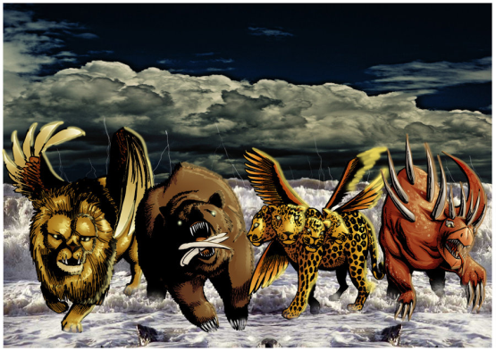
Revelation 13
The Unholy Trinity
The Man of Sin
Revelation 13:2. And the beast which I saw was like unto a leopard, and his feet were as the feet of a bear, and his mouth as the mouth of a lion: and the dragon gave him his power, and his seat, and great authority. (Cont’d)
However, there are difficulties in applying the same interpretation to the beasts of Daniel 7.
Although they do appear in order, the four beasts seem to be contemporaneous rather than sequential (Dan. 7:2, 11, 12, 17).
Thus it seems probable that the four beasts of Daniel 7 represent four great kingdoms, one each from the north, south, east, and west, like the four winds striving over the sea.
The fourth beast, evidently unidentifiable in terms of animals known to Daniel, was “dreadful and terrible, and strong exceedingly,” eventually dominating the other.
Notes:
Dan. 7:2-Daniel spake and said, I saw in my vision by night, and, behold, the four winds of the heaven strove upon the great sea.
Dan. 7:11-12-I beheld then because of the voice of the great words which the horn spake: I beheld even till the beast was slain, and his body destroyed, and given to the burning flame.
12As concerning the rest of the beasts, they had their dominion taken away: yet their lives were prolonged for a season and time.
Dan. 7:17-These great beasts, which are four, are four kings, which shall arise out of the earth.

Slide 11
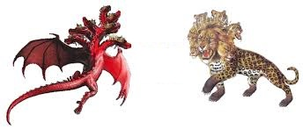
Revelation 13
The Unholy Trinity
The Man of Sin
Revelation 13:2. And the beast which I saw was like unto a leopard, and his feet were as the feet of a bear, and his mouth as the mouth of a lion: and the dragon gave him his power, and his seat, and great authority. (Cont’d)
It is apparently this last beast that John sees emerging from the sea.
It was not by his own strength or his own strategy that the beast has come into such a position of world eminence.
The beast, as did the dragon who empowered him, was seen by John to have seven heads and ten horns.

Slide 12

Revelation 13
The Unholy Trinity
The Man of Sin
Revelation 13:2. And the beast which I saw was like unto a leopard, and his feet were as the feet of a bear, and his mouth as the mouth of a lion: and the dragon gave him his power, and his seat, and great authority. (Cont’d)
That these seven heads represent seven historical kingdoms is indicated also in Rev. 17:9-11.
The identity of these kingdoms is not specified, but it seems reasonable that they represent the seven great powers that came into particular opposition to the plan of God as it was unfolding throughout history, as recorded in Scripture.
Notes:
Rev. 17:9-11-And here is the mind which hath wisdom. The seven heads are seven mountains, on which the woman sitteth.
10And there are seven kings: five are fallen, and one is, and the other is not yet come; and when he cometh, he must continue a short space.
11And the beast that was, and is not, even he is the eighth, and is of the seven, and goeth into perdition.

Slide 13
Revelation 13
The Unholy Trinity
The Man of Sin
Revelation 13:2. And the beast which I saw was like unto a leopard, and his feet were as the feet of a bear, and his mouth as the mouth of a lion: and the dragon gave him his power, and his seat, and great authority. (Cont’d)
With these considerations in mind, the most likely identification of these seven historical kingdoms is as follows:
1. Sumeria - Under Nimrod, Babel became the first postdiluvian center of human rebellion.
2. Egypt - Israel’s first oppressor

Slide 14
Revelation 13
The Unholy Trinity
The Man of Sin
Revelation 13:2. And the beast which I saw was like unto a leopard, and his feet were as the feet of a bear, and his mouth as the mouth of a lion: and the dragon gave him his power, and his seat, and great authority. (Cont’d)
3. Assyria - Invading armies carried the people of the northern kingdom into captivity.
4. Babylonia - Nebuchadnezzar carrying people of Judah into captivity.
5. Medo-Persia - The nation under which the Jews would have been exterminated by Haman.

Slide 15
Revelation 13
The Unholy Trinity
The Man of Sin
Revelation 13:2. And the beast which I saw was like unto a leopard, and his feet were as the feet of a bear, and his mouth as the mouth of a lion: and the dragon gave him his power, and his seat, and great authority. (Cont’d)
6. Greece - The Greek language became the language of the New Testament and Greek philosophy has dominated the Judaeo-Christian world ever since.
7. Rome - The greatest of the seven empires politically was Rome, which ruled at the time of Christ and severely persecuted the early Christians.

Slide 16
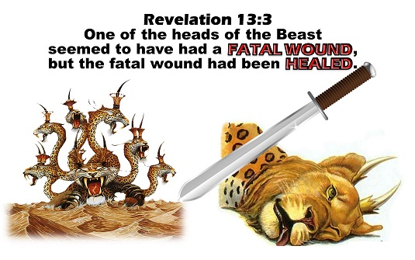
Revelation 13
The Unholy Trinity
The Man of Sin
Revelation 13:3. And I saw one of his heads as it were wounded to death; and his deadly wound was healed: and all the world wondered after the beast.
If the interpretation of the seven heads and seven kingdoms suggested above is correct, then one of them is apparently going to be revived in the last days.
Which of the heads is revived is not stated, although many expositors consider this to be a reference to the revival of the old Roman empire.
It is interesting that most of these ancient nations are today experiencing something of a revival.

Slide 17
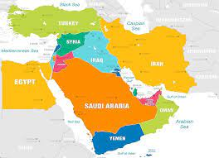
Revelation 13
The Unholy Trinity
The Man of Sin
Revelation 13:3. And I saw one of his heads as it were wounded to death; and his deadly wound was healed: and all the world wondered after the beast. (Cont’d)
Egypt has attempted to become spokesman for the Islamic world.
Persia, which is modern Iran, has likewise captured world attention because of its oil resources and militant Moslem fundamentalism.
Iraq corresponds to ancient Babylonia and Assyria and it has become with the U.S. help a strong Arab nation militarily.
Greece is still an important Mediterranean nation and a member of NATO.

Slide 18
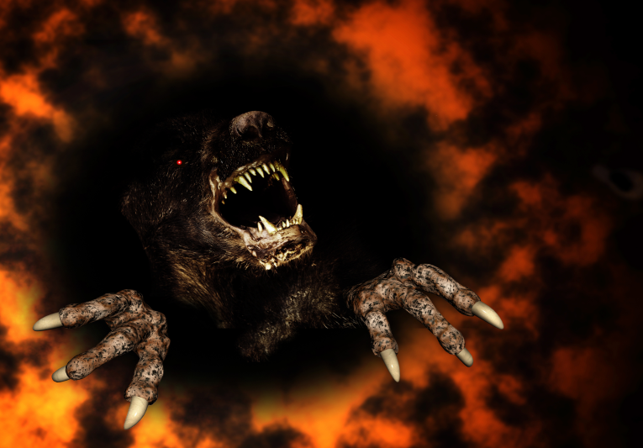
Revelation 13
The Unholy Trinity
The Man of Sin
Revelation 13:3. And I saw one of his heads as it were wounded to death; and his deadly wound was healed: and all the world wondered after the beast. (Cont’d)
None of these “revivals,” however, are sufficiently striking to make all the world “wonder after the beast.”
The beast, of course, is devil empowered an ascends out of the abyss (Rev. 11:7).
Although he himself is not the wounded head of the beast, his own recovery from the deadly wound will bear such striking analogy to the revival of the ancient nation represented by the head as to make a profound and stirring impression on every nation.
Notes:
Rev. 11:7-And when they shall have finished their testimony, the beast that ascendeth out of the bottomless pit shall make war against them, and shall overcome them, and kill them.

Slide 19
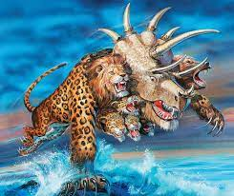
Revelation 13
The Unholy Trinity
The Man of Sin
Revelation 13:3. And I saw one of his heads as it were wounded to death; and his deadly wound was healed: and all the world wondered after the beast. (Cont’d)
The head that will be revived will certainly be also the kingdom that will best epitomize the nature and purposes of the dragon who empowers the beast.
It will be noted that the middle head on the beast is Babylon which would most appropriately be the chief head on the beast.
The possibility of reconstructing Babylon has been seriously considered in recent years. It is ideally situated, being very near the geographical center of the earth’s land masses, to serve as a world capital.

Slide 20
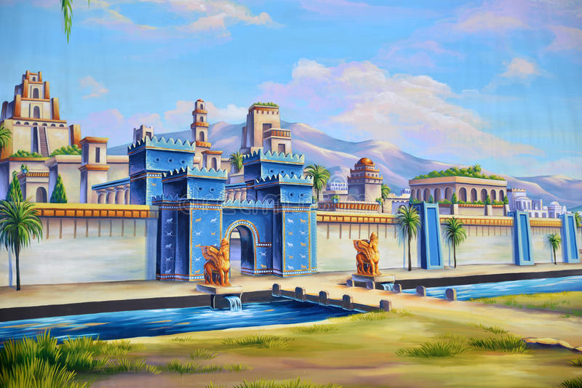
Revelation 13
The Unholy Trinity
The Man of Sin
Revelation 13:3. And I saw one of his heads as it were wounded to death; and his deadly wound was healed: and all the world wondered after the beast. (Cont’d)
Not only could Babylon serve as the political center of the world, but also as its commercial, cultural, and religious center.
And since the beast himself would have also experienced a remarkable personal (pseudo) death and resurrection, all the world would indeed marvel at the great power of the beast and the magnificence of his capital city.

Slide 21
Revelation 13
The Unholy Trinity
The Man of Sin
Revelation 13:4. And they worshipped the dragon which gave power unto the beast: and they worshipped the beast, saying, Who is like unto the beast? who is able to make war with him?
For many years prior to the rapture, a revival of various forms of ancient occultism will have been developing. This movement will be tremendously accelerated when Christ returns.
During the first three-and-a-half years of the tribulation, the preaching of Christ’s two witnesses, combined with the great judgments of the seals and trumpets, will finally eliminate every vestige of the scientific skepticism.

Slide 22
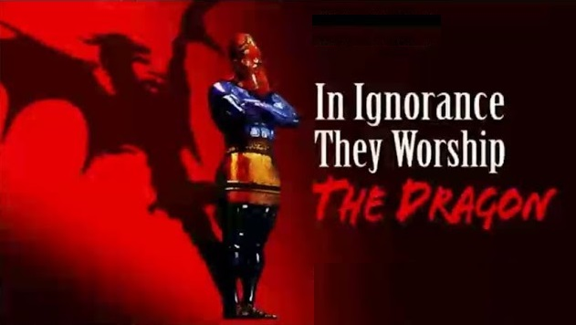
Revelation 13
The Unholy Trinity
The Man of Sin
Revelation 13:4. And they worshipped the dragon which gave power unto the beast: and they worshipped the beast, saying, Who is like unto the beast? who is able to make war with him? (Cont’d)
Men and women will have had many other evidences which will finally convince even the most skeptical of the reality of both God and Satan.
But then they will choose Satan.
They will acknowledge him as the rightful king of the cosmos.

Slide 23
Revelation 13
The Unholy Trinity
The Man of Sin
Revelation 13:4. And they worshipped the dragon which gave power unto the beast: and they worshipped the beast, saying, Who is like unto the beast? who is able to make war with him? (Cont’d)
Furthermore, they will acknowledge that the dragon had granted universal authority to his human counterpart, the beast, and so will worship the latter as well.
The three-and-a-half-year drought has been relieved, the plagues have stopped, the witnesses are gone; the beast is in charge, and the dragon and his angels have come to the earth.

Slide 24
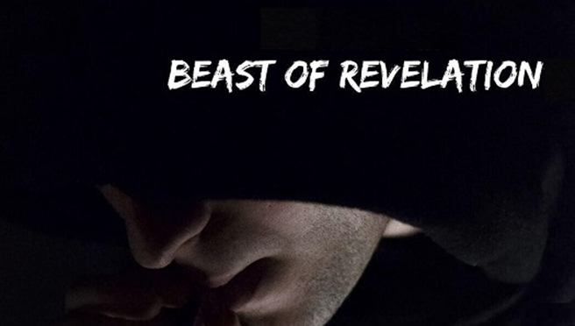
Revelation 13
The Unholy Trinity
The Man of Sin
Revelation 13:5. And there was given unto him a mouth speaking great things and blasphemies; and power was given unto him to continue forty and two months.
The mouth of the beast began to roar out great things. Counterfeiting God’s divinely inspired prophets of old, he makes satanically-inspired proclamations and predictions, filled with blasphemies against the true God and His Christ.

Slide 25
Revelation 13
The Unholy Trinity
The Man of Sin
Revelation 13:5. And there was given unto him a mouth speaking great things and blasphemies; and power was given unto him to continue forty and two months. (Cont’d)
Men will believe him, sad to say. With minds deceived and blinded by Satan (2 Corinthians 4:4; Revelation 12:9), further confused by drug addiction (Revelation 9:21) and benumbed by sins of every description, they will believe his blasphemies (2 Thessalonians 2:9-12).
His authority was to endure for only forty-two months. It is also the same period in which God will specially protect His people in the wilderness (Revelation 12:6,14).
Notes:
2 Corinthians 4:4-In whom the god of this world hath blinded the minds of them which believe not, lest the light of the glorious gospel of Christ, who is the image of God, should shine unto them.
Revelation 12:9-And the great dragon was cast out, that old serpent, called the Devil, and Satan, which deceiveth the whole world: he was cast out into the earth, and his angels were cast out with him.
Revelation 9:21-Neither repented they of their murders, nor of their sorceries, nor of their fornication, nor of their thefts.
2 Thessalonians 2:9-12-Even him, whose coming is after the working of Satan with all power and signs and lying wonders,
10And with all deceivableness of unrighteousness in them that perish; because they received not the love of the truth, that they might be saved.
11And for this cause God shall send them strong delusion, that they should believe a lie:
12That they all might be damned who believed not the truth, but had pleasure in unrighteousness.
Revelation 12:6-And the woman fled into the wilderness, where she hath a place prepared of God, that they should feed her there a thousand two hundred and threescore days.
Revelation 12:14-And to the woman were given two wings of a great eagle, that she might fly into the wilderness, into her place, where she is nourished for a time, and times, and half a time, from the face of the serpent.

Slide 26
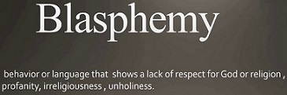
Revelation 13
The Unholy Trinity
The Man of Sin
Revelation 13:6. And he opened his mouth in blasphemy against God, to blaspheme his name, and his tabernacle, and them that dwell in heaven.
Not content merely to rail against God, the dragon-inspired beast must utter attacks and obscenities against all He stands for (His name), defaming His holiness, His love, His law, His grace.
This continual barrage of slander must now take place on earth, since the Devil no longer has access to heaven where he used to accuse the brethren.
Daniel also prophesied of his vile mouth (Daniel 7:8, 20, 25, 11:36).
Notes:
Daniel 7:8-I considered the horns, and, behold, there came up among them another little horn, before whom there were three of the first horns plucked up by the roots: and, behold, in this horn were eyes like the eyes of man, and a mouth speaking great things.
Daniel 7:20-And of the ten horns that were in his head, and of the other which came up, and before whom three fell; even of that horn that had eyes, and a mouth that spake very great things, whose look was more stout than his fellows.
Daniel 7:25-And he shall speak great words against the most High, and shall wear out the saints of the most High, and think to change times and laws: and they shall be given into his hand until a time and times and the dividing of time.
Daniel 11:36-And the king shall do according to his will; and he shall exalt himself, and magnify himself above every god, and shall speak marvellous things against the God of gods, and shall prosper till the indignation be accomplished: for that that is determined shall be done.

Slide 27
Revelation 13
The Unholy Trinity
The Kingdom of Man
Introduction
Ever since Nimrod, there have arisen many powerful and ambitious men who have aspired to rule the world. (Genghis Khan, Napoleon, Hitler, Stalin, and others). But one after another, they have failed.
The idealists of the western world have also dreamed of world government. (Woodrow Wilson and his League of Nations, the modern-day United Nations organization, all have tried and failed.)
Finally, however, there will be a world government of sorts, but once again it will be merely a grand exercise in humanistic futility.

Slide 28
Revelation 13
The Unholy Trinity
The Kingdom of Man
Revelation 13:7. And it was given unto him to make war with the saints, and to overcome them: and power was given him over all kindreds, and tongues, and nations.
The beast’s greatest resistance will be offered by “the saints,” a great number of believers in the true God and His Christ who will have been converted during the first half of the tribulation.
Many believers will be martyred during the first half of the tribulation and many more during the second half as a result of the beast’s vicious campaigns against them. Daniel speaks of this warfare against the saints (Daniel 7:21)
Notes:
Daniel 7:21-I beheld, and the same horn made war with the saints, and prevailed against them;

Slide 29
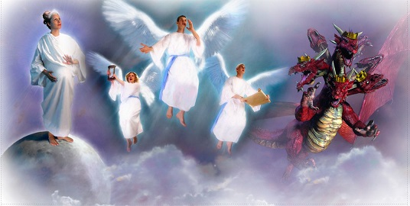
Revelation 13
The Unholy Trinity
The Kingdom of Man
Revelation 13:7. And it was given unto him to make war with the saints, and to overcome them: and power was given him over all kindreds, and tongues, and nations. (Cont’d)
We have noted already that the “woman”, mainly symbolizing at this time Israel’s believing remnant, is supernaturally protected in a special wilderness retreat prepared by God (Revelation 12:6, 13-16).
Notes:
Revelation 12:6-And the woman fled into the wilderness, where she hath a place prepared of God, that they should feed her there a thousand two hundred and threescore days.
Revelation 12:13-16-And when the dragon saw that he was cast unto the earth, he persecuted the woman which brought forth the man child.
14And to the woman were given two wings of a great eagle, that she might fly into the wilderness, into her place, where she is nourished for a time, and times, and half a time, from the face of the serpent.
15And the serpent cast out of his mouth water as a flood after the woman, that he might cause her to be carried away of the flood.
16And the earth helped the woman, and the earth opened her mouth, and swallowed up the flood which the dragon cast out of his mouth.

Slide 30
Revelation 13
The Unholy Trinity
The Kingdom of Man
Revelation 13:7. And there was given unto him a mouth speaking great things and blasphemies; and power was given unto him to continue forty and two months. (Cont’d)
The beast must also conquer the other nations of the world and their armies and this conquest will occupy much of his attention during the first half of the tribulation.
Some of the beast’s struggles to attain supremacy over the nations are outlined in Daniel 7:3-8, Daniel 11:19-25, Daniel 11:45, Daniel 12:1, Daniel 12:6-7.
Thus was “power” (the word actually means “authority”) given to him over every nation, every language group within that nation, and every clan within the language group.
Notes:
Daniel 7:3-8-And there appeared another wonder in heaven; and behold a great red dragon, having seven heads and ten horns, and seven crowns upon his heads.
4And his tail drew the third part of the stars of heaven, and did cast them to the earth: and the dragon stood before the woman which was ready to be delivered, for to devour her child as soon as it was born.
5And she brought forth a man child, who was to rule all nations with a rod of iron: and her child was caught up unto God, and to his throne.
6And the woman fled into the wilderness, where she hath a place prepared of God, that they should feed her there a thousand two hundred and threescore days.
7And there was war in heaven: Michael and his angels fought against the dragon; and the dragon fought and his angels,
8And prevailed not; neither was their place found any more in heaven.
Daniel 11:19-25-Then he shall turn his face toward the fort of his own land: but he shall stumble and fall, and not be found.
20Then shall stand up in his estate a raiser of taxes in the glory of the kingdom: but within few days he shall be destroyed, neither in anger, nor in battle.
21And in his estate shall stand up a vile person, to whom they shall not give the honour of the kingdom: but he shall come in peaceably, and obtain the kingdom by flatteries.
22And with the arms of a flood shall they be overflown from before him, and shall be broken; yea, also the prince of the covenant.
23And after the league made with him he shall work deceitfully: for he shall come up, and shall become strong with a small people.
24He shall enter peaceably even upon the fattest places of the province; and he shall do that which his fathers have not done, nor his fathers' fathers; he shall scatter among them the prey, and spoil, and riches: yea, and he shall forecast his devices against the strong holds, even for a time.
25And he shall stir up his power and his courage against the king of the south with a great army; and the king of the south shall be stirred up to battle with a very great and mighty army; but he shall not stand: for they shall forecast devices against him.
Daniel 11:45-And he shall plant the tabernacles of his palace between the seas in the glorious holy mountain; yet he shall come to his end, and none shall help him.
Daniel 12:1-And at that time shall Michael stand up, the great prince which standeth for the children of thy people: and there shall be a time of trouble, such as never was since there was a nation even to that same time: and at that time thy people shall be delivered, every one that shall be found written in the book.
Daniel 12:6-7-And one said to the man clothed in linen, which was upon the waters of the river, How long shall it be to the end of these wonders?
7And I heard the man clothed in linen, which was upon the waters of the river, when he held up his right hand and his left hand unto heaven, and sware by him that liveth for ever that it shall be for a time, times, and an half; and when he shall have accomplished to scatter the power of the holy people, all these things shall be finished.

Slide 31
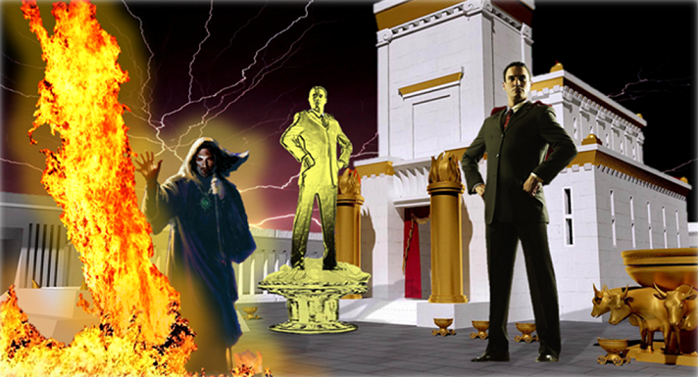
Revelation 13
The Unholy Trinity
The Kingdom of Man
Revelation 13:8. And all that dwell upon the earth shall worship him, whose names are not written in the book of life of the Lamb slain from the foundation of the world.
All men and women everywhere, every nation, will worship this very brilliant but evil man. They will reject the true God as God, even though they no longer doubt His existence (Romans 1:25).
Notes:
Romans 1:25-Who changed the truth of God into a lie, and worshipped and served the creature more than the Creator, who is blessed for ever. Amen.

Slide 32
Revelation 13
The Unholy Trinity
The Kingdom of Man
Revelation 13:8. And all that dwell upon the earth shall worship him, whose names are not written in the book of life of the Lamb slain from the foundation of the world. (Cond’t)
Here is humanism gone mad, that man himself is the pinnacle attained by the cosmic process of evolution and thus that man himself is God.
Not all those whose names are written in the Lamb’s book of life will have, to this point, made an open profession of faith in Christ. But they will in good time.
Many of these are godly Israelites, preserved by God in the wilderness until such time as they come to understand and acknowledge the Lord Jesus Christ as their Messiah and Savior.

Slide 33
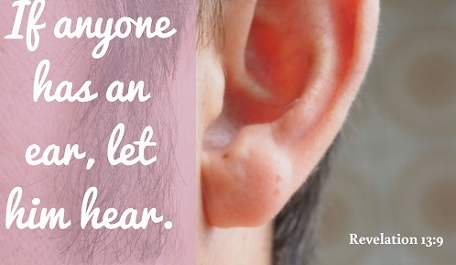
Revelation 13
The Unholy Trinity
The Kingdom of Man
Revelation 13:9. If any man have an ear, let him hear.
This is the same pleading message which John had earlier conveyed from the Lord to the angels of the seven churches.

Slide 34
Revelation 13
The Unholy Trinity
The Kingdom of Man
Revelation 13:9. If any man have an ear, let him hear. (Cond’t)
In this case, the message was not addressed “to the churches,” since there will be no organized churches. Nevertheless, the admonition is needed more than ever.
If men will worship the beast, they have no part in the book of life.
It is a solemn choice they must make, and they need to hear and understand its implications.

Slide 35
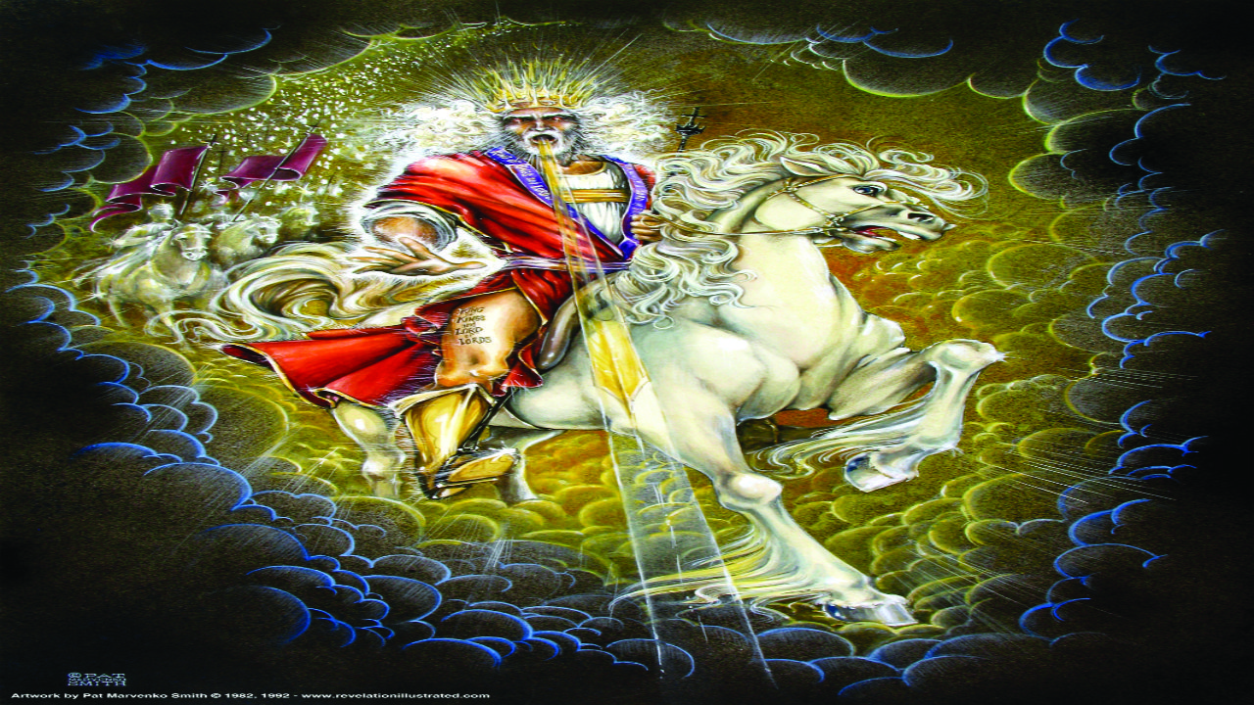
Revelation 13
The Unholy Trinity
The Kingdom of Man
Revelation 13:10. He that leadeth into captivity shall go into captivity: he that killeth with the sword must be killed with the sword. Here is the patience and the faith of the saints.
The Lord graciously interjects here a word of encouragement to those saints who are being persecuted.
Those who capture and execute men who refuse to worship the beast will themselves be slain - perhaps by the awful sword proceeding from the mouth of the coming conqueror (Rev. 19:15).
Notes:
Rev. 19:15-And out of his mouth goeth a sharp sword, that with it he should smite the nations: and he shall rule them with a rod of iron: and he treadeth the winepress of the fierceness and wrath of Almighty God.

Slide 36
Revelation 13
The Unholy Trinity
The Kingdom of Man
Revelation 13:10. He that leadeth into captivity shall go into captivity: he that killeth with the sword must be killed with the sword. Here is the patience and the faith of the saints. (Cond’t)
It is this promise and confidence which will help to sustain the saints through such a bitter time of persecution (Heb. 12:2).
The emphatic “Here!” would urge us to realize that the awful stress of these final days will dwarf anything endured by believers in former days. Here patience and faith are defined.
Notes:
Heb. 12:2-Looking unto Jesus the author and finisher of our faith; who for the joy that was set before him endured the cross, despising the shame, and is set down at the right hand of the throne of God.

Slide 37
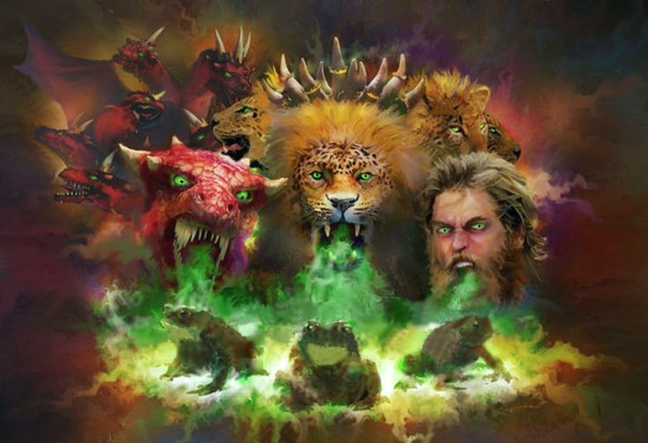
Revelation 13
The Unholy Trinity
The False Prophet
Introduction
The sign of the dragon and the beast now veers to the third member of the infernal trinity. Although he is not identified by this name here, he is three times later in Revelation called “the false prophet,” and is directly associated with the beast and the dragon (Revelation 16:13; 19:20; 20:10)
Notes:
Revelation 16:13-And I saw three unclean spirits like frogs come out of the mouth of the dragon, and out of the mouth of the beast, and out of the mouth of the false prophet.
Revelation 19:20-And the beast was taken, and with him the false prophet that wrought miracles before him, with which he deceived them that had received the mark of the beast, and them that worshipped his image. These both were cast alive into a lake of fire burning with brimstone.
Revelation 20:10-And the devil that deceived them was cast into the lake of fire and brimstone, where the beast and the false prophet are, and shall be tormented day and night for ever and ever.

Slide 38
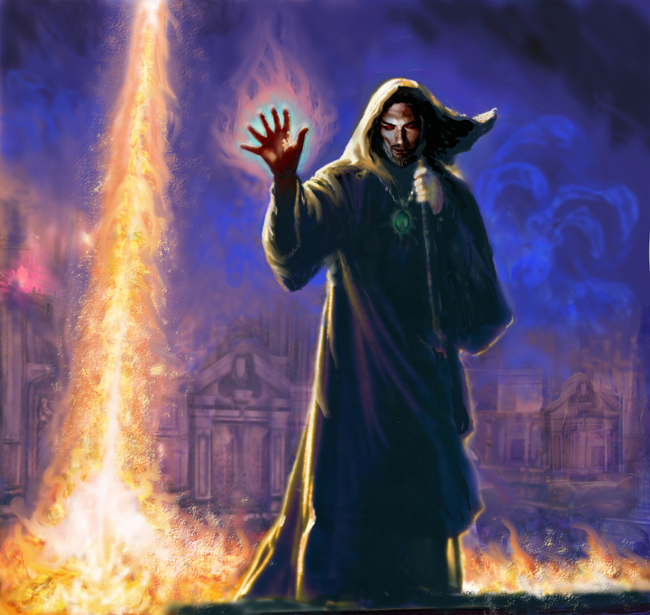
Revelation 13
The Unholy Trinity
The False Prophet
Revelation 13:11. And I beheld another beast coming up out of the earth; and he had two horns like a lamb, and he spake as a dragon.
John sees another beast arising from the earth, instead of from the sea like the first beast.

Slide 39
Revelation 13
The Unholy Trinity
The False Prophet
Revelation 13:11. And I beheld another beast coming up out of the earth; and he had two horns like a lamb, and he spake as a dragon. (Cont’d)
Since the first beast is a man, so is the second, but their backgrounds are different.
The first beast comes from one of the Mediterranean kingdoms (Daniel 9:27 suggests that he comes from the people of the ancient Roman empire.)
The second beast must come from somewhere in the great land masses outside the Mediterranean nations.
Notes:
Daniel 9:27 -And he shall confirm the covenant with many for one week: and in the midst of the week he shall cause the sacrifice and the oblation to cease, and for the overspreading of abominations he shall make it desolate, even until the consummation, and that determined shall be poured upon the desolate.
The “overspreading of abominations” has been interpreted in some commentaries to be the ancient Roman eagle ensigns that being namely, an idol set up on a wing or pinnacle of the temple.

Slide 40
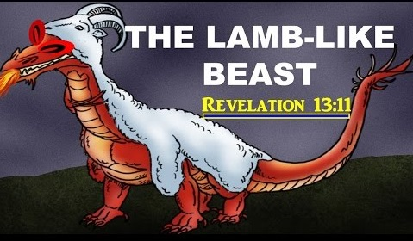
Revelation 13
The Unholy Trinity
The False Prophet
Revelation 13:11. And I beheld another beast coming up out of the earth; and he had two horns like a lamb, and he spake as a dragon. (Cont’d)
Since he is later called the false prophet, he apparently first comes to world attention as a miracle-working religious leader and possibly he is the leader of the world religious system as it will culminate in the last days.
He will originally counterfeit the gentle character of Christ (“two horns like a lamb”), but his “inspired” words will be those of Satan, the old dragon. First they will be sweetly deceptive words, soon they will become deadly, tyrannical, dragon words.

Slide 41
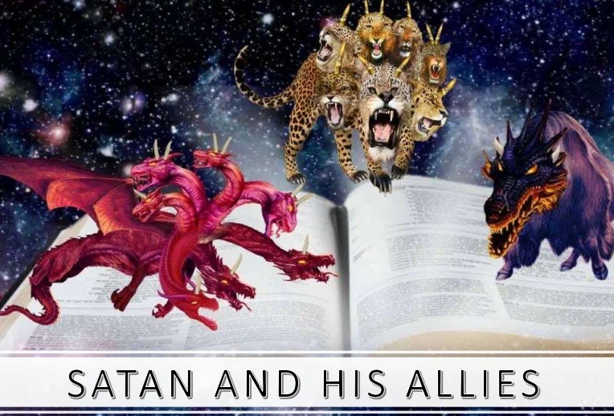
Revelation 13
The Unholy Trinity
The False Prophet
Revelation 13:12. And he exerciseth all the power of the first beast before him, and causeth the earth and them which dwell therein to worship the first beast, whose deadly wound was healed.
The two Satan-empowered men become allies, probably at some time before the actual onset of the tribulation period.

Slide 42
Revelation 13
The Unholy Trinity
The False Prophet
Revelation 13:12. And he exerciseth all the power of the first beast before him, and causeth the earth and them which dwell therein to worship the first beast, whose deadly wound was healed. (Cond’t)
By the time the political power of the first beast is reaching its zenith, the religious union of world religions is also being concentrated under control of the second beast.
With his worldwide reputation as a miracle-working prophet already established, he will see that the remarkable pseudo-resurrection of the beast is widely publicized and idolized around the world to persuade people to acknowledge him as divine and deserving of worship.

Slide 43
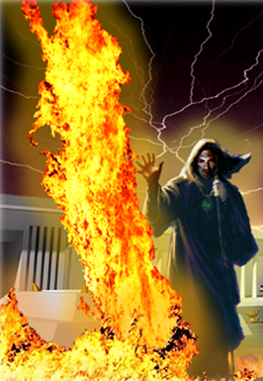
Revelation 13
The Unholy Trinity
The False Prophet
Revelation 13:13. And he doeth great wonders, so that he maketh fire come down from heaven on the earth in the sight of men,
The false prophet will be able to perform certain types of miracles by the power of Satan. Among these wonders will be the ability to call down fire from the sky.
Notes:
Rev. 11:5-And if any man will hurt them, fire proceedeth out of their mouth, and devoureth their enemies: and if any man will hurt them, he must in this manner be killed.

Slide 44
Revelation 13
The Unholy Trinity
The False Prophet
Revelation 13:13. And he doeth great wonders, so that he maketh fire come down from heaven on the earth in the sight of men, (Cond”t)
No doubt he will exploit his ability to produce fire from heaven because this had been one phenomenon which had been used by Christ’s two witnesses (Rev. 11:5).
It was important that men everywhere should see (perhaps on television) that the beast and false prophet had powers similar to those of the witnesses.
Notes:
Rev. 11:5-And if any man will hurt them, fire proceedeth out of their mouth, and devoureth their enemies: and if any man will hurt them, he must in this manner be killed.

Slide 45
Revelation 13
The Unholy Trinity
The False Prophet
Revelation 13:14. And deceiveth them that dwell on the earth by the means of those miracles which he had power to do in the sight of the beast; saying to them that dwell on the earth, that they should make an image to the beast, which had the wound by a sword, and did live.
Thirteen times in Revelation we read about those who “dwell on the earth.” These earth-dwellers easily are subject now to satanic deception and are especially impressed by the prophet’s ability to perform miracles.
Men through the ages have always been profoundly awed by the supernatural.

Slide 46
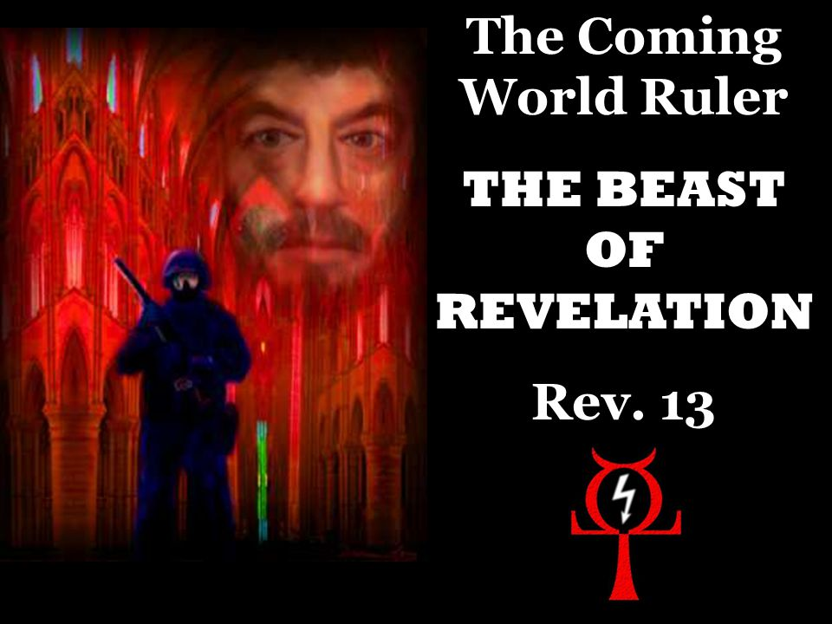
Revelation 13
The Unholy Trinity
The False Prophet
Revelation 13:14. And deceiveth them that dwell on the earth by the means of those miracles which he had power to do in the sight of the beast; saying to them that dwell on the earth, that they should make an image to the beast, which had the wound by a sword, and did live. (Cont’d)
Miracles are not necessarily evidence of divine origin and must always be tested in relation to their purpose and fidelity to Scripture (Isaiah 8:20).
Notes:
Isaiah 8:20-To the law and to the testimony: if they speak not according to this word, it is because there is no light in them.

Slide 47
Revelation 13
The Unholy Trinity
The False Prophet
Revelation 13:14. And deceiveth them that dwell on the earth by the means of those miracles which he had power to do in the sight of the beast; saying to them that dwell on the earth, that they should make an image to the beast, which had the wound by a sword, and did live. (Cont’d)
Especially in the last days will such demon-produced miracles be abundant (Matthew 24:24, 2 Thessalonians 2:9, 2:11, 2:3-4).
Men have always been prone to idolatry.
When intellectuals decide that no real God exists, they replace Him by evolution. Then, regarding man as the apex of evolution, they decide that man is God and idolize great men.
Notes:
Matthew 24:24-For there shall arise false Christs, and false prophets, and shall shew great signs and wonders; insomuch that, if it were possible, they shall deceive the very elect.
2 Thessalonians 2:9-Even him, whose coming is after the working of Satan with all power and signs and lying wonders,
2 Thessalonians 2:11-And for this cause God shall send them strong delusion, that they should believe a lie:
2 Thessalonians 2:3-4-Let no man deceive you by any means: for that day shall not come, except there come a falling away first, and that man of sin be revealed, the son of perdition;
4Who opposeth and exalteth himself above all that is called God, or that is worshipped; so that he as God sitteth in the temple of God, shewing himself that he is God.

Slide 48
Revelation 13
The Unholy Trinity
The False Prophet
Revelation 13:14. And deceiveth them that dwell on the earth by the means of those miracles which he had power to do in the sight of the beast; saying to them that dwell on the earth, that they should make an image to the beast, which had the wound by a sword, and did live. (Cont’d)
This idolatrous system of evolutionary humanism will come to its climax and its ultimate culmination in the worldwide worship of the beast as the greatest of all men. He is man in perfection, the king who would bring universal peace, prosperity and freedom from fear of God.
The establishment of this worldwide system of humanistic idolatry has at least two purposes:
(1) satisfaction of the immense ego of the man of sin.
(2) consolidation of his rule by causing people to accept him as a god as well as king.

Slide 49
Revelation 13
The Unholy Trinity
The False Prophet
Revelation 13:14. And deceiveth them that dwell on the earth by the means of those miracles which he had power to do in the sight of the beast; saying to them that dwell on the earth, that they should make an image to the beast, which had the wound by a sword, and did live. (Cont’d)
The great act of blasphemy was prophesied long ago by Daniel (Daniel 9:27).
The Lord Jesus Christ also referred to this coming event (Matthew 24:15-21).
This is undoubtedly also the event about which Paul wrote to the Thessalonians (2 Thessalonians 2:3-4).
The military and political might of the first beast is thus exploited by the religious cunning and wonder-working capabilities of the second beast.
Notes:
Daniel 9:27-And he shall confirm the covenant with many for one week: and in the midst of the week he shall cause the sacrifice and the oblation to cease, and for the overspreading of abominations he shall make it desolate, even until the consummation, and that determined shall be poured upon the desolate.
Matthew 24:15-21-When ye therefore shall see the abomination of desolation, spoken of by Daniel the prophet, stand in the holy place, (whoso readeth, let him understand:)
16Then let them which be in Judaea flee into the mountains:
17Let him which is on the housetop not come down to take any thing out of his house:
18Neither let him which is in the field return back to take his clothes.
19And woe unto them that are with child, and to them that give suck in those days!
20But pray ye that your flight be not in the winter, neither on the sabbath day:
21For then shall be great tribulation, such as was not since the beginning of the world to this time, no, nor ever shall be.
2 Thessalonians 2:3-4-Let no man deceive you by any means: for that day shall not come, except there come a falling away first, and that man of sin be revealed, the son of perdition;
4Who opposeth and exalteth himself above all that is called God, or that is worshipped; so that he as God sitteth in the temple of God, shewing himself that he is God.

Slide 50
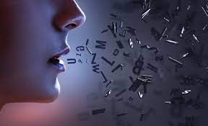
Revelation 13
The Unholy Trinity
The False Prophet
Revelation 13:15. And he had power to give life unto the image of the beast, that the image of the beast should both speak, and cause that as many as would not worship the image of the beast should be killed.
The false prophet next performs perhaps the greatest of all his feats of magic. The image begins to speak.
This image is more than a mere robot with a computer voice. That would be no great marvel today.
The image of the man of sin will speak intelligibly and his words will not be preprogrammed.

Slide 51
Revelation 13
The Unholy Trinity
The False Prophet
Revelation 13:15. And he had power to give life unto the image of the beast, that the image of the beast should both speak, and cause that as many as would not worship the image of the beast should be killed. (Cont’d)
It does not actually possess life, of course (only God can create life). The false prophet is enabled to impart a spirit to the image, one of Satan’s unclean spirits.
The spirit indwelling the image of the beast will utilize something like the complex “audio-animatronics” apparatus with which it will be equipped to convey Satan’s messages.
In some way, the edict will be conveyed around the world that it will be considered a capital offense not to worship the beast via his image, and the dragon via the beast.

Slide 52
Revelation 13
The Unholy Trinity
The False Prophet
Revelation 13:16. And he causeth all, both small and great, rich and poor, free and bond, to receive a mark in their right hand, or in their foreheads:
In order to better control the activities of the people of his vast dominion, each person is required to register and to receive a brand which will identify him as a loyal citizen of the world kingdom.
The nature of the mark is not described, but the basic principle has been well established for years in various nations.

Slide 53
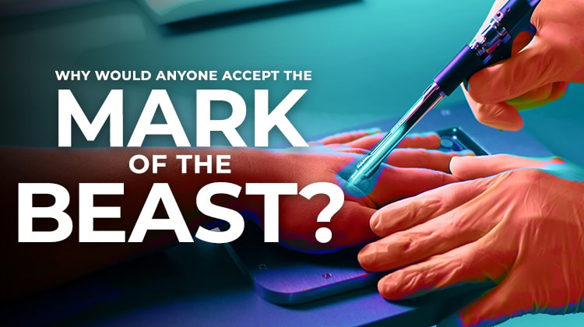
Revelation 13
The Unholy Trinity
The False Prophet
Revelation 13:16. And he causeth all, both small and great, rich and poor, free and bond, to receive a mark in their right hand, or in their foreheads: (Cont’d)
The mark is something like an etching or a tattoo which, once inscribed, cannot be removed, providing a permanent (possibly eternal) identification as a follower of the beast and the dragon.

Slide 54
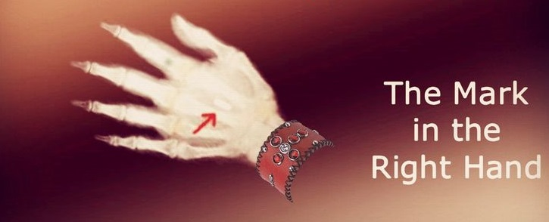
Revelation 13
The Unholy Trinity
The False Prophet
Revelation 13:17. And that no man might buy or sell, save he that had the mark, or the name of the beast, or the number of his name.
As far as convenience of enforcement is concerned, an openly visible mark is obviously much superior to a wallet card or other device.

Slide 55
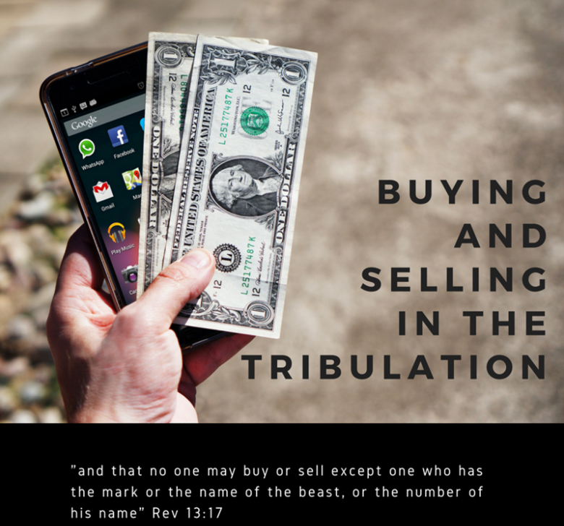
Revelation 13
The Unholy Trinity
The False Prophet
Revelation 13:17. And that no man might buy or sell, save he that had the mark, or the name of the beast, or the number of his name. (Cont’d)
But it will be extremely difficult to survive at all without the mark.
No transaction of any kind will be legal unless all parties to the transaction can display either on their foreheads or in their right hands the mark of the beast.

Slide 56
Revelation 13
The Unholy Trinity
The False Prophet
Revelation 13:17. And that no man might buy or sell, save he that had the mark, or the name of the beast, or the number of his name. (Cont’d)
There will undoubtedly be many (those who are still trusting God) who survive by living off the land or by setting up secret communes in the wilderness or by other means, but it will involve extreme hardship and danger.
It is perhaps these traumatic times to which the Lord refers in Matthew 25:31-46, the so-called “judgment of the nations” or (“gentiles”), when He will commend those who have provided help to His brethren, but will consign to everlasting punishment those who do not.
Evidently the brand may take any one of the following three forms.
Notes:
Matthew 25:31-46-When the Son of man shall come in his glory, and all the holy angels with him, then shall he sit upon the throne of his glory:
32And before him shall be gathered all nations: and he shall separate them one from another, as a shepherd divideth his sheep from the goats:
33And he shall set the sheep on his right hand, but the goats on the left.
34Then shall the King say unto them on his right hand, Come, ye blessed of my Father, inherit the kingdom prepared for you from the foundation of the world:
35For I was an hungred, and ye gave me meat: I was thirsty, and ye gave me drink: I was a stranger, and ye took me in:
36Naked, and ye clothed me: I was sick, and ye visited me: I was in prison, and ye came unto me.
37Then shall the righteous answer him, saying, Lord, when saw we thee an hungred, and fed thee? or thirsty, and gave thee drink?
38When saw we thee a stranger, and took thee in? or naked, and clothed thee?
39Or when saw we thee sick, or in prison, and came unto thee?
40And the King shall answer and say unto them, Verily I say unto you, Inasmuch as ye have done it unto one of the least of these my brethren, ye have done it unto me.
41Then shall he say also unto them on the left hand, Depart from me, ye cursed, into everlasting fire, prepared for the devil and his angels:
42For I was an hungred, and ye gave me no meat: I was thirsty, and ye gave me no drink:
43I was a stranger, and ye took me not in: naked, and ye clothed me not: sick, and in prison, and ye visited me not.
44Then shall they also answer him, saying, Lord, when saw we thee an hungred, or athirst, or a stranger, or naked, or sick, or in prison, and did not minister unto thee?
45Then shall he answer them, saying, Verily I say unto you, Inasmuch as ye did it not to one of the least of these, ye did it not to me.
46And these shall go away into everlasting punishment: but the righteous into life eternal.

Slide 57

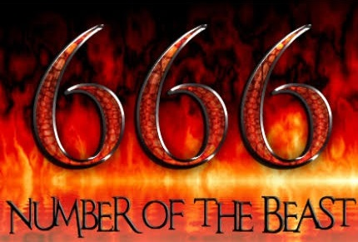
Revelation 13
The Unholy Trinity
The False Prophet
Revelation 13:17. And that no man might buy or sell, save he that had the mark, or the name of the beast, or the number of his name. (Cont’d)
One group receives the mark, probably applied to the bulk of the population.
Another group is imprinted with the beast’s own name, probably the group associated most closely with his purposes and actions.
The third group is marked with a number, that number which is peculiarly fitting for his character and name.

Slide 58
Revelation 13
The Unholy Trinity
Six Hundred Sixty-Six
Revelation 13:18. Here is wisdom. Let him that hath understanding count the number of the beast: for it is the number of a man; and his number is Six hundred threescore and six.
This concluding verse of this amazing chapter of Revelation is intriguing. It is as though John were posing a puzzle, a challenge that would help people determine the identity of the beast.
But why would he do this? And, if he felt people should know who the beast would be, why didn’t he just give his name.
The answer to the first question is that the beast will evidently come into power gradually, and will become well known in the world long before the tribulation actually begins.

Slide 59
Revelation 13
The Unholy Trinity
Six Hundred Sixty-Six
Revelation 13:18. Here is wisdom. Let him that hath understanding count the number of the beast: for it is the number of a man; and his number is Six hundred threescore and six. (Cont’d)
Forewarned is forearmed, however, so that if his true character could be recognized and exposed before he actually comes to power, much harm to Christ’s churches can be prevented.
Hence, “here is wisdom,” for Christians to recognize the beast before the world does.
The answer to the next question is that God reveals His mysteries only to those who really love His Word and search them out (Proverbs 2:1-6, Daniel 12:10, Matthew 13:10-11).
Notes:
Proverbs 2:1-6-My son, if thou wilt receive my words, and hide my commandments with thee;
2So that thou incline thine ear unto wisdom, and apply thine heart to understanding;
3Yea, if thou criest after knowledge, and liftest up thy voice for understanding;
4If thou seekest her as silver, and searchest for her as for hid treasures;
5Then shalt thou understand the fear of the LORD, and find the knowledge of God.
6For the LORD giveth wisdom: out of his mouth cometh knowledge and understanding.
Daniel 12:10-Many shall be purified, and made white, and tried; but the wicked shall do wickedly: and none of the wicked shall understand; but the wise shall understand.
Matthew 13:10-11-And the disciples came, and said unto him, Why speakest thou unto them in parables?
11He answered and said unto them, Because it is given unto you to know the mysteries of the kingdom of heaven, but to them it is not given.

Slide 60
Revelation 13
The Unholy Trinity
Six Hundred Sixty-Six
Revelation 13:18. Here is wisdom. Let him that hath understanding count the number of the beast: for it is the number of a man; and his number is Six hundred threescore and six. (Cont’d)
Evidently, the Lord wants his children to know the identity of the coming man of sin.
And here is the clue: “Count the number of the beast.”
But what is that? The previous verse tells us that it is “the number of a man.”

Slide 61
Revelation 13
The Unholy Trinity
Six Hundred Sixty-Six
Revelation 13:18. Here is wisdom. Let him that hath understanding count the number of the beast: for it is the number of a man; and his number is Six hundred threescore and six. (Cont’d)
But how does one count the number of a man’s name? In Hebrew and Greek, each symbol used for a letter of the alphabet was also used for a number.
Every letter in Greek has a corresponding numerical value, so that each word likewise has a numerical value equal to the sum of the values of each letter in the word.

Slide 62
Revelation 13
The Unholy Trinity
Six Hundred Sixty-Six
Revelation 13:18. Here is wisdom. Let him that hath understanding count the number of the beast: for it is the number of a man; and his number is Six hundred threescore and six. (Cont’d)
To “count” the number of a name means, obviously simply to add up the numbers attached to all the letters in the name.
Since there is essentially a one-to-one equivalence between letters of the Greek alphabet and letters of the English alphabet, it is possible to transliterate any name in one of the western languages into a corresponding number.
All of this suggests that whenever a particularly popular leader begins to figure prominently in world affairs, Christians would be well advised to “count the number of his name.”

Slide 63
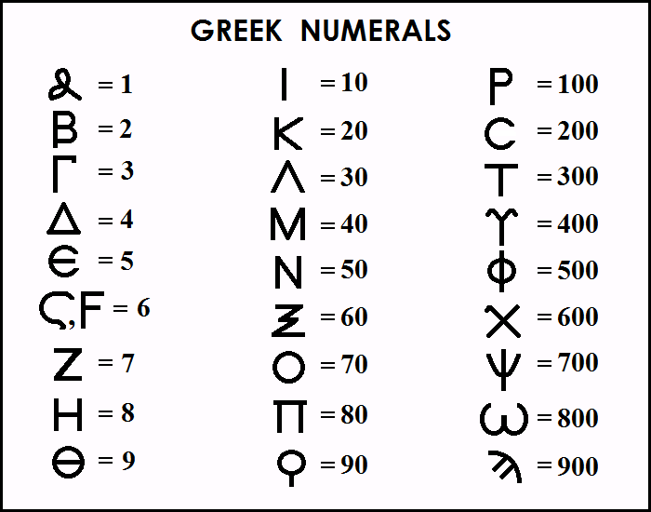

Slide 64
Revelation 13
The Unholy Trinity
Six Hundred Sixty-Six
Revelation 13:18. Here is wisdom. Let him that hath understanding count the number of the beast: for it is the number of a man; and his number is Six hundred threescore and six. (Cont’d)
The number 666 is significant in its own right.
Six has long been associated with man in his imperfection.
The three sixes together may be suggestive of the unholy trinity - the dragon, the beast, and the false prophet.
666 has the interesting characteristic of being the sum of the first 36 numbers.

Slide 65
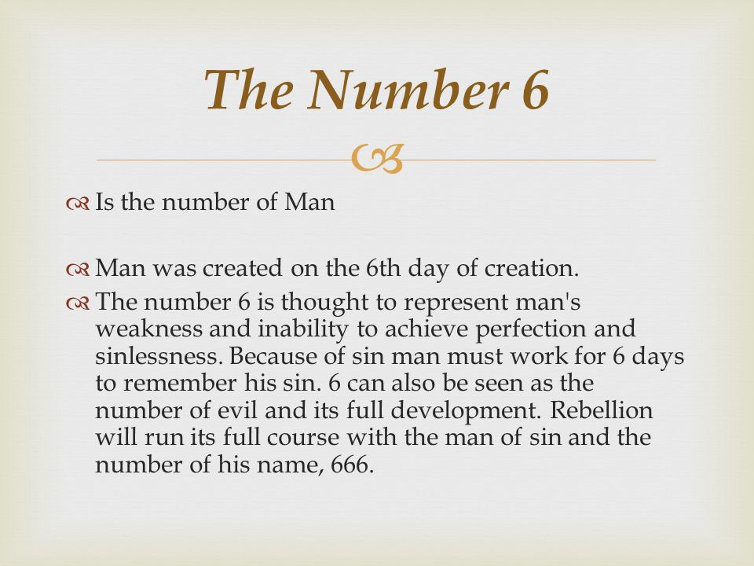
Revelation 13
The Unholy Trinity
Six Hundred Sixty-Six
Revelation 13:18. Here is wisdom. Let him that hath understanding count the number of the beast: for it is the number of a man; and his number is Six hundred threescore and six. (Cont’d)
This “number of man” seems to permeate the number 666.
It is also remarkable that John refers to him by the name “beast” exactly thirty-six times in Revelation.

Slide 66
Revelation 13
The Unholy Trinity
Six Hundred Sixty-Six
Revelation 13:18. Here is wisdom. Let him that hath understanding count the number of the beast: for it is the number of a man; and his number is Six hundred threescore and six. (Cont’d)
One other point of significance may be noted in connection with the number of the beast.
Although the Scriptures do not tell us what his mark will be, there is a strong possibility that the number of his name will be written as the Greek number Chi Xi Stigma (the normal way of writing the number “666” in New Testament Greek).
The greatest of all false Christ, the Antichrist, will appear at the very end of the age.

Slide 67
THIS CONCLUDES REVELATION 13

