Slide 1
II TIMOTHY
CHAPTER 3
9/4/2022
1

Slide 2
SUMMARY
Perilous times will come in the last days. Men will demonstrate many sins. The corrupt make captives of gullible women, resisting truth as the magicians resisted Moses. All who desire to live godly in Christ Jesus will suffer persecution. You must persevere in the truth although the evilness of men will become worse. All scripture is divinely inspired, and profitable for doctrine, reproof and instruction.
9/4/2022
2

Slide 3
2 TIMOTHY 3
Outline
DESCRIPTION OF LIFESTYLES IN THE FUTURE
SPECIFIC EXAMPLES OF JANNES AND JAMBRES
FOLLOW PAUL’S EXAMPLE
EXPECT PERSECUTION
REMEMBER WHAT YOU WERE TAUGHT
RELY UPON THE SCRIPTURES

Slide 4

II TIMOTHY 3:1-5 DESCRIPTION OF LIFESTYLES IN THE FUTURE
3.1 This know also, that in the last days perilous times shall come.
Paul begins this new section with a warning. He describes a time period known as "the last days“ which were obviously in the far future from Paul’s time.
9/4/2022
4
Notes:
Acts 2:17-

Slide 5
II TIMOTHY 3:1-5 DESCRIPTION OF LIFESTYLES IN THE FUTURE (Cond’t)
Biblically, the "last days" began with the start of the church age and continues today (Acts 2:17). Second, these last days will be difficult times of danger, persecution, and trial.
The Church age began on the Day of Pentecost (Acts 2); it will last until people who believe in Jesus Christ are raptured out of the world and taken to be with the Lord (1 Cor.15:51–57). The Church age, which corresponds with the dispensation of grace, is what we live in today. It is also known, in prophetic history, as between the 69th and 70th weeks of Daniel (Daniel 9:24–27; Romans 11).
9/4/2022
5
Notes:
Acts 2:17-And it shall come to pass in the last days, saith God, I will pour out of my Spirit upon all flesh: and your sons and your daughters shall prophesy, and your young men shall see visions, and your old men shall dream dreams:

Slide 6
II TIMOTHY 3:1-5 DESCRIPTION OF LIFESTYLES IN THE FUTURE (Cond’t)
It is not God’s intentions to keep future events a secret they are plainly spelled out in the Bible but simply ignored by most.
END TIMES TIMELINE
Rapture
Judgement Seat of Christ
Marriage of the Lamb
Magog Invasion
Battle of Gog and Magog
Tribulation (70th Week of Daniel)
Great Tribulation
Abomination of Desolation
Second Coming of Christ
Battle of Armageddon
75-day Interregnum (Interval)
Judgement of the Sheep and Goats
Millennium
Marriage Supper of the Lamb
Satan’s Final Rebellion (War of Gog and Magog)
Great White Throne Judgement
Eternal State
9/4/2022
6

Slide 7
II TIMOTHY 3:1-5 DESCRIPTION OF LIFESTYLES IN THE FUTURE (Cond’t)
3.2 For men shall be lovers of their own selves, covetous, boasters, proud, blasphemers, disobedient to parents, unthankful, unholy,
Paul begins an extensive list of attributes which characterize false teachers and unbelievers. People with these behaviors, and those who persist in them, are to be avoided. 1)People will be selfish, rather than serving others. 2) They will be covetous and obsessed with wealth.
9/4/2022
7

Slide 8
II TIMOTHY 3:1-5 DESCRIPTION OF LIFESTYLES IN THE FUTURE (Cond’t)
3) People will be boasters, self-assuming; valuing themselves beyond all others. 4) They will be "proud," meaning they are preoccupied with people noticing them and their actions. 5) People will be "blasphemers" showing contempt or disrespect toward God 6) They will also break the commandment to honor one's parents. This is a common thread in the lives of those who despise authority. 7) people will be ungrateful and feeling “entitled” to things.
9/4/2022
8
Notes:
Exodus 20:12-Honour thy father and thy mother: that thy days may be long upon the land which the LORD thy God giveth thee.

Slide 9

II TIMOTHY 3:1-5 DESCRIPTION OF LIFESTYLES IN THE FUTURE (Cond’t)
8) People will be "unholy," not truly desiring to live according to God's truth.
9/4/2022
9

Slide 10

II TIMOTHY 3:1-5 DESCRIPTION OF LIFESTYLES IN THE FUTURE (Cond’t)
3.3 Without natural affection, trucebreakers, false accusers, incontinent, fierce, despisers of those that are good,
Here Paul continues by adding six additional traits to the eight already noted. 9) People will be “without natural affection.” There is a great increase in perverse sexual behavior. 10) "trucebreakers,“ this means those who refuse to honor
9/4/2022
10

Slide 11
II TIMOTHY 3:1-5 DESCRIPTION OF LIFESTYLES IN THE FUTURE (Cond’t)
agreements.“ 11) people will be "false accusers” or slanderous meaning one who lies, slanders, or makes false accusations. 12) people will be "incontinent” or without self-control. The Greek for incontinent (akrates) means without strength. 13) People will be "fierce”-- savage or untamed and implies a wild and un-controlled attitude. 14) People will be “despisers of those that are good”. In other words, these evil people do not merely despise "goodness," they specifically dislike good people.
9/4/2022
11

Slide 12
II TIMOTHY 3:1-5 DESCRIPTION OF LIFESTYLES IN THE FUTURE (Cond’t)
3.4 Traitors, heady, highminded, lovers of pleasures more than lovers of God;
Paul continues with four additional traits to the fourteen already noted. 15) People will be "traitors“-- those who actively work against the interests of their so-called friends and allies. The word “traitor” was used to describe Judas who betrayed Christ. 16) People will be "heady” or reckless, not thinking before acting, or acting in a thoughtless manner. 17) People will be “highminded” or puffed up, conceited literally
9/4/2022
12

Slide 13
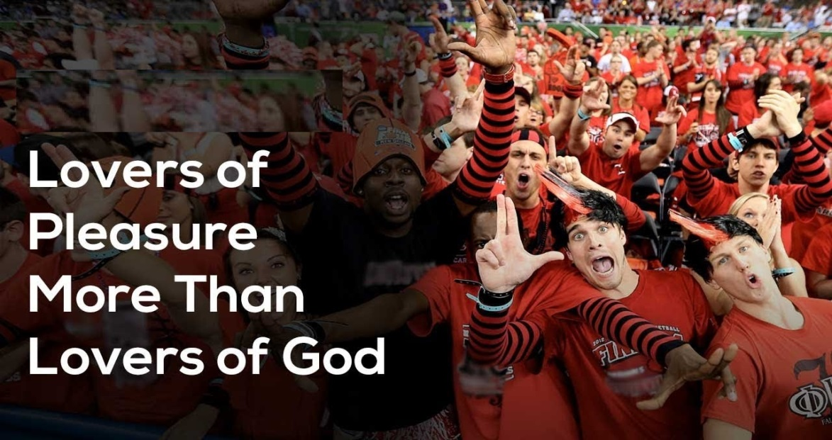
II TIMOTHY 3:1-5 DESCRIPTION OF LIFESTYLES IN THE FUTURE (Cond’t)
18) People will be “lovers of pleasures more than lovers of God.” The love of pleasures has the potential of robbing the soul of its love of the Lord. You need only to look at the number of “pleasure-seekers” on the Lord’s Day vs. those in church to see that is indeed what is happening today.
9/4/2022
13

Slide 14
II TIMOTHY 3:1-5 DESCRIPTION OF LIFESTYLES IN THE FUTURE (Cond’t)
3.5 Having a form of godliness, but denying the power thereof: from such turn away.
This verse adds one final attribute, for a total of 19 traits which characterize false teachers and unbelievers. 19) People are known for putting on the "form of godliness, but denying the power thereof.” They are “window dressing” their faith in God, but rejecting the actual power of the Holy Spirit. Timothy is to specifically stay clear of those who claim to follow God yet deny Him through their actions and false teachings.
9/4/2022
14

Slide 15
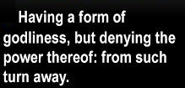
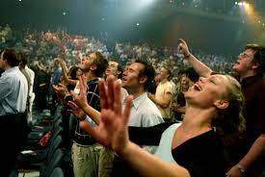
II TIMOTHY 3:1-5 DESCRIPTION OF LIFESTYLES IN THE FUTURE (Cond’t)
9/4/2022
15

Slide 16
II TIMOTHY 3:6-9 SPECIFIC EXAMPLES OF JANNES AND JAMBRES
3.6 For of this sort are they which creep into houses, and lead captive silly women laden with sins, led away with divers lusts,
Paul's description here suggests a con-man or swindler which implies a leading away, or a taking captive. These are cunning and deceitful people who call themselves Christians to gain entrance into private homes. Once there they will soon find people willing to listen to them. Women especially will be easily impressed by
9/4/2022
16

Slide 17
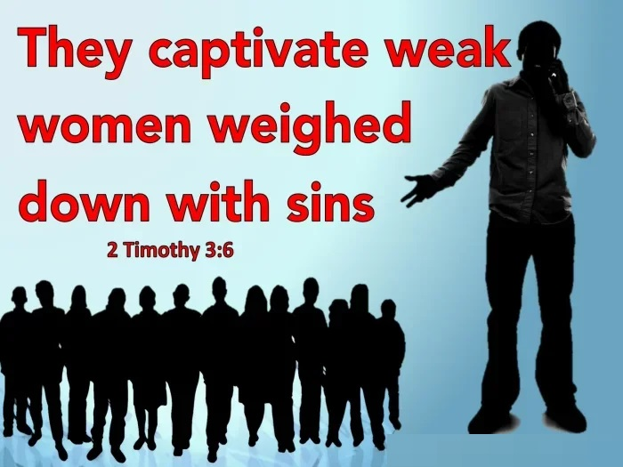
II TIMOTHY 3:6-9 SPECIFIC EXAMPLES OF JANNES AND JAMBRES (Cond’t)
the words of these false teachers. They soon become captives of their evil teachers.
9/4/2022
17

Slide 18
II TIMOTHY 3:6-9 SPECIFIC EXAMPLES OF JANNES AND JAMBRES (Cond’t)
3.7 Ever learning, and never able to come to the knowledge of the truth.
This refers to those woman from the previous verse who are always seeking the newest, latest, greatest spiritual teaching. They were “ever learning” new things, but never learning the word of God. At some point, a person needs to allow the truth found in the scriptures to be their guide rather than constantly bouncing from one fad or novelty to the next.
9/4/2022
18

Slide 19
II TIMOTHY 3:6-9 SPECIFIC EXAMPLES OF JANNES AND JAMBRES (Cond’t)
3.8 Now as Jannes and Jambres withstood Moses, so do these also resist the truth: men of corrupt minds, reprobate concerning the faith.
Jannes and Jambres are traditionally associated with two of Pharaoh's magicians who opposed Moses (Exodus 7:11–12, 22; 8:7, 18). These men were known for three things. 1) they opposed the truth. They stood against the command of God to let the Jewish people go from slavery. 2) these men were spiritually and intellectually
9/4/2022
19
Notes:
Exodus 7:11–12-Then Pharaoh also called the wise men and the sorcerers: now the magicians of Egypt, they also did in like manner with their enchantments.
12 For they cast down every man his rod, and they became serpents: but Aaron's rod swallowed up their rods.
Exodus 7:22-And the magicians of Egypt did so with their enchantments: and Pharaoh's heart was hardened, neither did he hearken unto them; as the LORD had said.
Exodus 8:7- And the magicians did so with their enchantments, and brought up frogs upon the land of Egypt.
Exodus 8:18-And the magicians did so with their enchantments to bring forth lice, but they could not: so there were lice upon man, and upon beast.

Slide 20

II TIMOTHY 3:6-9 SPECIFIC EXAMPLES OF JANNES AND JAMBRES (Cond’t)
depraved. They did not know God, did not seek God, and did not believe His words. 3) these men's teachings earned them only rejection by God.
9/4/2022
20
Notes:
Exodus 7:11–12-
Exodus 7:22-
Exodus 8:7-
Exodus 8:18-

Slide 21

II TIMOTHY 3:6-9 SPECIFIC EXAMPLES OF JANNES AND JAMBRES (Cond’t)
3.9 But they shall proceed no further: for their folly shall be manifest unto all men, as theirs also was.
Paul ends this section condemning the ungodliness of false teachers. Regardless of the efforts, and even the temporary success, of false teachers, they will not succeed for long. False doctrine cannot prevail long where the sacred Scriptures are read and studied.
9/4/2022
21

Slide 22
II TIMOTHY 3:10-11 FOLLOW PAUL’S EXAMPLE
3.10 But thou hast fully known my doctrine, manner of life, purpose, faith, longsuffering, charity, patience,
Paul now transitions from the ungodly actions of evil people and false teachers to his own godly life and its influence on Timothy. Seven items are presented in this verse, regarding specific areas in which Timothy has closely observed Paul's life. 1) Timothy followed Paul's “doctrine” or teachings that he preached. 2) Timothy followed Paul's “manner of life” his
9/4/2022
22

Slide 23
II TIMOTHY 3:10-11 FOLLOW PAUL’S EXAMPLE (Cond’t)
conduct and actions. 3) Timothy followed Paul's “purpose” or aim in life, meaning he was a person whose focus was the gospel. 4) Timothy followed Paul's “faith”, in both salvation and ongoing faithfulness as a believer. 5) Timothy followed Paul's “longsuffering” or perseverance against those who opposed the truth. 6) Timothy followed Paul's “charity” or love for the lost. 7) Timothy followed Paul's patience in dealing with all his adversities.
9/4/2022
23

Slide 24
II TIMOTHY 3:10-11 FOLLOW PAUL’S EXAMPLE (Cond’t)
3.11 Persecutions, afflictions, which came unto me at Antioch, at Iconium, at Lystra; what persecutions I endured: but out of them all the Lord delivered me.
Paul refers to three of his own experiences to illustrate the truth that the person who whole-heartedly follows God must expect persecution. In the last portion of the verse Paul states assertively that the Lord stood by him and delivered him out of each of these persecutions.
9/4/2022
24

Slide 25

II TIMOTHY 3:12-13 EXPECT PERSECUTION
3.12 Yea, and all that will live godly in Christ Jesus shall suffer persecution.
After considering his own life, Paul speaks of others desiring to live godly lives. Those that live for God will always be opposed by the world and suffer persecution.
9/4/2022
25

Slide 26
II TIMOTHY 3:12-13 EXPECT PERSECUTION (Cond’t)
3.13 But evil men and seducers shall wax worse and worse, deceiving, and being deceived.
An alarm is raised against the deceptions of false teachers. The sins of "evil men and seducers" will get worse and worse. What Timothy was currently experiencing from these false teachers and evil people would not get better. Such people would continue their "deceiving and being deceived“ ways.
9/4/2022
26

Slide 27

II TIMOTHY 3:14-15 REMEMBER WHAT YOU WERE TAUGHT
3.14 But continue thou in the things which thou hast learned and hast been assured of, knowing of whom thou hast learned them;
Paul now exhorts him to hold fast to Christian doctrines, whoever might oppose them, or whatever might be the consequence. For Timothy had been taught God’s word when a child, and he had received additional instruction from Paul.
9/4/2022
27

Slide 28
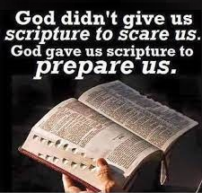
II TIMOTHY 3:14-15 REMEMBER WHAT YOU WERE TAUGHT (Cond’t)
3.15 And that from a child thou hast known the holy scriptures, which are able to make thee wise unto salvation through faith which is in Christ Jesus.
This verse notes his lifelong immersion in the word of God. The Old Testament writings gave wisdom for salvation, but salvation itself came through faith in Jesus Christ.
9/4/2022
28

Slide 29
II TIMOTHY 3:16-17 RELY UPON THE SCRIPTURES
3.16 All scripture is given by inspiration of God, and is profitable for doctrine, for reproof, for correction, for instruction in righteousness:
The source of scripture is not human, but divine. The written scripture is perfect, it is "profitable" for many areas of life. 1) Scripture is profitable for doctrine or teaching. It is used to instruct people to know God better. 2) Scripture is profitable for reproof or
9/4/2022
29

Slide 30

II TIMOTHY 3:16-17 RELY UPON THE SCRIPTURES (Cond’t)
rebuke, the idea of exposing or pointing out sin. 3) Scripture is useful for correction. Scripture convicts of sin and offers a solution to it. 4) Scripture is profitable for instruction in righteousness. Though similar to doctrine, instruction in righteousness is more focused on practical application.
9/4/2022
30

Slide 31

II TIMOTHY 3:16-17 RELY UPON THE SCRIPTURES (Cond’t)
3.17 That the man of God may be perfect, throughly furnished unto all good works.
Paul concludes the chapter on scripture stating it can make the "man of God" perfect or complete and well appointed unto all good work. Accurate biblical understanding better enhances biblical application to life's issues.
9/4/2022
31

Slide 32
THIS CONCLUDES
II TIMOTHY CHAPTER 3
9/4/2022
32

