Slide 1
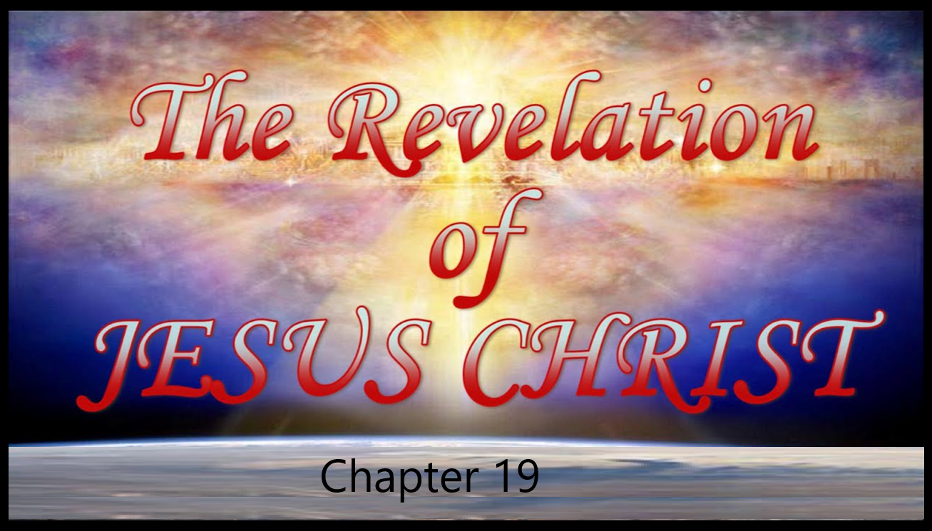

Slide 2
Revelation 19
The King Triumphant
Introduction
In the previous chapter, John was shown Babylon’s dramatic overthrow and complete destruction. Never has a great world city had such a meteoric rise as New Babylon, and never will one experience such a cataclysmic and total fall. The fall of great Babylon is to be even more sudden than its rise.
Now John in chapter 19 provides additional background concerning the judgment of Babylon and the overthrow of the kingdoms of man in favor of the kingdom of God. Revelation 19 can be considered the apex of the book of Revelation because it describes the most important event remaining in history, the Second Coming of Christ.

Slide 3
Revelation 19
The King Triumphant
Outline
The Four Alleluias Of Heavenly Praise
The Marriage of the Lamb
The King of Kings
The Great Battle of Armageddon

Slide 4
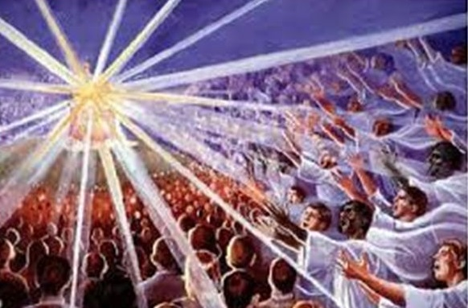
Revelation 19
The King Triumphant
The Four Alleluias Of Heavenly Praise
Revelation 19:1. And after these things I heard a great voice of much people in heaven, saying, Alleluia; Salvation, and glory, and honour, and power, unto the Lord our God:
The voices are of all those in heaven including: (1) the voices of the Church, having been raptured before the Tribulation, (2) the voices of the Tribulation saints, many of whom were martyred, and (3) the voices of various ranks of angels. They sing in unison as one mighty, thunderous voice (Rev. 19:6).
Notes:
Rev. 19:6-And I heard as it were the voice of a great multitude, and as the voice of many waters, and as the voice of mighty thunderings, saying, Alleluia: for the Lord God omnipotent reigneth.

Slide 5
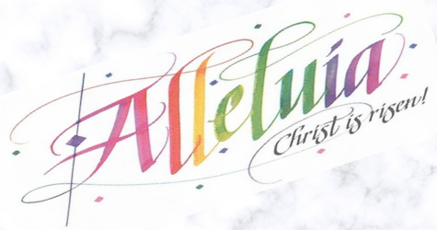
Revelation 19
The King Triumphant
The Four Alleluias Of Heavenly Praise
Revelation 19:1. And after these things I heard a great voice of much people in heaven, saying, Alleluia; Salvation, and glory, and honour, and power, unto the Lord our God: (Cond’t)
In Chapter 19 “Alleluia” is cried out 4 times from this assembly in heaven—verse 1 is the first time. “Alleluia” is cried again in verses 3, 4 and 6 and these are the only occurrences of the word in the New Testament. It is the same as ‘Hallelujah”, meaning “Praise the Lord”.
Notes:
Rev. 19:6-And I heard as it were the voice of a great multitude, and as the voice of many waters, and as the voice of mighty thunderings, saying, Alleluia: for the Lord God omnipotent reigneth.

Slide 6
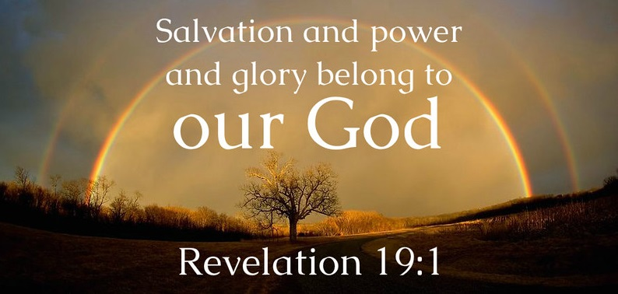
Revelation 19
The King Triumphant
The Four Alleluias Of Heavenly Praise
Revelation 19:1. And after these things I heard a great voice of much people in heaven, saying, Alleluia; Salvation, and glory, and honour, and power, unto the Lord our God: (Cond’t)
Here, salvation is probably broader than personal redemption, but includes the rescue of all of creation, and especially the earth, from the corrupting influence of the Harlot.
Glory and honor and power are attributed to God because of His act of creation.
Notes:
Rev. 19:6-And I heard as it were the voice of a great multitude, and as the voice of many waters, and as the voice of mighty thunderings, saying, Alleluia: for the Lord God omnipotent reigneth.

Slide 7
Revelation 19
The King Triumphant
The Four Alleluias Of Heavenly Praise
Revelation 19:2. For true and righteous are his judgments: for he hath judged the great whore, which did corrupt the earth with her fornication, and hath avenged the blood of his servants at her hand.
The judgments described in the book of Revelation are not evidence of God’s unfairness. Rather, their severity is a testimony to His righteousness—for only He knows the full breadth and depth of the sin which He now judges. The judgments of the LORD are true and righteous altogether.
God is holy and true. His holiness requires judgment of sin. His true character guarantees He will deliver judgment.

Slide 8
Revelation 19
The King Triumphant
The Four Alleluias Of Heavenly Praise
Revelation 19:2. For true and righteous are his judgments: for he hath judged the great whore, which did corrupt the earth with her fornication, and hath avenged the blood of his servants at her hand. (Cond’t)
Although there have been many harlots upon the earth, this is a unique harlot—the mother of harlots.
This exultation over the great Harlot is in response to the destruction of the city of Babylon.
The entire earth was involved in fornication because of her influence.
. How long, O Lord, until You judge and avenge our blood--the answer is NOW.

Slide 9
Revelation 19
The King Triumphant
The Four Alleluias Of Heavenly Praise
Revelation 19:3. And again they said, Alleluia. And her smoke rose up for ever and ever.
Alleluia is cried out a second time.
The smoke of Babylon’s destruction will continue rising into space even after the fires themselves have ceased.
The text “forever and ever” implies that her destruction will be into the ages of the ages.

Slide 10
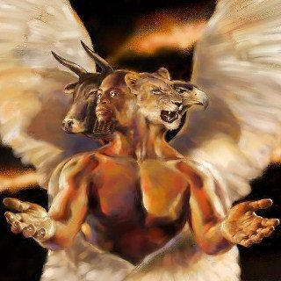
Revelation 19
The King Triumphant
The Four Alleluias Of Heavenly Praise
Revelation 19:4. And the four and twenty elders and the four beasts fell down and worshipped God that sat on the throne, saying, Amen; Alleluia.
The elders occupy a position of prominence near the throne along with the four living creatures. It appears that those closest to God appear to occupy positions of special service, blessing, and favor.
The term elders appears 67 times in the bible (KJV) and always refers to men. The term is never used of angelic beings.
The term elders itself denotes maturity and growth.

Slide 11
Revelation 19
The King Triumphant
The Four Alleluias Of Heavenly Praise
Revelation 19:4. And the four and twenty elders and the four beasts fell down and worshipped God that sat on the throne, saying, Amen; Alleluia. (Cond’t)
Attempts to identify the elders have fallen into three broad categories. They are representatives of Israel, representatives of the church (saints), or representatives of both.
Perhaps (and this is only speculation) the 24 elders are the 24 patriarchs listed the Old Testament. Twelve before the flood and twelve after the flood.
The four living creatures were first seen by John in the midst of the throne. They are of a high angelic order.
Notes:
Genesis has possible answer—24 patriarchs listed in the line of the promised seed (Adam thru Pharez). Adam, Seth, Enos, Cainan, Mahalaleel, Jared, Enoch, Methusaleh, Lamech, Noah, Shem, Arphaxad, Salah, Eber, Peleg, Reu, Serug, Nahor, Terah, Abraham, Isaac, Jacob, Judah, Pharez.
Another Possibility Great Men of the OT Bible:
Adam; 2) Seth; 3) Enoch; 4) Methuselah; 5) Noah; 6) Shem; 7) Job; 8) Abraham; 9) Isaac; 10) Jacob; 11) Joseph; 12) Moses;
13) Joshua; 14) Gideon; 15) Elijah; 16) Elisha; 17) Nehemiah; 18) David; 19) Solomon; 20) Isaiah; 21) Jeremiah; 22) Ezekiel; 23) Daniel; 24) Jonah

Slide 12
Revelation 19
The King Triumphant
The Four Alleluias Of Heavenly Praise
Revelation 19:4. And the four and twenty elders and the four beasts fell down and worshipped God that sat on the throne, saying, Amen; Alleluia. (Cond’t)
The participation of the elders falling in worship here indicates the great importance attached to the destruction of Babylon. God gains glory by her destruction, an important step on the way to establishing the Millennial Kingdom on earth.
Amen here means truly, as when expressing agreement. Note this is the third time the word “Alleluia” is used giving praise to the Lord .

Slide 13
Revelation 19
The King Triumphant
The Four Alleluias Of Heavenly Praise
Revelation 19:5. And a voice came out of the throne, saying, Praise our God, all ye his servants, and ye that fear him, both small and great.
The voice comes from near the throne. It is not the voice of God Himself, as indicated by what is said: “Praise our God.” Most likely it is the voice of an angel of high rank, such as one of the living creatures.
Many of those who praise are the very servants who’s blood was shed by the Harlot. They praise all the more because God has avenged their martyrdom. Having experienced greater depths of persecution, they have greater ability to extol and elevate God.

Slide 14
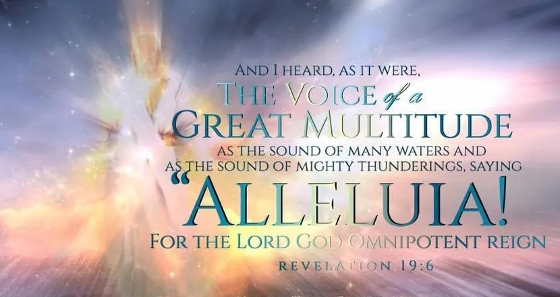
Revelation 19
The King Triumphant
The Four Alleluias Of Heavenly Praise
Revelation 19:6. And I heard as it were the voice of a great multitude, and as the voice of many waters, and as the voice of mighty thunderings, saying, Alleluia: for the Lord God omnipotent reigneth.
The voices are of all those in heaven and they spoke in unison as one mighty roar of thunderous voices.
This is the fourth and final time “Alleluia” appears in the New Testament.

Slide 15
Revelation 19
The King Triumphant
The Four Alleluias Of Heavenly Praise
Revelation 19:6. And I heard as it were the voice of a great multitude, and as the voice of many waters, and as the voice of mighty thunderings, saying, Alleluia: for the Lord God omnipotent reigneth. (Cond’t)
All the heavenly instruments and sounds and voices of unimaginable purity, power, and magnificence on command, shout forth: ALLELUIA!
Omnipotent is all-powerful: none of His purposes can be withheld.
I know that You can do everything, and that no purpose of Yours can be withheld from You (Job 42:2).

Slide 16
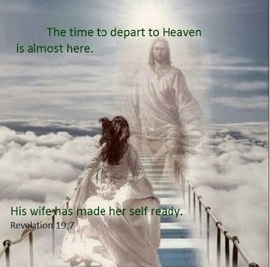
Revelation 19
The King Triumphant
The Four Alleluias Of Heavenly Praise
Revelation 19:7. Let us be glad and rejoice, and give honour to him: for the marriage of the Lamb is come, and his wife hath made herself ready.
Their gladness and rejoicing is because the marriage has come. As in the First Coming of Christ, a long period of waiting is about to conclude (Zec. 9:9). The hopes and dreams of his servants will find consummation in His approaching intimacy.
Notes:
Zec. 9:9-Rejoice greatly, O daughter of Zion; shout, O daughter of Jerusalem: behold, thy King cometh unto thee: he is just, and having salvation; lowly, and riding upon an ass, and upon a colt the foal of an ass.
Mat. 16:18-And I say also unto thee, That thou art Peter, and upon this rock I will build my church; and the gates of hell shall not prevail against it.

Slide 17
Revelation 19
The King Triumphant
The Four Alleluias Of Heavenly Praise
Revelation 19:7. Let us be glad and rejoice, and give honour to him: for the marriage of the Lamb is come, and his wife hath made herself ready.
Their gladness and rejoicing is because the marriage has come. As in the First Coming of Christ, a long period of waiting is about to conclude (Zec. 9:9). The hopes and dreams of his servants will find consummation in His approaching intimacy.
Notes:
Zec. 9:9-Rejoice greatly, O daughter of Zion; shout, O daughter of Jerusalem: behold, thy King cometh unto thee: he is just, and having salvation; lowly, and riding upon an ass, and upon a colt the foal of an ass.
Mat. 16:18-And I say also unto thee, That thou art Peter, and upon this rock I will build my church; and the gates of hell shall not prevail against it.

Slide 18
Revelation 19
The King Triumphant
The Four Alleluias Of Heavenly Praise
Revelation 19:8. And to her was granted that she should be arrayed in fine linen, clean and white: for the fine linen is the righteousness of saints.
The fine linen is the righteousness of saints not their own righteousness, for it is said that this was “given” to the bride - to the saints.
The bride is granted her wedding garments now and found to be wearing them when she rides forth with Christ at the Second Coming (Rev. 19:14). This indicates that the wedding itself takes place in heaven prior to the Second Coming:
Notes:
Rev. 19:14 - And the armies which were in heaven followed him upon white horses, clothed in fine linen, white and clean.

Slide 19
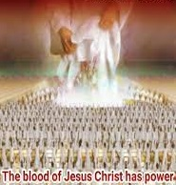
Revelation 19
The King Triumphant
The Four Alleluias Of Heavenly Praise
Revelation 19:8. And to her was granted that she should be arrayed in fine linen, clean and white: for the fine linen is the righteousness of saints. (Cond’t)
The bride’s linen is clean and bright, denoting her sinlessness before God, having been washed in the blood of the Lamb (Rev. 7:14).
The characteristics described of the bride: her making herself ready, her requiring clean clothing, and her linen being the righteous acts of the saints, identify those who have been redeemed.
Notes:
Rev. 7:14 - And I said unto him, Sir, thou knowest. And he said to me, These are they which came out of great tribulation, and have washed their robes, and made them white in the blood of the Lamb.

Slide 20
Revelation 19
The King Triumphant
The Marriage of the Lamb
Revelation 19:9. And he saith unto me, Write, Blessed are they which are called unto the marriage supper of the Lamb. And he saith unto me, These are the true sayings of God.
The angel that attended John all along, and showed him this revelation speaks and reminds John of his original commission, to write down the things which he is being shown.
Those who are called to the marriage supper of the Lamb are blessed because the supper will take place in the kingdom of God.
And when one of them that sat at meat with him heard these things, he said unto him, Blessed is he that shall eat bread in the kingdom of God. (Luke 14:15)

Slide 21
Revelation 19
The King Triumphant
The Marriage of the Lamb
Revelation 19:9. And he saith unto me, Write, Blessed are they which are called unto the marriage supper of the Lamb. And he saith unto me, These are the true sayings of God. (Cont’d)
But what distinction, if any, is to be made between the guests of the wedding and the attendants of the Bride.
It is certain that all who are saved, both before and after Christ, will be with Him, eating and drinking with Him in the kingdom of God.
Furthermore, the New Jerusalem is identified as the Bride of Christ, no doubt because it is the eternal home of all who are saved, those who collectively constitute His Bride.

Slide 22
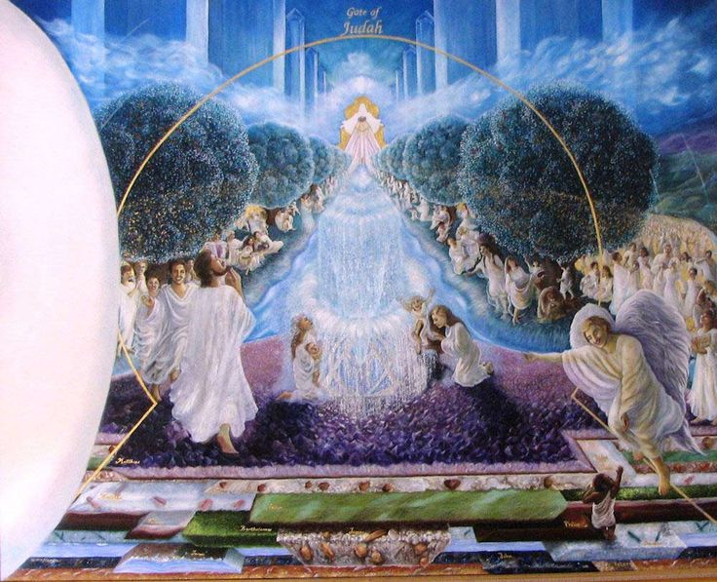
Revelation 19
The King Triumphant
The Marriage of the Lamb
Revelation 19:9. And he saith unto me, Write, Blessed are they which are called unto the marriage supper of the Lamb. And he saith unto me, These are the true sayings of God. (Cont’d)
The Bride, therefore, represents and includes all her attendants and all the wedding guests as well.

Slide 23
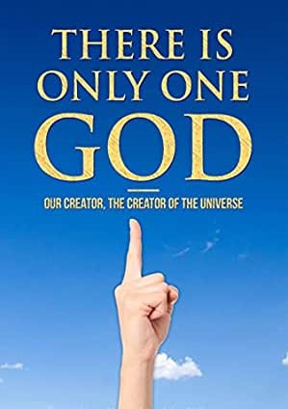
Revelation 19
The King Triumphant
The Marriage of the Lamb
Revelation 19:9. And he saith unto me, Write, Blessed are they which are called unto the marriage supper of the Lamb. And he saith unto me, These are the true sayings of God. (Cont’d)
There is only one God, and that God will be in personal fellowship forever with all the redeemed saints of all the ages.

Slide 24
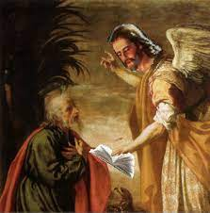
Revelation 19
The King Triumphant
The Marriage of the Lamb
Revelation 19:10. And I fell at his feet to worship him. And he said unto me, See thou do it not: I am thy fellowservant, and of thy brethren that have the testimony of Jesus: worship God: for the testimony of Jesus is the spirit of prophecy.
So significant was the mighty angel who had escourted John through the great scenes, and so overwhelming his revelation, the apostle felt a sudden compulsion to bow down in worship before him.
The angel reminded him that only God should be worshipped.

Slide 25
Revelation 19
The King Triumphant
The Marriage of the Lamb
Revelation 19:10. And I fell at his feet to worship him. And he said unto me, See thou do it not: I am thy fellowservant, and of thy brethren that have the testimony of Jesus: worship God: for the testimony of Jesus is the spirit of prophecy. (Cont’d)
This was indeed, a mighty angel, but he would only proclaim to be a fellow servant, with John, of the One to be worshipped.
Like John and his Christian brethren, the angel himself maintained and proclaimed the same ”the testimony of Jesus” and nothing more.

Slide 26
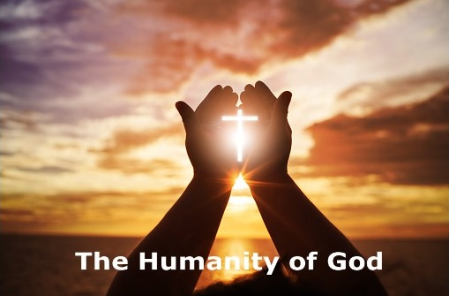
Revelation 19
The King Triumphant
The Marriage of the Lamb
Revelation 19:10. And I fell at his feet to worship him. And he said unto me, See thou do it not: I am thy fellowservant, and of thy brethren that have the testimony of Jesus: worship God: for the testimony of Jesus is the spirit of prophecy. (Cont’d)
This verse is the only place in the Bible where the phrases “the testimony of Jesus” and “the spirit of prophecy” appear.
The emphasis here is on His human name and thus the testimony has specifically to do with His humanity.

Slide 27
Revelation 19
The King Triumphant
The Marriage of the Lamb
Revelation 19:10. And I fell at his feet to worship him. And he said unto me, See thou do it not: I am thy fellowservant, and of thy brethren that have the testimony of Jesus: worship God: for the testimony of Jesus is the spirit of prophecy. (Cont’d)
That God would become a man was hard to believe and would need the faithful and consistent testimony of both holy angels and godly men.
The “testimony of Jesus” is the true prophecy.
It contradicts the testimony of false prophets (1 John 4:1-3)
Notes:
1 John 4:1-3-Beloved, believe not every spirit, but try the spirits whether they are of God: because many false prophets are gone out into the world.
2Hereby know ye the Spirit of God: Every spirit that confesseth that Jesus Christ is come in the flesh is of God:
3And every spirit that confesseth not that Jesus Christ is come in the flesh is not of God: and this is that spirit of antichrist, whereof ye have heard that it should come; and even now already is it in the world.

Slide 28
Revelation 19
The King Triumphant
The King of Kings
Introduction
The saints have now been called unto the wedding feast.
But the supper itself must be held on earth, and the earth is still in bondage to the kings of the earth, and they in turn to the dragon and the beast and the false prophet.
Babylon has been destroyed, but the armies of the kings have been assembled at Armageddon.
They know that Christ is about to return and are determined to wage a final, all-out battle to prevent His regaining sovereignty over the earth.

Slide 29
Revelation 19
The King Triumphant
The King of Kings
Introduction (Cont’d)
All the principalities and powers of darkness are also there, following their master, Satan, the god of this world.
They know their time is come, and the climatic battle of the ages is about to begin.

Slide 30
Revelation 19
The King Triumphant
The King of Kings
Revelation 19:11. And I saw heaven opened, and behold a white horse; and he that sat upon him was called Faithful and True, and in righteousness he doth judge and make war.
John several times before had seen “heaven opened,” but never a scene like this.
This is evidently the same symbolic horse and Rider that John had seen going forth “to conquer” at the very beginning of the tribulation (Rev. 6:2), and he sees Him setting forth in the great event of final conquest.
Notes:
Rev. 6:2-And I saw, and behold a white horse: and he that sat on him had a bow; and a crown was given unto him: and he went forth conquering, and to conquer.

Slide 31
Revelation 19
The King Triumphant
The King of Kings
Revelation 19:11. And I saw heaven opened, and behold a white horse; and he that sat upon him was called Faithful and True, and in righteousness he doth judge and make war. (Cont’d)
He is the “Faithful and True” witness.
And because He is true and faithful, He must act in righteousness. He must finally, after long ages of grace and mercy, become the Judge and Warrior.
This is the first of three magnificent names accorded to the Lord Jesus as He returns to earth in power and great glory.
Notes:
Rev 3:14-Thou hast a few names even in Sardis which have not defiled their garments; and they shall walk with me in white: for they are worthy.

Slide 32
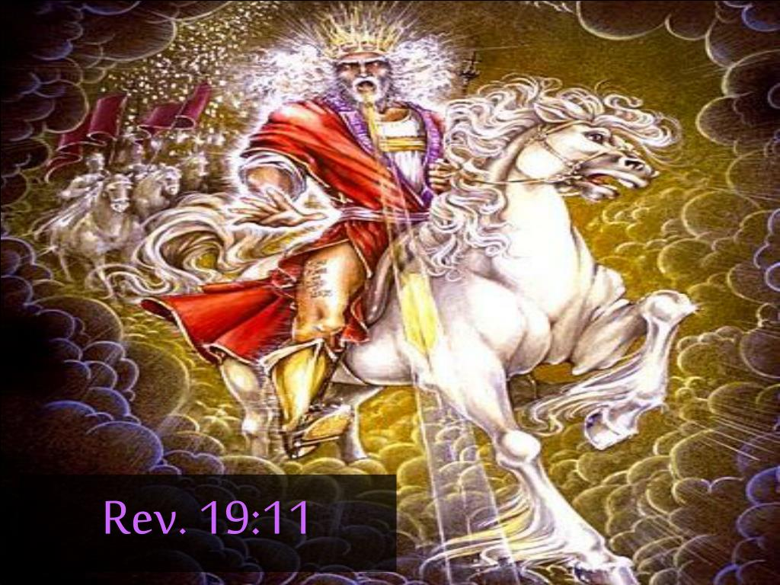
Revelation 19
The King Triumphant
The King of Kings
Revelation 19:11. And I saw heaven opened, and behold a white horse; and he that sat upon him was called Faithful and True, and in righteousness he doth judge and make war. (Cont’d)
His name is the Word of God – Second name
(Rev. 19:13)
And finally His third name is recognized as King of kings and Lord of lords (Rev. 19:16)
Notes:
Rev 19:13-And he was clothed with a vesture dipped in blood: and his name is called The Word of God.
Rev. 19:16-And he hath on his vesture and on his thigh a name written, KING OF KINGS, AND LORD OF LORDS.

Slide 33
Revelation 19
The King Triumphant
The King of Kings
Revelation 19:12. His eyes were as a flame of fire, and on his head were many crowns; and he had a name written, that no man knew, but he himself.
There is no room for doubt as to the identity of this conquering Commander on the white horse. (Rev 1:14)
But now adorning His head were many crowns.
He had a name written that no man knew. This name represents the fullness of who He is. This name represents the “name above all names” and can never be known except by God himself.
Notes:
Rev 1:14-His head and his hairs were white like wool, as white as snow; and his eyes were as a flame of fire;

Slide 34
Revelation 19
The King Triumphant
The King of Kings
Revelation 19:12. His eyes were as a flame of fire, and on his head were many crowns; and he had a name written, that no man knew, but he himself. (Cont’d)
It is apparently across these crowns that a name was written. John could see the writing, but he could not decipher it.
It is probably not the name “Jesus” but the name “given to Jesus” when He was raised from the dead and exalted far above all principality, and power, and might, and dominion, and every name that is named. (Ephesians 1:21)
Notes:
Ephesians 1:21-Far above all principality, and power, and might, and dominion, and every name that is named, not only in this world, but also in that which is to come:

Slide 35
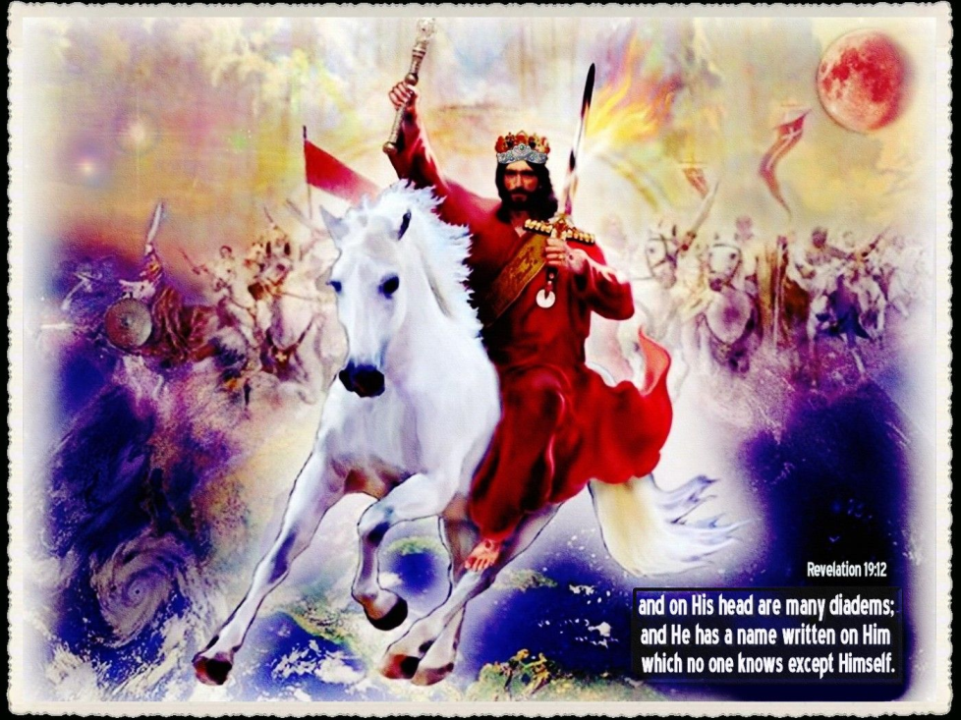
Revelation 19
The King Triumphant
The King of Kings
Revelation 19:12. His eyes were as a flame of fire, and on his head were many crowns; and he had a name written, that no man knew, but he himself. (Cont’d)
The names assigned to the Lord Jesus Christ in Scripture are many and beautiful, but all of them together cannot exhaust the infinite meaning of His name.
The fullness of His mighty name, only He can know.

Slide 36
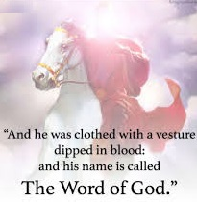
Revelation 19
The King Triumphant
The King of Kings
Revelation 19:13. And he was clothed with a vesture dipped in blood: and his name is called The Word of God.
The blood-dipped vesture speaks of the shed blood of His enemies.
As earlier stated, the great valley filled, with the armies of the kings, will flow with blood to the bridles of the horses (Rev. 14:20).
Notes:
Rev. 14:20-And the winepress was trodden without the city, and blood came out of the winepress, even unto the horse bridles, by the space of a thousand and six hundred furlongs.

Slide 37
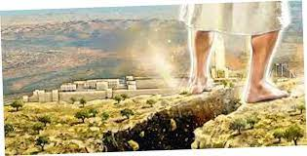
Revelation 19
The King Triumphant
The King of Kings
Revelation 19:13. And he was clothed with a vesture dipped in blood: and his name is called The Word of God. (Cont’d)
The slain multitudes are real, and the conquering Redeemer is real.
As the majestic Rider reaches Jerusalem, “his feet shall stand in that day upon the Mount of Olives” (Zech. 14:4).

Slide 38
Revelation 19
The King Triumphant
The King of Kings
Revelation 19:13. And he was clothed with a vesture dipped in blood: and his name is called The Word of God. (Cont’d)
In His glorious appearing, remember that the mighty Conqueror is none other than the incarnate Word of God.
It was by the Word of the Lord that the heavens were made (Psalm 33:6) and the worlds were framed (Heb 11:3)
It is by the same Word that the heavens and earth are kept in store (2 Peter 3:7).
That Word which was in the beginning (John 1:1) is also the Omega, and will dwell forever with His people.
Notes:
Psalm 33:6-By the word of the LORD were the heavens made; and all the host of them by the breath of his mouth.
Heb 11:3-Through faith we understand that the worlds were framed by the word of God, so that things which are seen were not made of things which do appear.
2 Peter 3:7-But the heavens and the earth, which are now, by the same word are kept in store, reserved unto fire against the day of judgment and perdition of ungodly men.
John 1:1-In the beginning was the Word, and the Word was with God, and the Word was God.

Slide 39
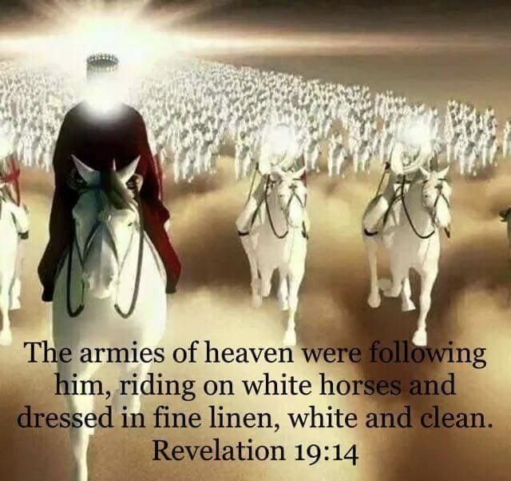
Revelation 19
The King Triumphant
The King of Kings
Revelation 19:14. And the armies which were in heaven followed him upon white horses, clothed in fine linen, white and clean.
The victorious Rider is followed by a tremendous stream of warriors, all in gleaming white uniforms and all on beautiful white horses.

Slide 40
Revelation 19
The King Triumphant
The King of Kings
Revelation 19:14. And the armies which were in heaven followed him upon white horses, clothed in fine linen, white and clean. (Cond’t)
The white horses and white linen armor speak of a great victory and glorious homecoming which will literally take place on the earth. The saints follow the Rider to the battle but they will not be involved in the battle, for He has the only weapons needed.
This glorious coming of the Lord with His saints has been prophesied since the dawn of history.
The great event was likewise foretold by the prophets of Israel as well as by the Apostles.

Slide 41

Revelation 19
The King Triumphant
The King of Kings
Revelation 19:15. And out of his mouth goeth a sharp sword, that with it he should smite the nations: and he shall rule them with a rod of iron: and he treadeth the winepress of the fierceness and wrath of Almighty God.
John had seen this sharp sword before (Rev. 1:16), the piercing sharpness of the lethal words of judgment leaping from the mouth of the wrathful Son of man. (Isa 11:4; 2 Thess. 2:8)
The “sword” refers to the fiery words of judgment from the Lord.
The nations to be smitten are the Gentile nations. The Jewish nation will already have undergone its own judgment during the tribulation period.
Notes:
Isa 11:4-But with righteousness shall he judge the poor, and reprove with equity for the meek of the earth: and he shall smite the earth with the rod of his mouth, and with the breath of his lips shall he slay the wicked.
2 Thess. 2:8-And then shall that Wicked be revealed, whom the Lord shall consume with the spirit of his mouth, and shall destroy with the brightness of his coming:

Slide 42
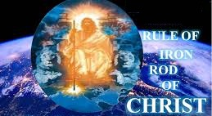
Revelation 19
The King Triumphant
The King of Kings
Revelation 19:15. And out of his mouth goeth a sharp sword, that with it he should smite the nations: and he shall rule them with a rod of iron: and he treadeth the winepress of the fierceness and wrath of Almighty God. (Cont’d)
During the millennial age, these Gentile nations will be ruled with a rod of iron.
Christ will demand absolute obedience.
It will be a dictatorship of love, but a dictatorship nonetheless.

Slide 43
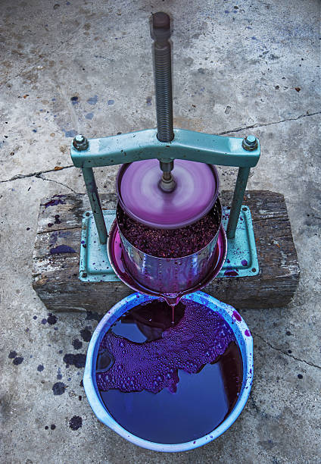
Revelation 19
The King Triumphant
The King of Kings
Revelation 19:15. And out of his mouth goeth a sharp sword, that with it he should smite the nations: and he shall rule them with a rod of iron: and he treadeth the winepress of the fierceness and wrath of Almighty God. (Cont’d)
Once again there is a return to the figure of the overflowing winepress and the blood-dipped vesture.
Christ treads it alone, so that only His vesture is dipped in blood.
The winepress depicts the fierceness and wrath of Almighty God.

Slide 44

Revelation 19
The King Triumphant
The King of Kings
Revelation 19:15. And out of his mouth goeth a sharp sword, that with it he should smite the nations: and he shall rule them with a rod of iron: and he treadeth the winepress of the fierceness and wrath of Almighty God. (Cont’d)
This expresses with intensity the unleashed ferocity of a long-suffering God, whose patience has endured for ages the wickedness and rebellion and blasphemy of the men and women He loved and sought to redeem. (Proverbs 1:24-27)
Notes:
Proverbs 1:24-27-Because I have called, and ye refused; I have stretched out my hand, and no man regarded;
25But ye have set at nought all my counsel, and would none of my reproof:
26I also will laugh at your calamity; I will mock when your fear cometh;
27When your fear cometh as desolation, and your destruction cometh as a whirlwind; when distress and anguish cometh upon you.

Slide 45
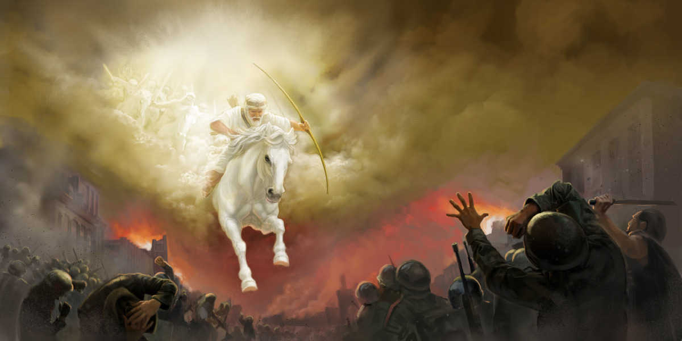
Revelation 19
The King Triumphant
The King of Kings
Revelation 19:15. And out of his mouth goeth a sharp sword, that with it he should smite the nations: and he shall rule them with a rod of iron: and he treadeth the winepress of the fierceness and wrath of Almighty God. (Cont’d)
The sharp sword striking forth from the offended King smites the nations.
Bursting arteries will spew their blood until the great trough flows in blood and the press is full (Joel 3:13).
Notes:
Joel 3:13-Put ye in the sickle, for the harvest is ripe: come, get you down; for the press is full, the fats overflow; for their wickedness is great.

Slide 46
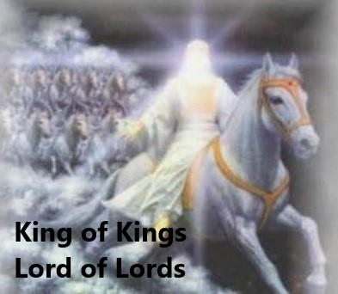
Revelation 19
The King Triumphant
The King of Kings
Revelation 19:16. And he hath on his vesture and on his thigh a name written, KING OF KINGS, AND LORD OF LORDS.
Here is yet another wonderful name of Christ, written both on His blood-dipped vesture and also upon His thigh.
This title was used earlier by the Apostle Paul speaking of the future “appearing of our Lord Jesus Christ.”
He is King of time and King of space, King of all creation.

Slide 47
Revelation 19
The King Triumphant
The Great Battle of Armageddon
Introduction
The spirits of demons, working miracles, have now persuaded all the kings of the earth to send their armies to Armageddon to be ready to fight their great Enemy.
They know Christ is about to descend to the earth, and they have experienced His awful judgments.
There is no longer desire or opportunity for salvation.
So they march and wait fearfully for the heavens to open and Christ to come.

Slide 48
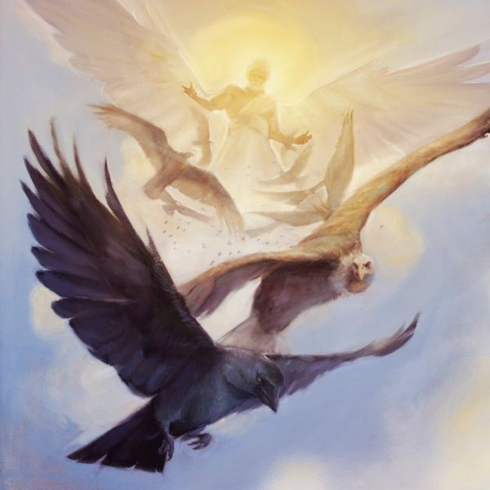
Revelation 19
The King Triumphant
The Great Battle of Armageddon
Revelation 19:17. And I saw an angel standing in the sun; and he cried with a loud voice, saying to all the fowls that fly in the midst of heaven, Come and gather yourselves together unto the supper of the great God;
Now an invitation is issued to another feast, the supper of the great God.
Those invited to the supper are the birds of prey and their dinner is to be the flesh and blood of the slain multitudes at Armageddon.

Slide 49
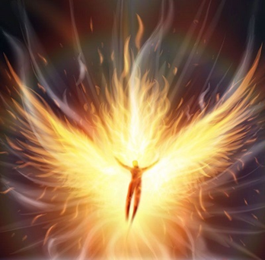
Revelation 19
The King Triumphant
The Great Battle of Armageddon
Revelation 19:17. And I saw an angel standing in the sun; and he cried with a loud voice, saying to all the fowls that fly in the midst of heaven, Come and gather yourselves together unto the supper of the great God; (Cont’d)
It is energy from the sun that maintains the physical and biological processes taking place on the earth.
However, the task of cleansing the earth of the awful carnage at Armageddon will be more than unaided solar energy can accomplish.

Slide 50
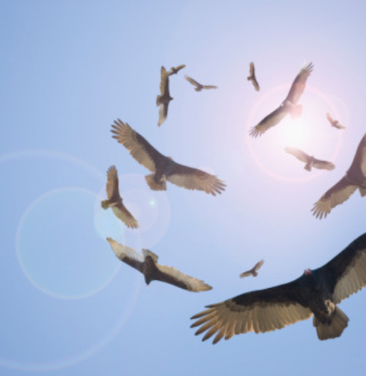
Revelation 19
The King Triumphant
The Great Battle of Armageddon
Revelation 19:17. And I saw an angel standing in the sun; and he cried with a loud voice, saying to all the fowls that fly in the midst of heaven, Come and gather yourselves together unto the supper of the great God; (Cont’d)
Accordingly, the angel calls out a mighty cry, reaching all the way from the sun, capable of being heard and understood by the hawks and ravens, the crows and vultures, from all over the world.
Now the birds of prey begin to gather, in the air, circling over the masses of humanity stretched out below them. This fills the hearts of the armies on the ground with great gloom and dread. (Matt 24:28 and Zeph 1:7)
Notes:
Matt 24:28-For wheresoever the carcase is, there will the eagles be gathered together.
Zeph 1:7-Hold thy peace at the presence of the Lord GOD: for the day of the LORD is at hand: for the LORD hath prepared a sacrifice, he hath bid his guests.

Slide 51
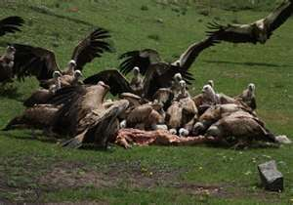
Revelation 19
The King Triumphant
The Great Battle of Armageddon
Revelation 19:18. That ye may eat the flesh of kings, and the flesh of captains, and the flesh of mighty men, and the flesh of horses, and of them that sit on them, and the flesh of all men, both free and bond, both small and great.
Mighty kings and mighty warriors, great men and small men, all men, will become meat for the vultures.
The haughtiness of men will be brought low (Isaiah 2:12).
This scene is very similar to that described in (Ezekiel 39:17-20) in the batlle of Gog and Magog.
Notes:
Isaiah 2:12-For the day of the LORD of hosts shall be upon every one that is proud and lofty, and upon every one that is lifted up; and he shall be brought low:
Ezekiel 39:17-20-And, thou son of man, thus saith the Lord GOD; Speak unto every feathered fowl, and to every beast of the field, Assemble yourselves, and come; gather yourselves on every side to my sacrifice that I do sacrifice for you, even a great sacrifice upon the mountains of Israel, that ye may eat flesh, and drink blood.
18Ye shall eat the flesh of the mighty, and drink the blood of the princes of the earth, of rams, of lambs, and of goats, of bullocks, all of them fatlings of Bashan.
19And ye shall eat fat till ye be full, and drink blood till ye be drunken, of my sacrifice which I have sacrificed for you.
20Thus ye shall be filled at my table with horses and chariots, with mighty men, and with all men of war, saith the Lord GOD.

Slide 52
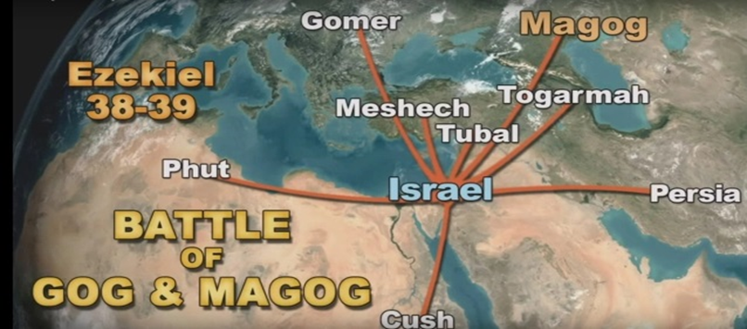
Revelation 19
The King Triumphant
The Great Battle of Armageddon
Revelation 19:18. That ye may eat the flesh of kings, and the flesh of captains, and the flesh of mighty men, and the flesh of horses, and of them that sit on them, and the flesh of all men, both free and bond, both small and great. (Cont’d)
The battle of Gog and Magog almost certainly will take place at the beginning of the tribulation, Armageddon at its end.

Slide 53
Revelation 19
The King Triumphant
The Great Battle of Armageddon
Revelation 19:18. That ye may eat the flesh of kings, and the flesh of captains, and the flesh of mighty men, and the flesh of horses, and of them that sit on them, and the flesh of all men, both free and bond, both small and great. (Cont’d)
There are wide spread reports in recent years that there has been a great increase in the population of birds of prey in the Middle East.
Whether or not this is true, there will be two great banquets one day to spread over the armies of (1) Gog and (2) those of the beast.

Slide 54
Revelation 19
The King Triumphant
The Great Battle of Armageddon
Revelation 19:19. And I saw the beast, and the kings of the earth, and their armies, gathered together to make war against him that sat on the horse, and against his army.
The last time the beast and the kings of the earth were seen together is recorded in Rev 17:13, where the kings had deeded their power and strength over to the beast.
Under the impact of the ensuing bowl judgments, the beast and the false prophet, as instructed by the old dragon, called all the kings to gather their armies together to Armageddon (Rev 16:13-16).
Notes:
Rev 17:13-These have one mind, and shall give their power and strength unto the beast.
Rev 16:13-16-And I saw three unclean spirits like frogs come out of the mouth of the dragon, and out of the mouth of the beast, and out of the mouth of the false prophet.
14For they are the spirits of devils, working miracles, which go forth unto the kings of the earth and of the whole world, to gather them to the battle of that great day of God Almighty.
15Behold, I come as a thief. Blessed is he that watcheth, and keepeth his garments, lest he walk naked, and they see his shame.
16And he gathered them together into a place called in the Hebrew tongue Armageddon.

Slide 55
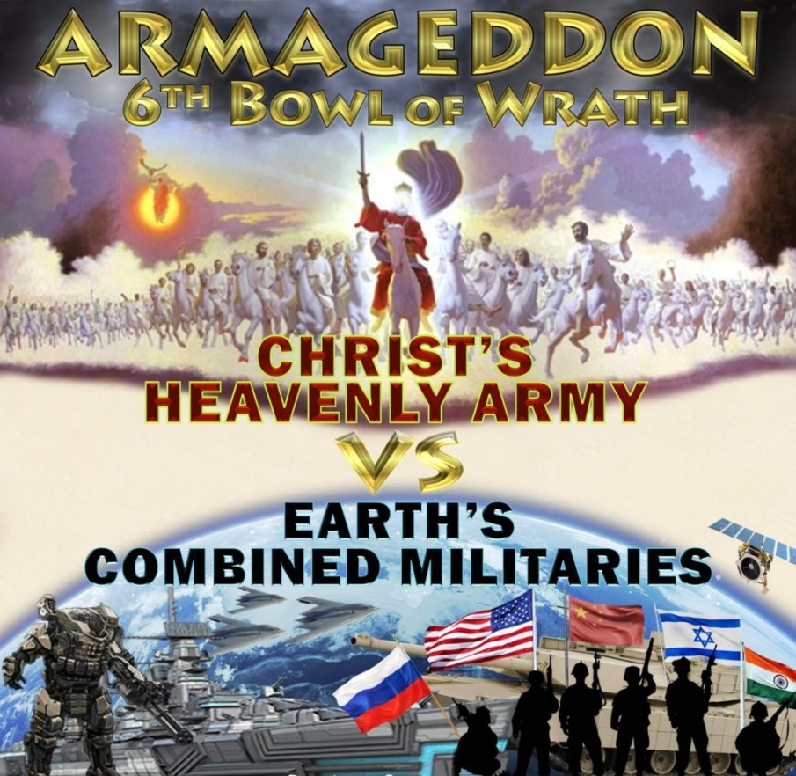
Revelation 19
The King Triumphant
The Great Battle of Armageddon
Revelation 19:19. And I saw the beast, and the kings of the earth, and their armies, gathered together to make war against him that sat on the horse, and against his army. (Cont’d)
Now they all are gathered together at Armageddon awaiting the coming of Christ and His army of saints hoping to defeat Him.

Slide 56
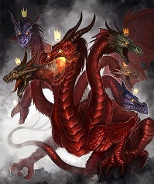
Revelation 19
The King Triumphant
The Great Battle of Armageddon
Revelation 19:19. And I saw the beast, and the kings of the earth, and their armies, gathered together to make war against him that sat on the horse, and against his army. (Cont’d)
The day of final confrontation is almost here. (Joel 3:14 and Isaiah 34:1-2)
Notes:
Joel 3:14-Multitudes, multitudes in the valley of decision: for the day of the LORD is near in the valley of decision.
Isaiah 34:1-2-Come near, ye nations, to hear; and hearken, ye people: let the earth hear, and all that is therein; the world, and all things that come forth of it.
2For the indignation of the LORD is upon all nations, and his fury upon all their armies: he hath utterly destroyed them, he hath delivered them to the slaughter.

Slide 57
Revelation 19
The King Triumphant
The Great Battle of Armageddon
Revelation 19:20. And the beast was taken, and with him the false prophet that wrought miracles before him, with which he deceived them that had received the mark of the beast, and them that worshipped his image. These both were cast alive into a lake of fire burning with brimstone.
The multitudes in the armies of the kings of the earth had placed great faith in their leader, the beast, believing that he would indeed prove to be greater than Christ.
With the beast and the false prophet there to exercise their brilliant leadership and miraculous powers, the earthly armies still hoped desperately that the Lamb and those following Him could be defeated when they descended from their great platform in the skies.

Slide 58
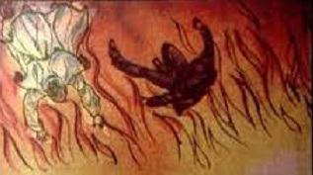
Revelation 19
The King Triumphant
The Great Battle of Armageddon
Revelation 19:20. And the beast was taken, and with him the false prophet that wrought miracles before him, with which he deceived them that had received the mark of the beast, and them that worshipped his image. These both were cast alive into a lake of fire burning with brimstone. (Cont’d)
How terrifying, then, to see their great leaders suddenly and unceremoniously snatched from their midst!
But their fright was nothing compared to that of the beast and the prophet, as they were suddenly seized and cast into a vast fiery lake burning with brimstone.

Slide 59
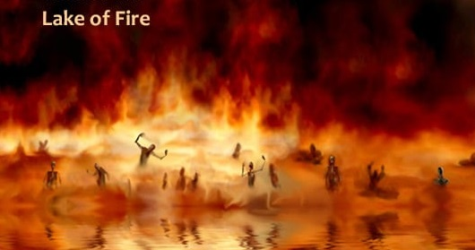
Revelation 19
The King Triumphant
The Great Battle of Armageddon
Revelation 19:20. And the beast was taken, and with him the false prophet that wrought miracles before him, with which he deceived them that had received the mark of the beast, and them that worshipped his image. These both were cast alive into a lake of fire burning with brimstone. (Cont’d)
The lake of fire is clearly not the same as Hades, or Sheol, which terms are often translated “hell” in the New and Old Testaments, respectively.

Slide 60
Revelation 19
The King Triumphant
The Great Battle of Armageddon
Revelation 19:20. And the beast was taken, and with him the false prophet that wrought miracles before him, with which he deceived them that had received the mark of the beast, and them that worshipped his image. These both were cast alive into a lake of fire burning with brimstone. (Cont’d)
The Lord Jesus Christ Himself spoke of this place of “everlasting fire, prepared for the devil and his angels” (Matthew 25:41). See also Mark 9:43-48.
Those who are incarcerated there will be “tormented with fire and brimstone in the presence of the holy angels, and in the presence of the Lamb: And the smoke of their torment ascendeth up for ever and ever” (Rev. 14:10-11)
Notes:
Mark 9:43-48-And if thy hand offend thee, cut it off: it is better for thee to enter into life maimed, than having two hands to go into hell, into the fire that never shall be quenched:
44Where their worm dieth not, and the fire is not quenched.
45And if thy foot offend thee, cut it off: it is better for thee to enter halt into life, than having two feet to be cast into hell, into the fire that never shall be quenched:
46Where their worm dieth not, and the fire is not quenched.
47And if thine eye offend thee, pluck it out: it is better for thee to enter into the kingdom of God with one eye, than having two eyes to be cast into hell fire:
48Where their worm dieth not, and the fire is not quenched.
Rev. 14:10-11-The same shall drink of the wine of the wrath of God, which is poured out without mixture into the cup of his indignation; and he shall be tormented with fire and brimstone in the presence of the holy angels, and in the presence of the Lamb:
11And the smoke of their torment ascendeth up for ever and ever: and they have no rest day nor night, who worship the beast and his image, and whosoever receiveth the mark of his name.

Slide 61
Revelation 19
The King Triumphant
The Great Battle of Armageddon
Revelation 19:20. And the beast was taken, and with him the false prophet that wrought miracles before him, with which he deceived them that had received the mark of the beast, and them that worshipped his image. These both were cast alive into a lake of fire burning with brimstone. (Cont’d)
The beast and the false prophet are the very first to be cast into the lake of fire.
Their knees must bow and their tongues confess that Jesus Christ is Lord (Phil. 2:10-11).
And then they “shall be punished with everlasting destruction from the presence of the Lord, and from the glory of His power” (2 Thess. 1:9).
Notes:
Phil. 2:10-11-That at the name of Jesus every knee should bow, of things in heaven, and things in earth, and things under the earth;
11And that every tongue should confess that Jesus Christ is Lord, to the glory of God the Father.

Slide 62
Revelation 19
The King Triumphant
The Great Battle of Armageddon
Revelation 19:20. And the beast was taken, and with him the false prophet that wrought miracles before him, with which he deceived them that had received the mark of the beast, and them that worshipped his image. These both were cast alive into a lake of fire burning with brimstone. (Cont’d)
Initially they will be cast alive into the lake of fire.
Their bodies will be quickly burned up and they will die, in the physical sense.
However, their spirits, will continue to occupy the lake of fire forever.

Slide 63
Revelation 19
The King Triumphant
The Great Battle of Armageddon
Revelation 19:21. And the remnant were slain with the sword of him that sat upon the horse, which sword proceeded out of his mouth: and all the fowls were filled with their flesh.
Their great leaders were suddenly seized and carried away from their command post and the armies were left in utter dismay and confusion.
This is the scene particularly foretold in Luke 21:26-27.
The frightened multitudes will await their own fate, and they will not have long to wait.
Notes:
Luke 21:26-27-Men's hearts failing them for fear, and for looking after those things which are coming on the earth: for the powers of heaven shall be shaken.
27And then shall they see the Son of man coming in a cloud with power and great glory.

Slide 64
Revelation 19
The King Triumphant
The Great Battle of Armageddon
Revelation 19:21. And the remnant were slain with the sword of him that sat upon the horse, which sword proceeded out of his mouth: and all the fowls were filled with their flesh. (Cont’d)
Proceeding like a slicing sword directly from the mouth of the majestic Rider as He rides up from Edom.
Like grapes trampled in a winepress, the blood bursts from their veins and death is instantaneous.
The spirits of the slain multitudes depart into Hades, there to await the judgment at the great white throne.
This is the great climatic battle of the ages, long foreseen by the prophets. (Psalm 110:5-6)
Notes:
Psalm 110:5-6-The Lord at thy right hand shall strike through kings in the day of his wrath.
6He shall judge among the heathen, he shall fill the places with the dead bodies; he shall wound the heads over many countries.

Slide 65
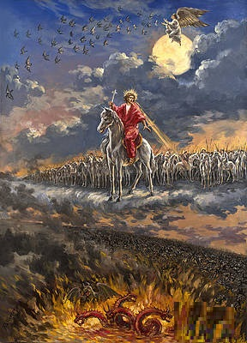
Revelation 19
The King Triumphant
The Great Battle of Armageddon
Revelation 19:21. And the remnant were slain with the sword of him that sat upon the horse, which sword proceeded out of his mouth: and all the fowls were filled with their flesh. (Cont’d)
There are many Scriptures that validate the foretelling of the prophets (Psalm 9:17; Isaiah 34:3-6; Jeremiah 25:29-33; Zephaniah 1:17-18; Zeph. 3:8)
At this time, as the conquering Christ comes up from Edom to Jerusalem, smiting all the assembled armies as he comes, that the Jews who have returned to Jerusalem finally will receive Him as their Messiah and Savior.
Notes:
Psalm 9:17-The wicked shall be turned into hell, and all the nations that forget God.
Isaiah 34:3-6-Their slain also shall be cast out, and their stink shall come up out of their carcases, and the mountains shall be melted with their blood.
4And all the host of heaven shall be dissolved, and the heavens shall be rolled together as a scroll: and all their host shall fall down, as the leaf falleth off from the vine, and as a falling fig from the fig tree.
5For my sword shall be bathed in heaven: behold, it shall come down upon Idumea, and upon the people of my curse, to judgment.
6The sword of the LORD is filled with blood, it is made fat with fatness, and with the blood of lambs and goats, with the fat of the kidneys of rams: for the LORD hath a sacrifice in Bozrah, and a great slaughter in the land of Idumea.
Jeremiah 25:29-33-For, lo, I begin to bring evil on the city which is called by my name, and should ye be utterly unpunished? Ye shall not be unpunished: for I will call for a sword upon all the inhabitants of the earth, saith the LORD of hosts.
30Therefore prophesy thou against them all these words, and say unto them, The LORD shall roar from on high, and utter his voice from his holy habitation; he shall mightily roar upon his habitation; he shall give a shout, as they that tread the grapes, against all the inhabitants of the earth.
31A noise shall come even to the ends of the earth; for the LORD hath a controversy with the nations, he will plead with all flesh; he will give them that are wicked to the sword, saith the LORD.
32Thus saith the LORD of hosts, Behold, evil shall go forth from nation to nation, and a great whirlwind shall be raised up from the coasts of the earth.
33And the slain of the LORD shall be at that day from one end of the earth even unto the other end of the earth: they shall not be lamented, neither gathered, nor buried; they shall be dung upon the ground.
Zephaniah 1:17-18-And I will bring distress upon men, that they shall walk like blind men, because they have sinned against the LORD: and their blood shall be poured out as dust, and their flesh as the dung.
their silver nor their gold shall be able to deliver them in the day of the LORD'S wrath; but the whole land shall be devoured by the fire of his jealousy: for he shall make even a speedy riddance of all them that dwell in the land.
Zeph. 3:8-Therefore wait ye upon me, saith the LORD, until the day that I rise up to the prey: for my determination is to gather the nations, that I may assemble the kingdoms, to pour upon them mine indignation, even all my fierce anger: for all the earth shall be devoured with the fire of my jealousy.

Slide 66
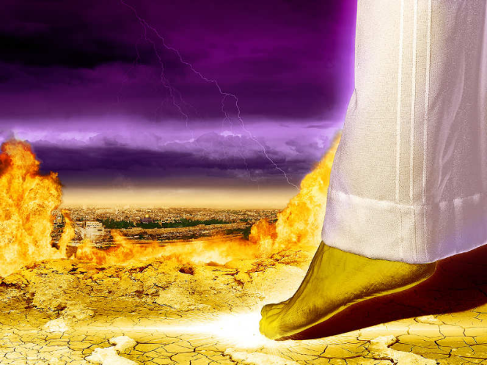
Revelation 19
The King Triumphant
The Great Battle of Armageddon
Revelation 19:21. And the remnant were slain with the sword of him that sat upon the horse, which sword proceeded out of his mouth: and all the fowls were filled with their flesh. (Cont’d)
Most likely at this time He will stand triumphantly on Mt. Zion, with the 144,000 chosen Israelites, who will have returned to Jerusalem with their Jewish converts from their sojourn in the wilderness.
He will also “stand in that day upon the Mt of Olives” (Zech. 14:4), from which He had ascended long ago (Acts 1:9-12), thereby triggering the great earthquake which will open the healing springs and rivers (Zech. 14:8).
Notes:
Acts 1:9-12-And when he had spoken these things, while they beheld, he was taken up; and a cloud received him out of their sight.
10And while they looked stedfastly toward heaven as he went up, behold, two men stood by them in white apparel;
11Which also said, Ye men of Galilee, why stand ye gazing up into heaven? this same Jesus, which is taken up from you into heaven, shall so come in like manner as ye have seen him go into heaven.
12Then returned they unto Jerusalem from the mount called Olivet, which is from Jerusalem a sabbath day's journey.Zech. 14:8-And it shall be in that day, that living waters shall go out from Jerusalem; half of them toward the former sea, and half of them toward the hinder sea: in summer and in winter shall it be.

Slide 67
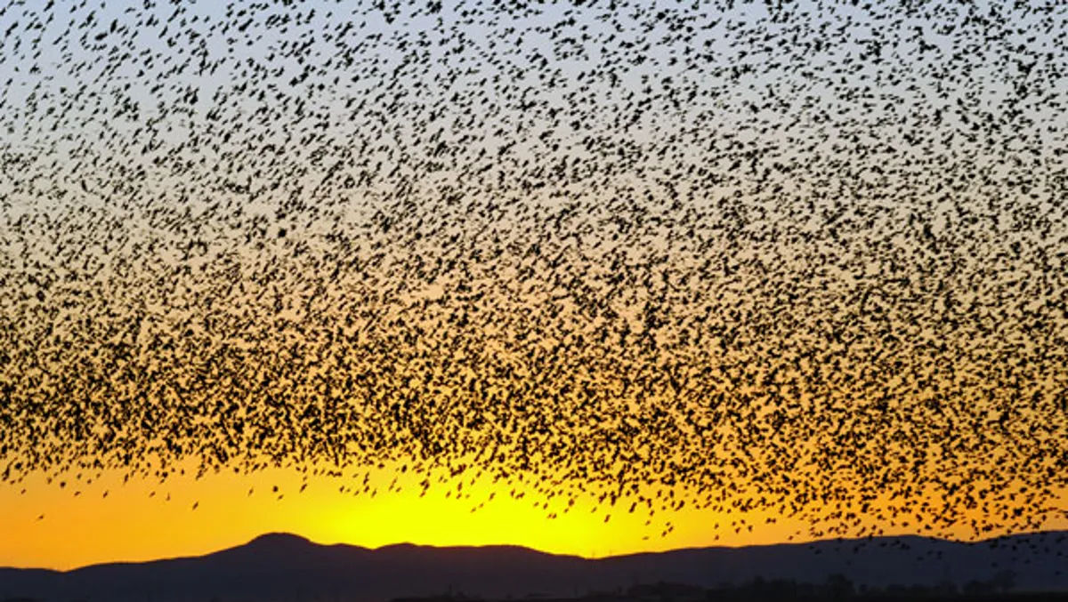
Revelation 19
The King Triumphant
The Great Battle of Armageddon
Revelation 19:21. And the remnant were slain with the sword of him that sat upon the horse, which sword proceeded out of his mouth: and all the fowls were filled with their flesh. (Cont’d)
Then will the great cloud of ravenous birds swoop down from the heavens, gorging themselves on the flesh and blood of the once high-and-mighty rebels.
The time is surely coming when God’s great purpose for His creation must be brought to its consummation and this requires that it be purged from sin.

Slide 68
THIS CONCLUDES REVELATION 19

